Slide 1


Financial Highlights
As of June 30, 2023
One Minute Report – Click Below

Slide 2

Highlights of Interim Financial Report (unaudited)
June 30, 2023

Slide 3


Posted on Our Website
Finance / Monthly Finance Reports (hcde-texas.org)
Linked from State Comptroller’s website
http://www.texastransparency.org/local/schools.php

Slide 4

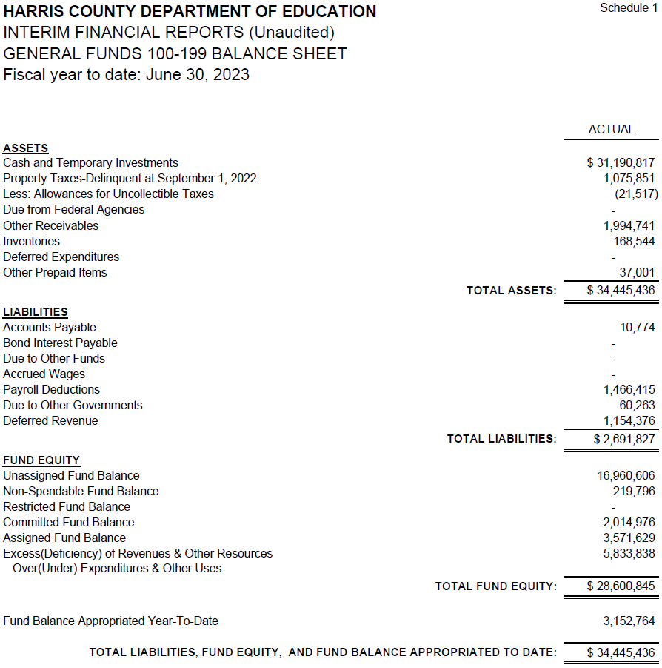
INTERIM FINANCIAL REPORT
(unaudited)
GENERAL FUND
Balance Sheet as of June 30, 2023
Total Assets:
$ 34,445,436
Total Liabilities:
$ 2,691,827
Total Fund Equity:
$ 31,753,609

Slide 5
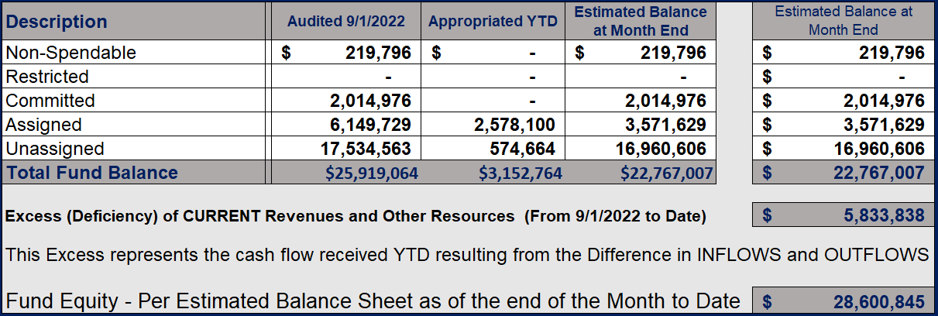
INTERIM FINANCIAL REPORT (unaudited)
ASST. SUPERINTENDENT FOR BUSINESS SERVICES MESSAGE
As of June 30, 2023
The ESTIMATED General Fund balance at 05/31/2023 is $32,574,010 after current appropriations.
As year end adjustments are completed, a budget amendment will be submitted to the board for items assigned, restricted and committed that will roll forward into FY 2024.

Slide 6
INTERIM FINANCIAL REPORT (unaudited)
As of June 30, 2023
Financial Ratios
Level One - Indicator of Financial Strength
Level Two - Indicator of Efficient Leverage
Level Three - Indicators of Efficiency
Level Four - Indicators of Revenue Growth

Slide 7
INTERIM FINANCIAL REPORT (unaudited)
As of June 30, 2023
Indicators of Financial Strength
Percent of Fund Balance to G/F
Expenditures Ratio
What is the percent of rainy-day fund balance?
(*) Unadjusted
Working Capital Ratio
What is the cash flow availability for the organization?
Unassigned Fund Balance $ 16,960,606
Total G/F Expenditures $50,301,366
Goal : > 30% of G/F Exp.
Benchmark: 10% to 29%
Danger: Under 10%
Goal : >$15,000,000
Benchmark : $10M to $15M
Danger : Under < $10M
Total Current Assets
Less Total Current Liabilities
$34,445,436 – 2,691,827 = 31,753,609
33% FY23
36% FY22
$32M FY23
$31M FY22
Budgeted 24%
Details on Schedule 3
Budgeted $33M
Details on Schedule 1

Slide 8
INTERIM FINANCIAL REPORT (unaudited)
As of June 30, 2023
Indicators of Efficient Leverage Reserves
Unassigned Fund Balance Ratio
How much is available in reserves?
Debt to Income Ratio
What is the ability of HCDE to cover its debt payments?
Unassigned Fund Balance $16,960,606
Total Fund Balance $31,752,902
Annual Principal and Interest Payments on
Term Debt and Capital Leases $2,944,268
G/F Revenue Less Facility Charges
56,135,204 - 4,874,486
Goal: <75%
Benchmark: 50% to 75%
Danger: <50%
Goal: <25% of annual revenue
Benchmark: 25% to <49%
Danger: Over > 50%
53% FY23
52% FY22
5.7% FY23
8.9% FY22
Budgeted 79%
Details on Schedule 1
Budgeted 8%
Details on Schedule 5

Slide 9
INTERIM FINANCIAL REPORT (unaudited)
As of June 30, 2023
Indicators of Efficiency
Tax Revenue to Total Revenue Ratio
How efficient is HCDE at leveraging local
taxes? (Current)
Indirect Cost to Tax Ratio
How much dependency on indirect cost from grants?
Current Tax Revenue $ 27,749,958
Indirect Cost General Fund $1,609,710
Total Revenue $ 101,062,395
Total General Fund Revenues $56,135,204
Goal: <20% of revenue
Benchmark: 20% to 30%
Danger: Over >30%
Goal: >5%
Benchmark: 2% to 5%
Danger: Under < 2%
28% FY23
29% FY22
3% FY23
3% FY22
Budgeted 22%
Details on Schedule 2
Budgeted 4%
Details on Schedule 3
Notes:
25,231,339

Slide 10
INTERIM FINANCIAL REPORT (unaudited)
As of June 30, 2023
Indicators of Revenue Growth
Fee for Service Revenue Ratio
How are revenues spread across all Funds?
Fee for Service Revenue Growth Ratio
What is the market growth for fee on services?
Total Fee for Service Revenues (G/F) $20,676,691
Total Revenues $101,062,395
Fee for Service Current Year Less Fee for Services Last Year $20,676,691 - 18,310,635
Fees for Service Last Year $ 18,310,635
Goal: >30% of annual revenue Benchmark: 10% to 29%
Danger: Under 10%
Goal: >3% of + growth
Benchmark: 0% to 3%
Danger: Under 0%
20% FY23
21% FY22
13% FY23
0% FY22
Budgeted 19%
Details on Schedule 14
Budgeted 7%
Details on Schedule 14

Slide 11
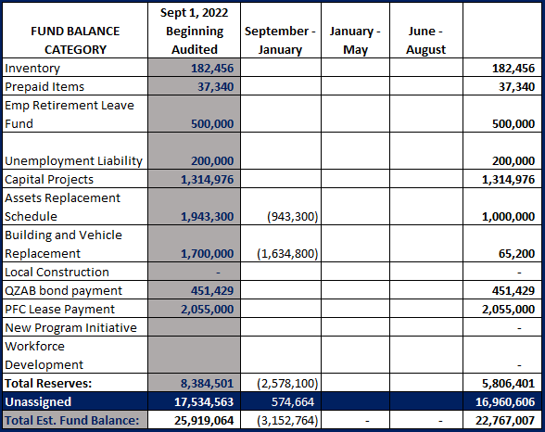
FY 2022-2023
Fund Balance
-
Budgeted Activity

Slide 12
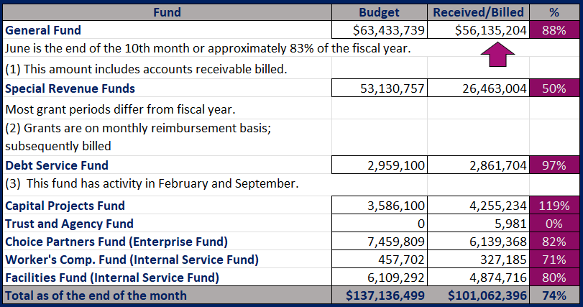
INTERIM FINANCIAL REPORT (unaudited)
GENERAL, SPECIAL REVENUE, DEBT SERVICE FUNDS, CAPITAL PROJECTS,
AND INTERNAL SERVICE FUNDS
REVENUES (INFLOWS)
Budget to Actual for period ending June 30, 2023

Slide 13
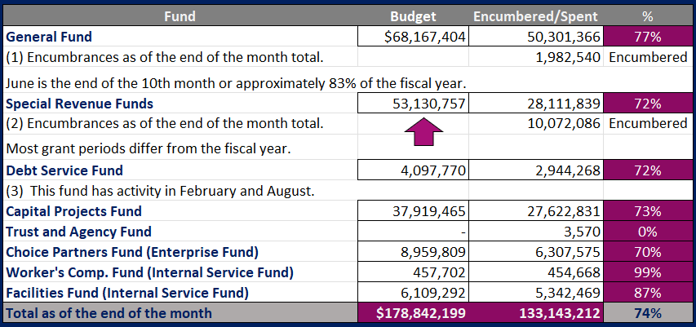
INTERIM FINANCIAL REPORT (unaudited)
GENERAL, SPECIAL REVENUE, DEBT SERVICE FUNDS, CAPITAL PROJECTS,
AND INTERNAL SERVICE FUNDS
Expenditures (OUTFLOWS)
Budget to Actual for period ending June 30, 2023

Slide 14
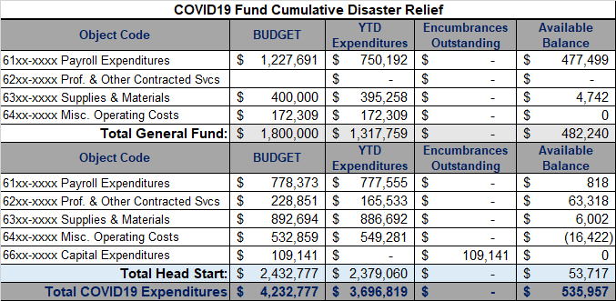
INTERIM FINANCIAL REPORT (unaudited) FY 2021 – 23 COVID19 Budget to Actual – Expenditures
for period ending June 30, 2023

Slide 15
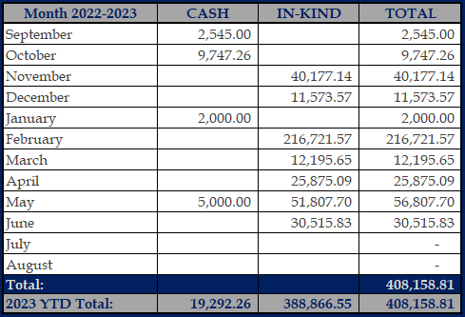
INTERIM FINANCIAL REPORT (unaudited)
FY 2022-23 Donations Report
All Funds as of June 30, 2023

Slide 16
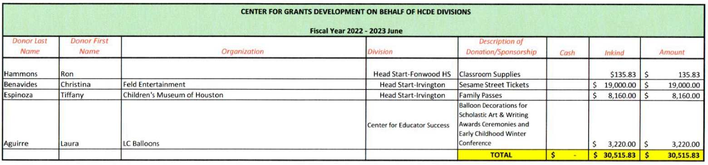
`
INTERIM FINANCIAL REPORT (unaudited)
FY 2022-23 Donations Report
All Funds as of June 30, 2023

Slide 17
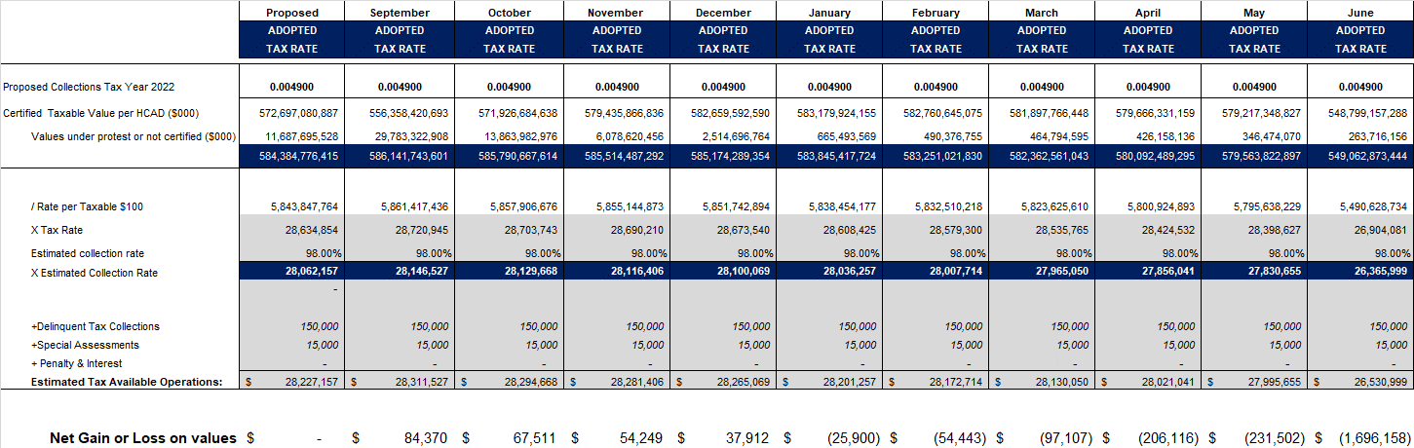
INTERIM FINANCIAL REPORT (unaudited)
TAX COLLECTIONS COMPARATIVE ANALYSIS
Fiscal Year-To-Date as of June 30, 2023
$549.1 B
See Tax Calculator at:
https://hcde-texas.org/transparency/tax-rate/
17

Slide 18
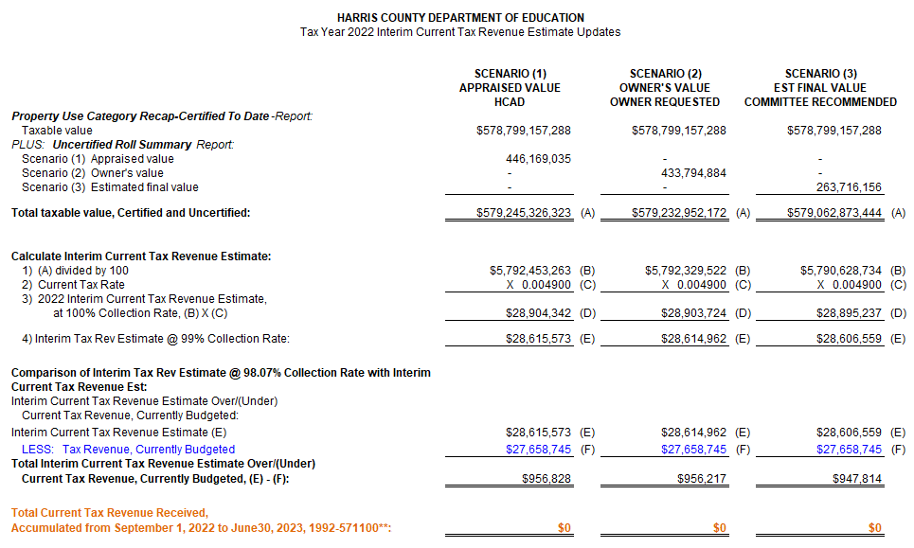
INTERIM FINANCIAL REPORT (unaudited) TAX COLLECTIONS
Fiscal Year-To-Date as of June 30, 2023
(8th month / 12 months)

Slide 19
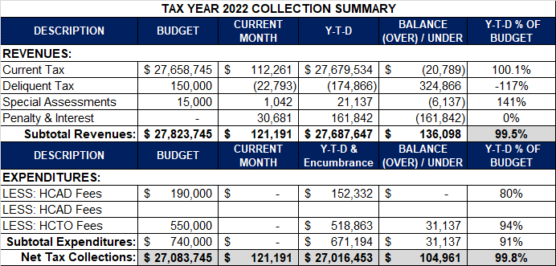
INTERIM FINANCIAL REPORT (unaudited) TAX COLLECTIONS
Fiscal Year-To-Date as of June 30, 2023
(10th month / 12 months)
a) 2022 Proposed Tax Rate = $0.004900/$100 Property Assessment/Appraisal - --> Annual Tax on a $259,375 - $75,219 = $201,066/100
x .004900 = $9.85 (net of 29% homestead exception.)
b) $705,000/$25,188,000 = 2.80% Collection and assessment costs

Slide 20
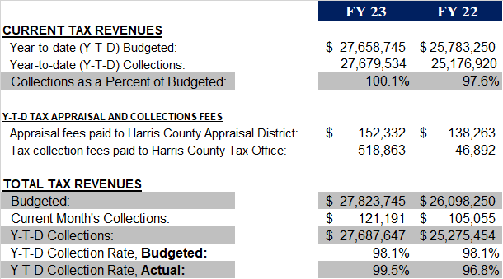
INTERIM FINANCIAL REPORT (unaudited) TAX COLLECTIONS
Fiscal Year-To-Date as of June 30, 2023
(10th month / 12 months)
2022 Adopted Tax Rate = $0.004900/$100 Property Assessment/Appraisal - --> Annual Tax on a $259,375 - $75,219 = $201,066/100 x .004900 = $9.85 (net of 29% homestead exception.)
b) $705,000/$25,188,000 = 2.80% Collection and assessment costs

Slide 21
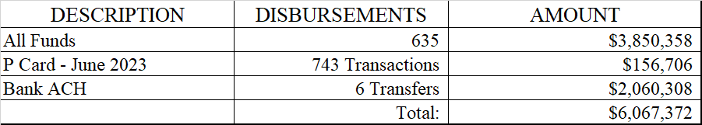
INTERIM FINANCIAL REPORT (unaudited)
DISBURSEMENT – ALL FUNDS
June 30, 2023
Notes:
All Purchase Orders and Payment Authorizations are reviewed before disbursement.
All Procurement Card charges are reviewed by cardholder, supervisor, and business office staff each month.
A report on CH Local Expenditures is included in the monthly report.

Slide 22
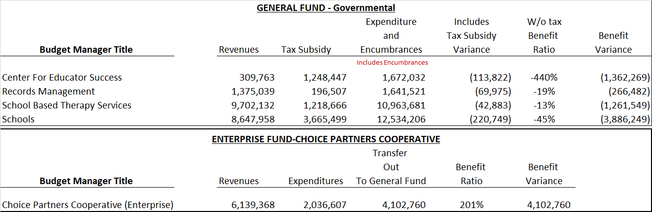
INTERIM FINANCIAL REPORT (unaudited)
Segment Division Data
As of June 30, 2023

Slide 23
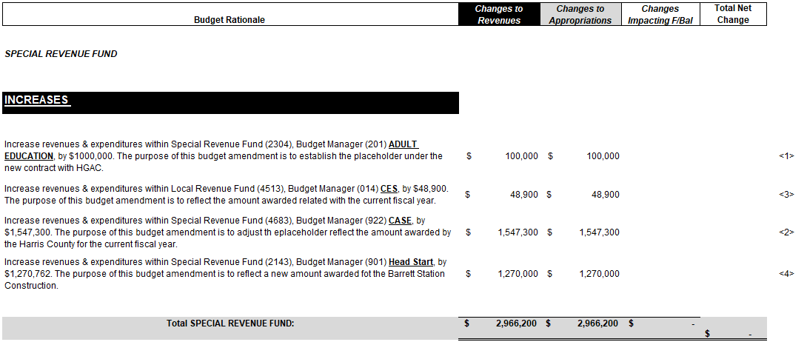
HIGHLIGHTS OF BUDGET AMENDMENT REPORT
July 12th, 2023 Board Meeting
(unaudited)
Amendments

Slide 24

Education Foundation Update
June 30, 2023

Slide 25
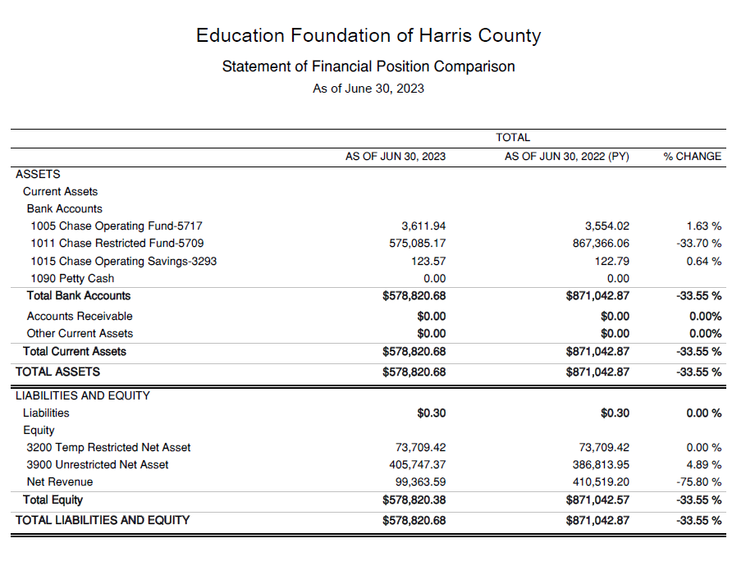
Statement of Financial Position
Net Equity $578,820

Slide 26
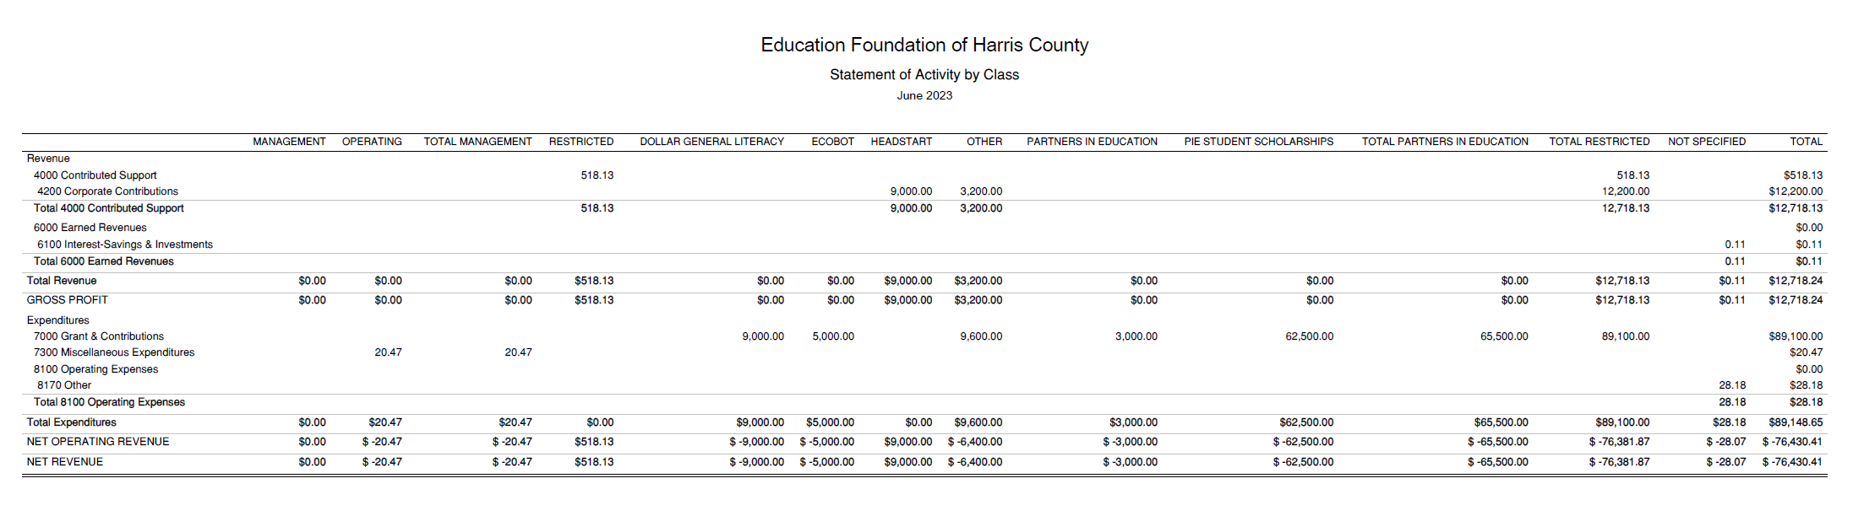
Statement of Activities Classified
REVENUES
$12,000
Dollar General
$518
Other
EXPENDITURES
$9,000
Headstart/DG
$5,000
Ecobot
$62,500
PIE Scholarship
$3,000
PIE Sponsorship

Slide 27
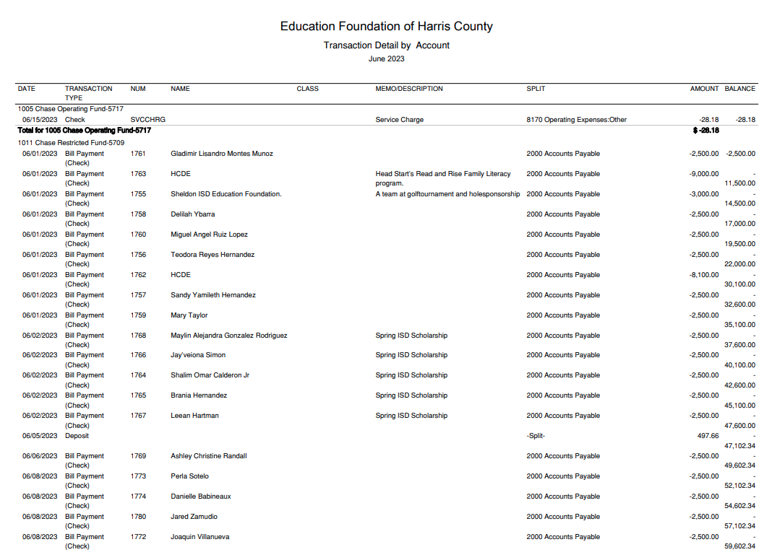
Transaction Detail by Inflow & Outflow

Slide 28
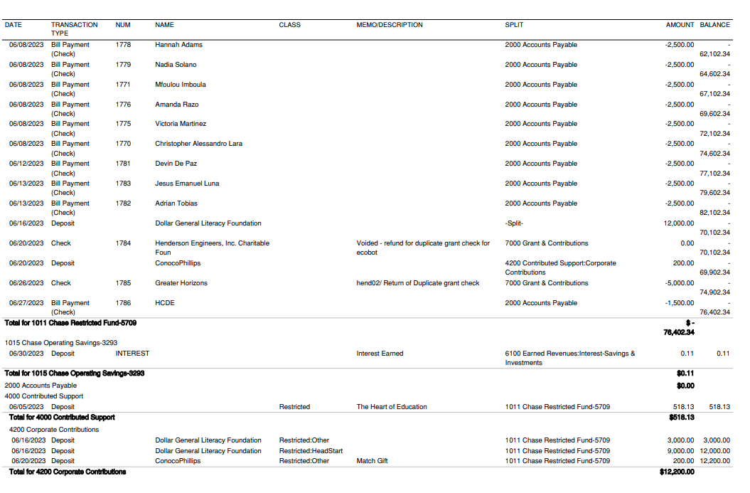
Transaction Detail by Inflow & Outflow

Slide 29
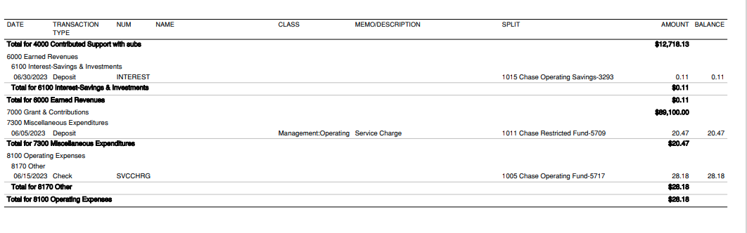
Transaction Detail by Inflow & Outflow

Slide 30
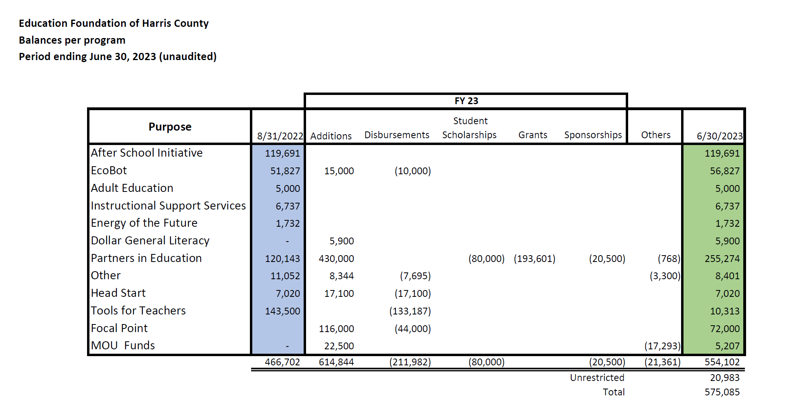
Balances Per Program

Slide 31

PFC & Lease Revenue Projects Update
June 30, 2023

Slide 32
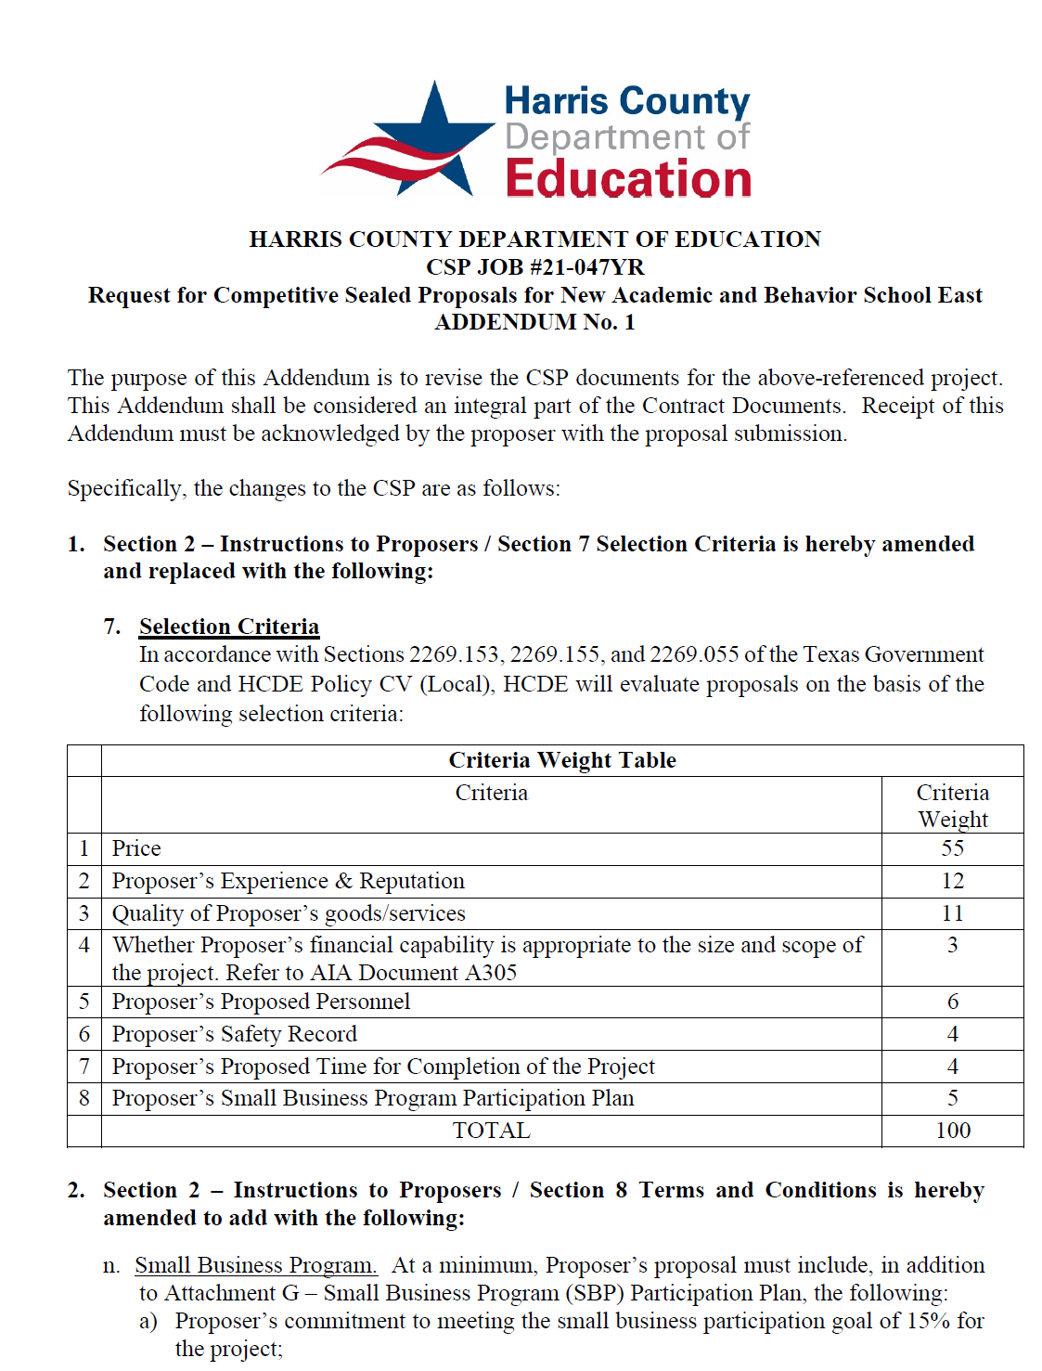
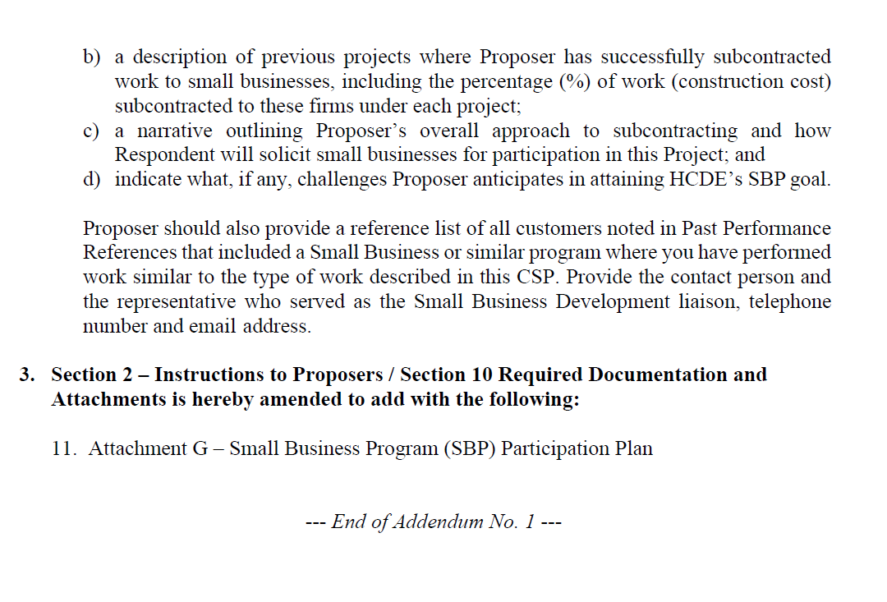
Small Business
Program for construction
Launch industry's first collaboration feature
This is our plan as we launch the industry's first collaboration feature

Slide 33
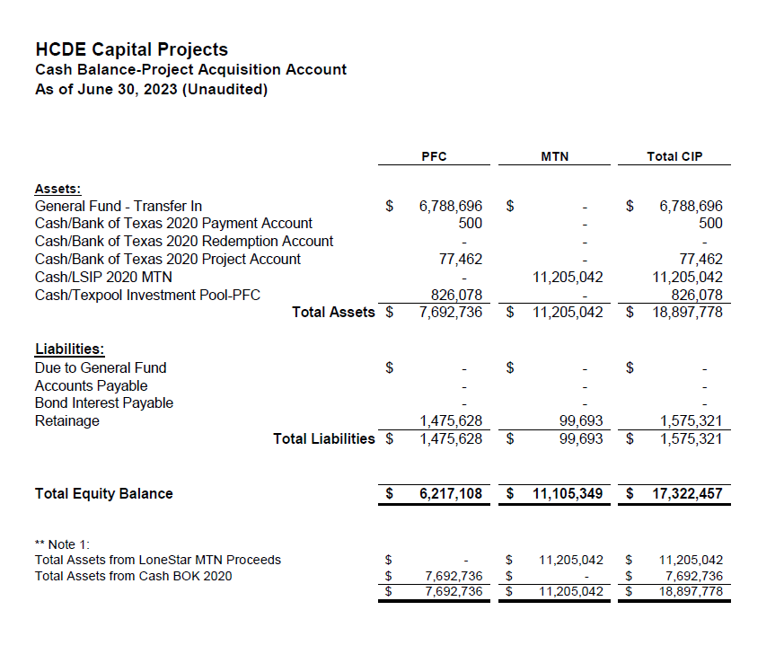

AB East School Contract $12,358,000 Awarded and Signed
Adult Ed Center Contract $15,121,000 awarded on Oct 2021 Board Mtg
HP East Contract $7,271,000 awarded on Nov 2021
Irvington – Pending Architect Assignment
Cash Balance –
Project Acquisition Account
As of June 30, 2023

Slide 34
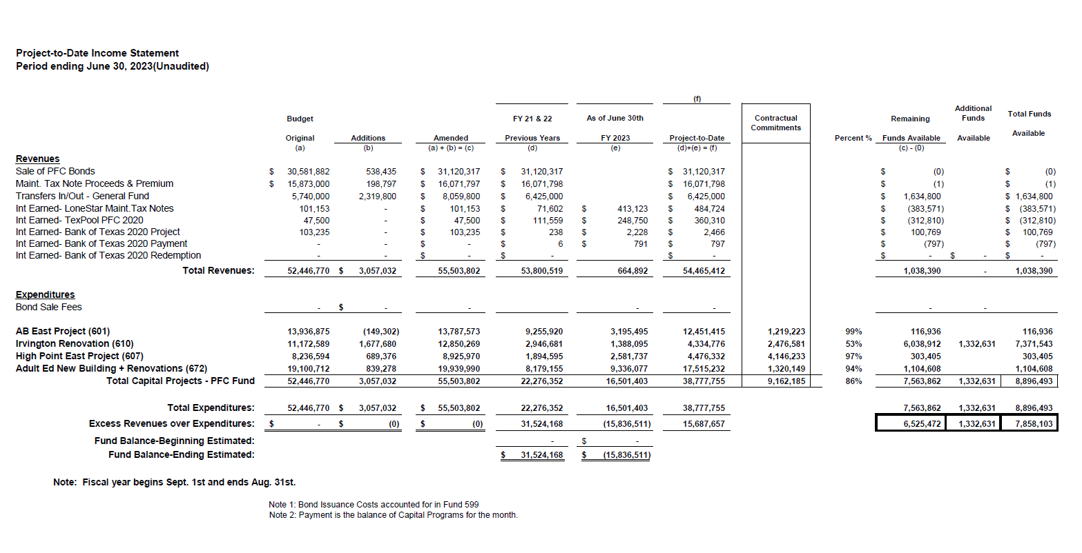
Income Statement– Project Acquisition Account
As of June 30, 2023

Slide 35
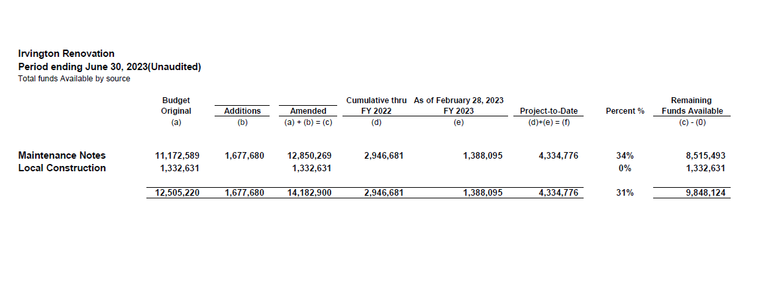
Irvington Renovation – Funds by Source
As of June 30, 2023
35

Slide 36

Capital Program Proposal from Aug 3, 2020
36

Slide 37






2020 Projected Capital Improvement Program
Project | Substantial Completion Date | Project Budget | Maintenance Notes Projected | Revenue Bonds Proceeds | General Funds Use of Fund Bal. | Interest Earnings Projection
Reagan Adm Bldg. | Feb 9, 2023 | $8,365,500 | $ 8,365,500 | N/A | N/A
Adult Ed Building | Oct 25, 2022 | $18,358,750 | $ 3,659,000 | $12,728,598 | $1,870,000 | $101,153
HP East Middle | Oct 25, 2022 | $7,916,645 | $ 1,089,500 | $4,909,645 | $1,870,000 | $47,500
Ab East Campus | Aug 16, 2022 | $17,805,875 | $ 2,759,000 | $12,943,640 | $2,000,000 | 103,235
 | Total | $52,446,770 | $15,873,000 | $30,581,882 | $5,740,000 | $251,888
 |  | Closed on 12-2-20 | Invested in pools.
Build a product accessible on all devices
This is our plan as we build a product accessible on all devices.
Note: The Total Public Notice was $54,000,000. ($35,000,000 for Revenue bonds and $19,000,000 for Maintenance Notes) on August 10, 2020. A transfer of $1,350,000 plus $50,000 in reimbursable expenditures was made from AB East to allocate Program Manager costs to establish the budgets.
Based on Pricing the principal amount will vary due to the premium projected in the bond sale. Revenues Bonds estimated at $27,730,000 and Maintenance Notes for $13,695,000

Slide 38

Interim Financial Report (Unaudited)
I certify that the foregoing information is true and accurate to the best of my knowledge.
/s/ Jesus J. Amezcua, RTSBA,CPA, Ph.D., CPFIM, Asst. Supt. for Business Support Services
/s/ Marcia Leiva, Chief Accounting Officer

