Slide 1
Financial Highlights
As of September 30,2024
One Minute Report – Click Below
https://www.showme.com/sh?h=7M8qfQm

Slide 2
Highlights of Interim Financial Report (unaudited)
September 30,2024

Slide 3
Posted on Our Website
Finance / Monthly Finance Reports (hcde-texas.org)
Linked from State Comptroller’s website
http://www.texastransparency.org/local/schools.php

Slide 4
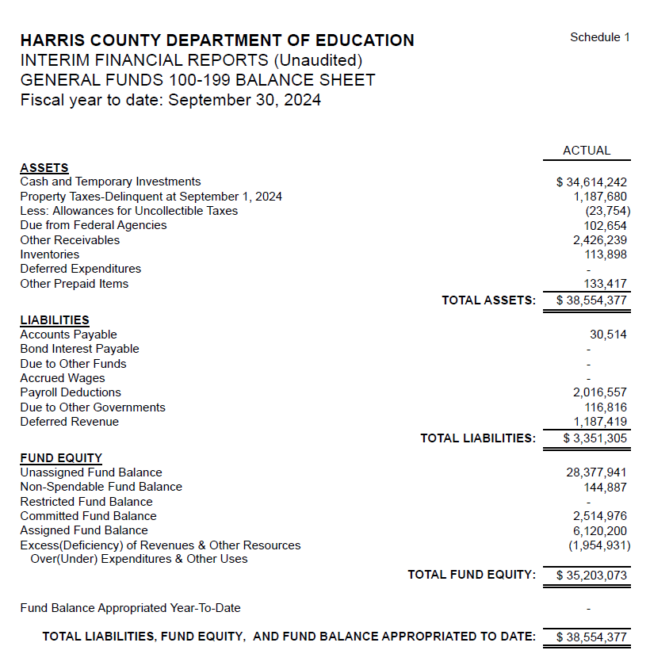
INTERIM FINANCIAL REPORT (unaudited) GENERAL FUND
Balance Sheet as of September 30,2024
Total Assets:
$ 38,554,377
Total Liabilities:
$ 3,351,305
Total Fund Equity:
$ 35,203,073

Slide 5
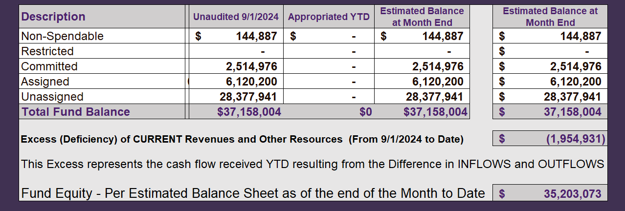
INTERIM FINANCIAL REPORT (unaudited) ASST. SUPERINTENDENT FOR BUSINESS SERVICES MESSAGE As of September 30,2024
The ESTIMATED General Fund balance at 09/30/2024 is $35,203,073 after current appropriations.
As year end adjustments are completed, a budget amendment will be submitted to the board for items assigned, restricted and committed that will roll forward into FY 2025.

Slide 6
INTERIM FINANCIAL REPORT (unaudited) As of September 30,2024 Financial Ratios
Level One - Indicator of Financial Strength
Level Two - Indicator of Efficient Leverage
Level Three - Indicators of Efficiency
Level Four - Indicators of Revenue Growth

Slide 7
INTERIM FINANCIAL REPORT (unaudited) As of September 30,2024 Indicators of Financial Strength
Percent of Fund Balance to G/F
Expenditures Ratio
What is the percent of rainy-day fund balance?
(*) Unadjusted
Working Capital Ratio
What is the cash flow availability for the organization?
Unassigned Fund Balance $ 28,377,941
Total G/F Expenditures $ 3,970,752
Goal : > 30% of G/F Exp.
Benchmark: 10% to 29%
Danger: Under 10%
Goal : >$15,000,000
Benchmark : $10M to $15M
Danger : Under < $10M
Total Current Assets
Less Total Current Liabilities
$38,554,377-3,351,305=35,203,073
715% FY25
569% FY24
$35M FY25
$23M FY24
Budgeted 24%
Details on Schedule 3
Budgeted $33M
Details on Schedule 1

Slide 8
INTERIM FINANCIAL REPORT (unaudited) As of September 30,2024 Indicators of Efficient Leverage Reserves
Unassigned Fund Balance Ratio
How much is available in reserves?
Debt to Income Ratio
What is the ability of HCDE to cover
its debt payments?
Unassigned Fund Balance $28,377,941
Total Fund Balance $35,203,073
Annual Principal and Interest Payments on
Term Debt and Capital Leases : $0
G/F Revenue Less Facility $2,015,281-269,205
Charges :
Goal: <75%
Benchmark: 50% to 75%
Danger: <50%
Goal: <25% of annual revenue
Benchmark: 25% to <49%
Danger: Over > 50%
81% FY25
87% FY24
0 % FY25
0% FY24
Budgeted 71%
Details on Schedule 1
Budgeted 6%
Details on Schedule 5

Slide 9
INTERIM FINANCIAL REPORT (unaudited) As of September 30,2024 Indicators of Efficiency
Tax Revenue to Total Revenue Ratio
How efficient is HCDE at leveraging local
taxes? (Current)
Indirect Cost to Tax Ratio
How much dependency on indirect cost from grants?
Current Tax Revenue $ 470
Indirect Cost General Fund $0
Total Revenue $ 3,888,879
Total General Fund Revenues $2,015,821
Total General Fund Revenues $1,306,381
Goal: <20% of revenue
Benchmark: 20% to 30%
Danger: Over >30%
Goal: >5%
Benchmark: 2% to 5%
Danger: Under < 2%
Goal: >5%
Benchmark: 2% to 5%
Danger: Under < 2%
0% FY25
0% FY24
0% FY25
0% FY24
Budgeted 25%
Details on Schedule 2
Budgeted 2.5%
Details on Schedule 3

Slide 10
INTERIM FINANCIAL REPORT (unaudited) As of September 30,2024 Indicators of Revenue Growth
Fee for Service Revenue Ratio
How are revenues spread across all Funds?
Fee for Service Revenue Growth Ratio
What is the market growth for fee on services?
Total Fee for Service Revenues (G/F) $507,658
Total Revenues $3,890,121
Fee for Service Current Year Less Fee for Services Last Year $507,658-214,290
Fees for Service Last Year $214,290
Goal: >30% of annual revenue Benchmark: 10% to 29%
Danger: Under 10%
Goal: >3% of + growth
Benchmark: 0% to 3%
Danger: Under 0%
13 % FY25
8% FY24
137% FY25
-35% FY24 ​
Budgeted 19%
Details on Schedule 14
Budgeted 17%
Details on Schedule 14

Slide 11
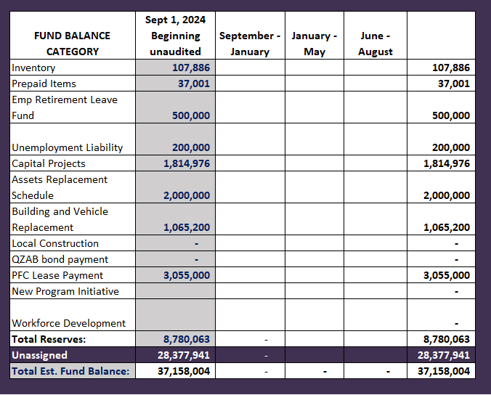
FY 2024-2025 Fund Balance - Budgeted Activity

Slide 12
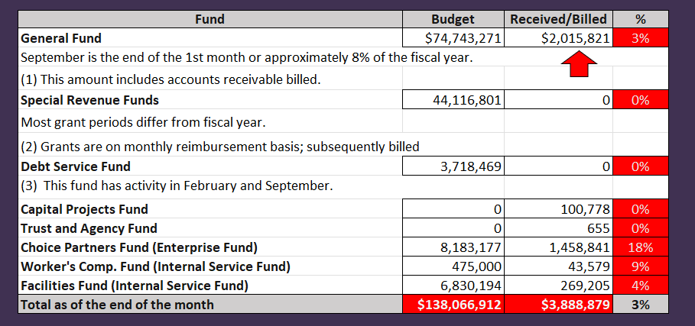
INTERIM FINANCIAL REPORT (unaudited) GENERAL, SPECIAL REVENUE, DEBT SERVICE FUNDS, CAPITAL PROJECTS,
AND INTERNAL SERVICE FUNDS
REVENUES (INFLOWS)
Budget to Actual for period ending September 30,2024

Slide 13
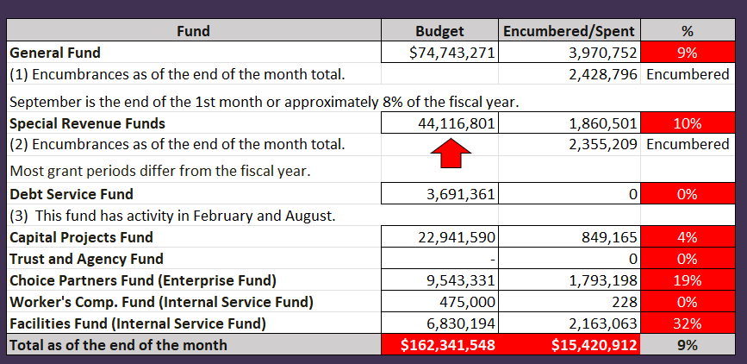
INTERIM FINANCIAL REPORT (unaudited)
GENERAL, SPECIAL REVENUE, DEBT SERVICE FUNDS, CAPITAL PROJECTS,
AND INTERNAL SERVICE FUNDS Expenditures (OUTFLOWS)
Budget to Actual for period ending September 30,2024

Slide 14
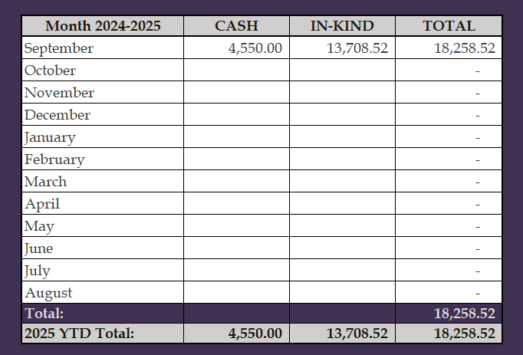
INTERIM FINANCIAL REPORT (unaudited) FY 2024-25 Donations Report All Funds as of September 30,2024

Slide 15
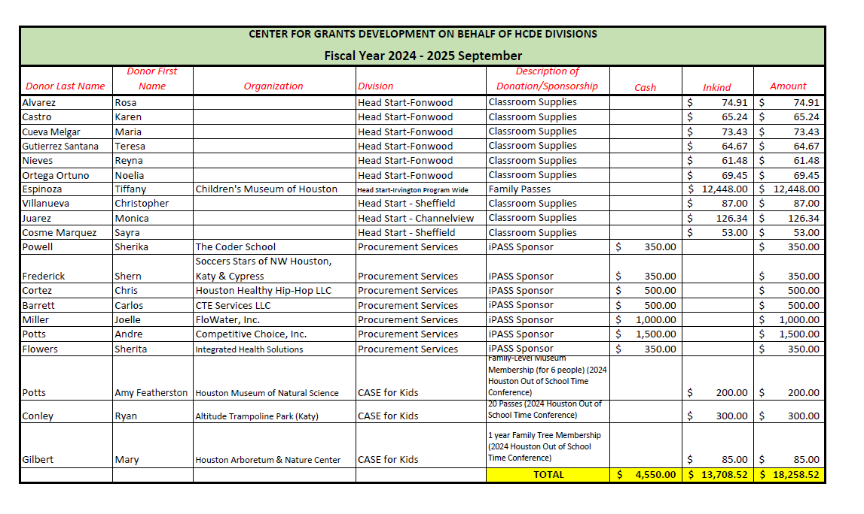
INTERIM FINANCIAL REPORT (unaudited) FY 2024-25 Donations Report All Funds as of September 30,2024

Slide 16
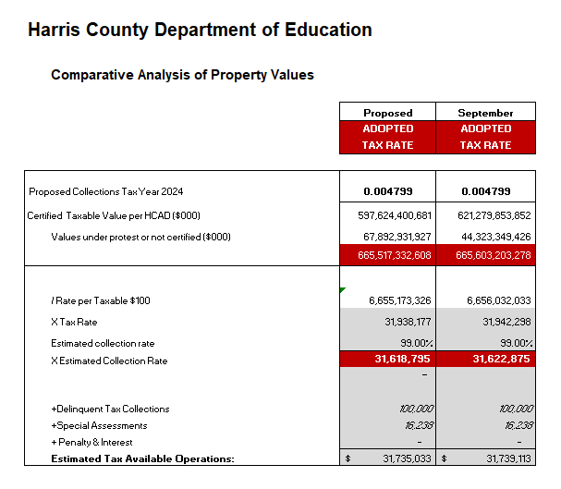
INTERIM FINANCIAL REPORT (unaudited) TAX COLLECTIONS COMPARATIVE ANALYSIS Fiscal Year-To-Date as of September 30,2024
$665 B
$665 B
See Tax Calculator at:
https://hcde-texas.org/transparency/tax-rate/
16

Slide 17
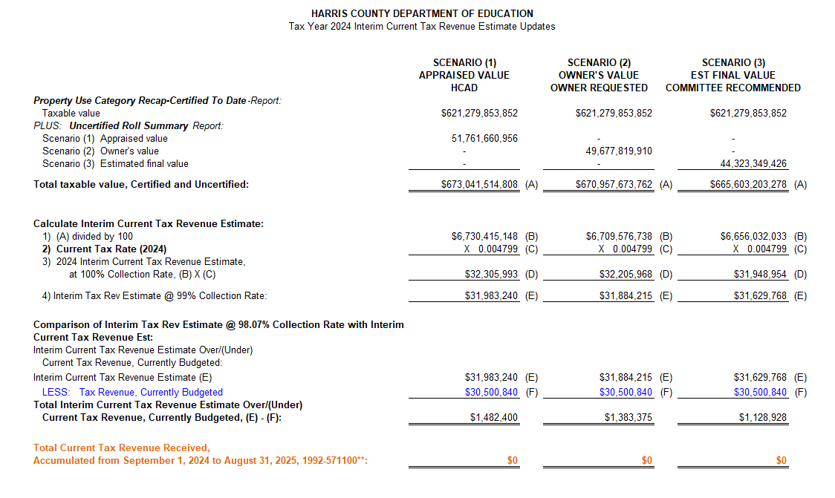
INTERIM FINANCIAL REPORT (unaudited) TAX COLLECTIONS
Fiscal Year-To-Date as of September 30,2024
(1st month / 12 months)

Slide 18
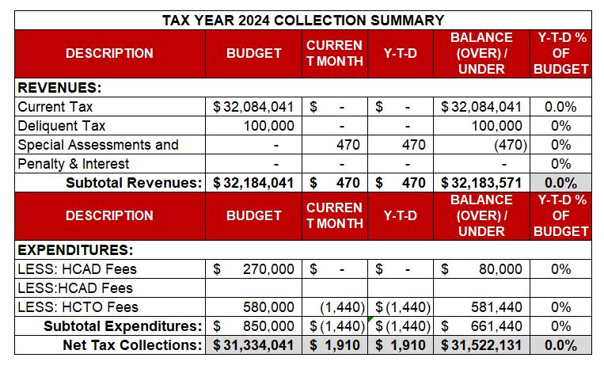
INTERIM FINANCIAL REPORT (unaudited) TAX COLLECTIONS
Fiscal Year-To-Date as of September 30,2024
(1st month / 12 months)
a) 2023 Proposed Tax Rate = $0.004800/$100 Property Assessment/Appraisal - --> Annual Tax on a $259,375 - $75,219 = $201,066/100
x .004800 = $9.65 (net of 29% homestead exception.)
b) $705,000/$30,500,840 = 2.32% Collection and assessment costs

Slide 19
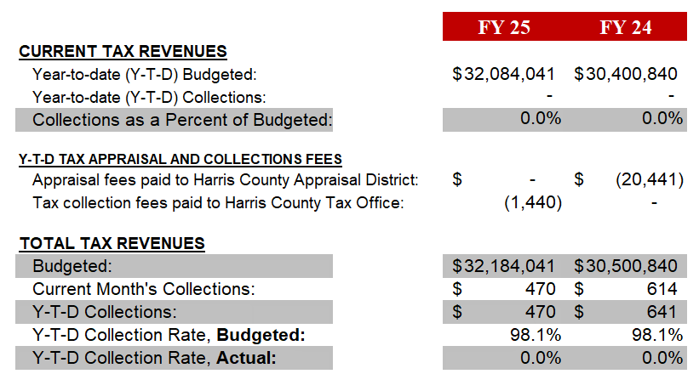
INTERIM FINANCIAL REPORT (unaudited) TAX COLLECTIONS
Fiscal Year-To-Date as of September 30,2024
(1st month / 12 months)
2022 Adopted Tax Rate = $0.004900/$100 Property Assessment/Appraisal - --> Annual Tax on a $259,375 - $75,219 = $201,066/100 x .004900 = $9.85 (net of 29% homestead exception.)
b) $705,000/$25,188,000 = 2.80% Collection and assessment costs

Slide 20
INTERIM FINANCIAL REPORT (unaudited) DISBURSEMENT – ALL FUNDS September 30,2024
Notes:
All Purchase Orders and Payment Authorizations are reviewed before disbursement.
All Procurement Card charges are reviewed by cardholder, supervisor, and business office staff each month.
A report on CH Local Expenditures is included in the monthly report.

Slide 21
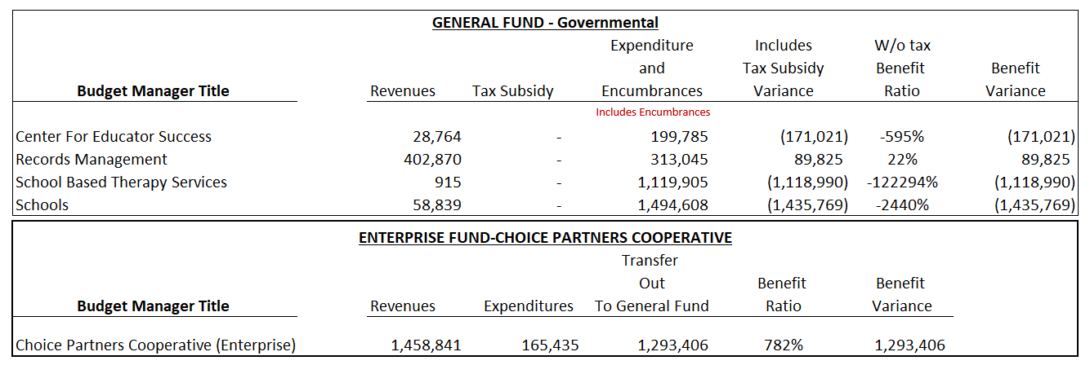
INTERIM FINANCIAL REPORT (unaudited) Segment Division Data As of September 30,2024

Slide 22
HIGHLIGHTS OF BUDGET AMENDMENT REPORT October 16th, Board Meeting (unaudited)
No Budget Amendments

Slide 23
Education Foundation Update
September 30,2024

Slide 24
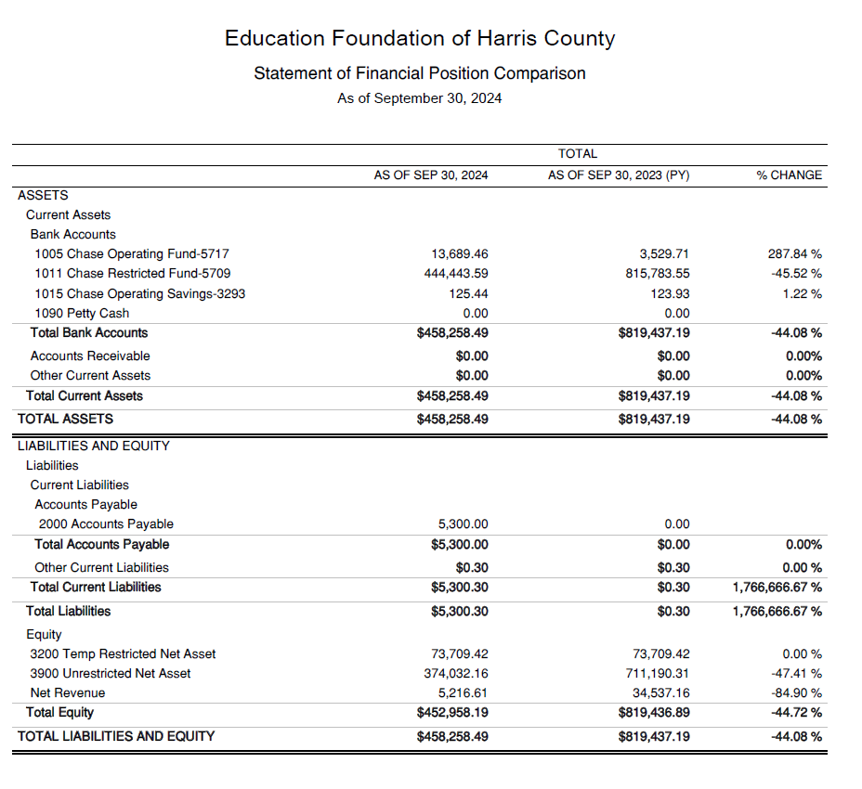
Statement of Financial Position
Net Equity 452,958

Slide 25
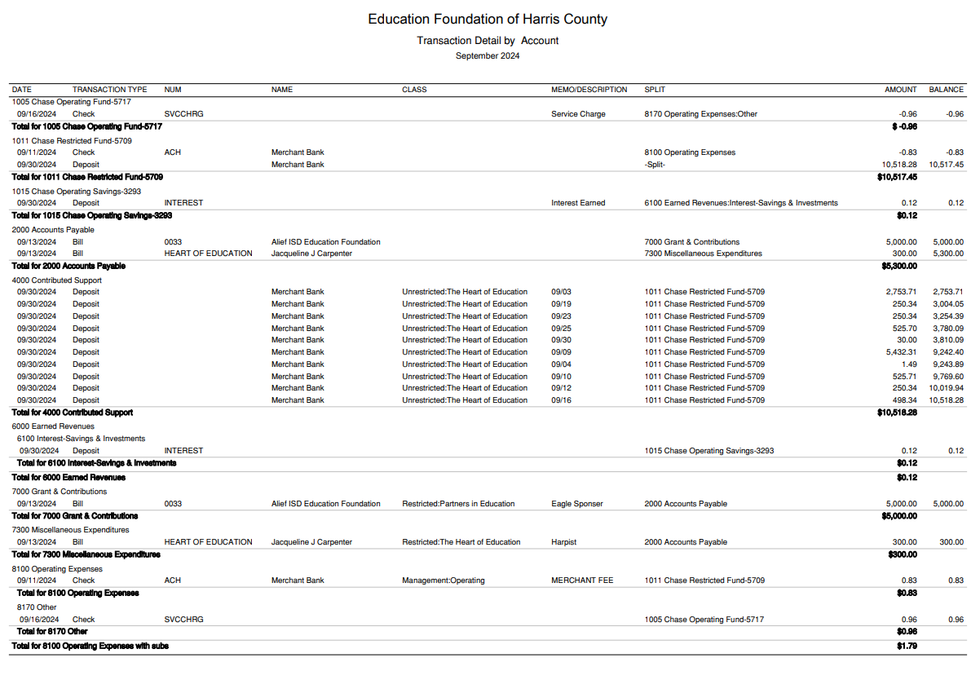
Transaction Detail by Inflow & Outflow

Slide 26
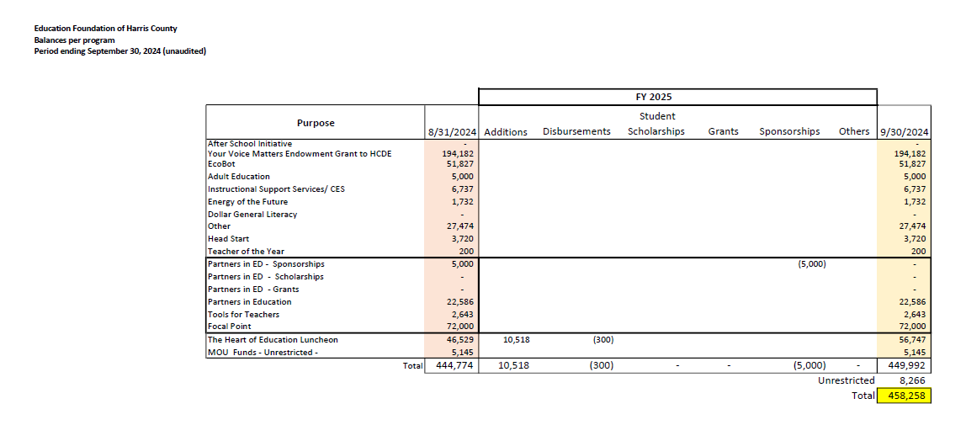
Ed Foundation Balances Per Program

Slide 27
PFC & Lease Revenue Projects Update
September 30,2024

Slide 28
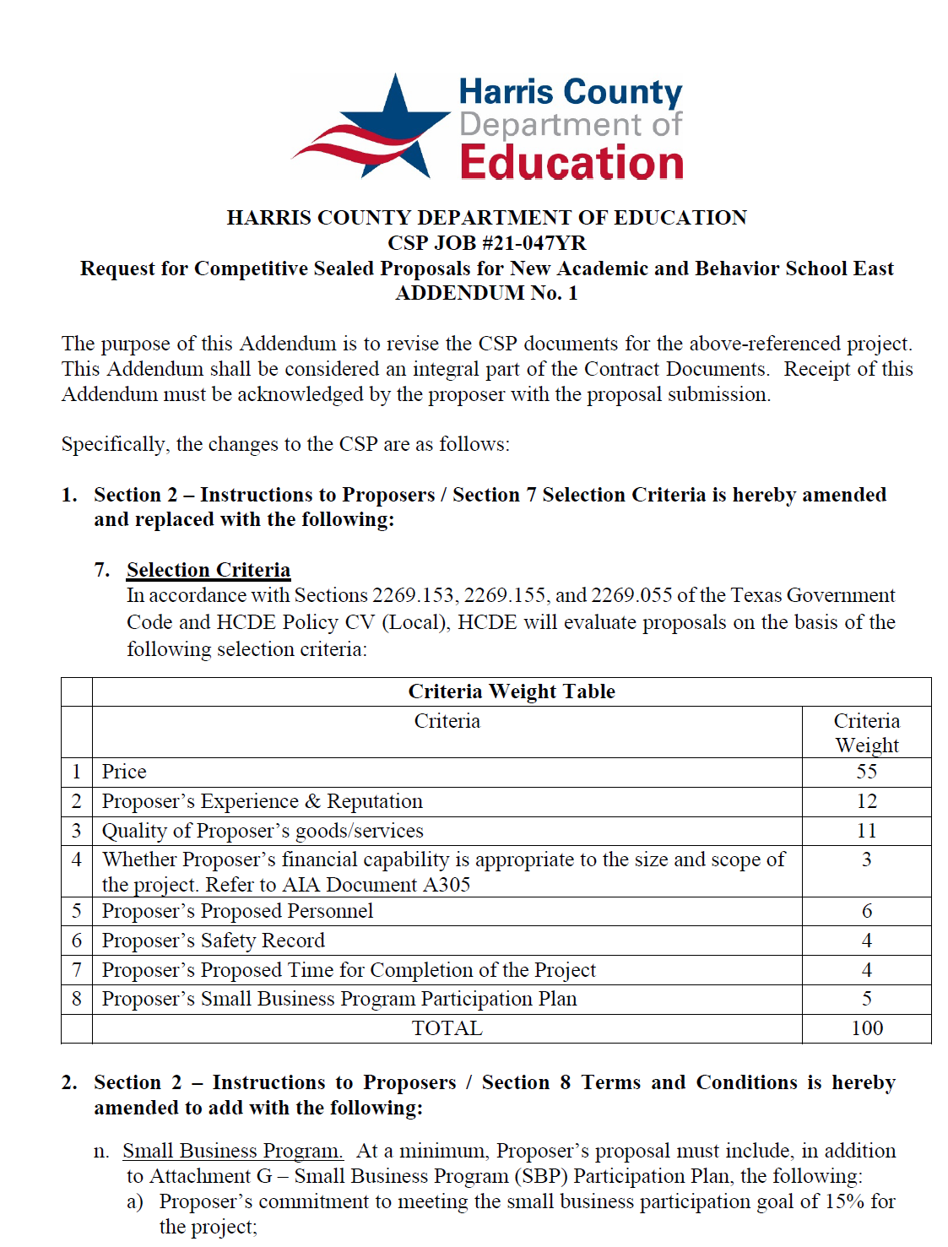
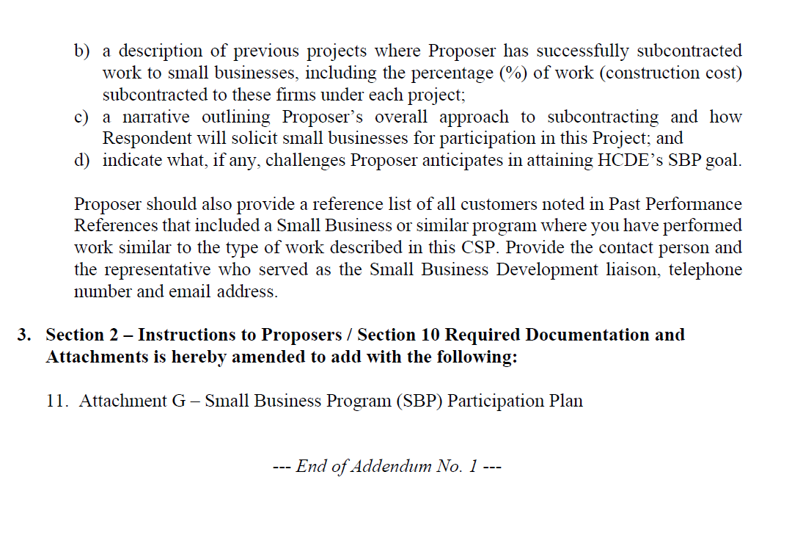
Small Business Program for construction
Launch industry's first collaboration feature
This is our plan as we launch the industry's first collaboration feature

Slide 29
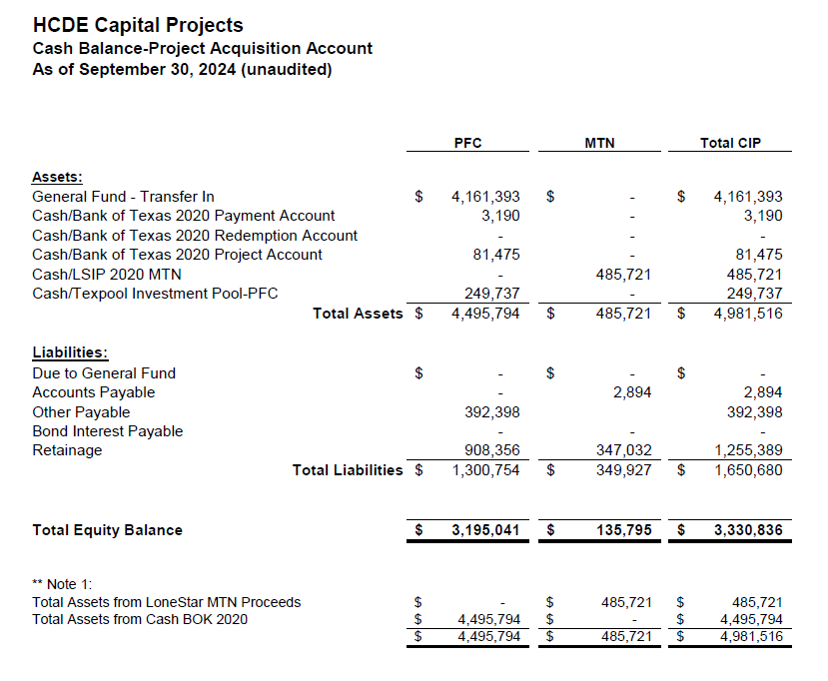
AB East School Contract $12,358,000 Awarded
Adult Ed Center Contract $15,121,000 Awarded on Oct 2021 Board Mtg
HP East Contract $7,271,000 Awarded on Nov 2021
Irvington – $11,172,589 Awarded on Jan 2024
Cash Balance –
Project Acquisition Account
As of September 30,2024

Slide 30
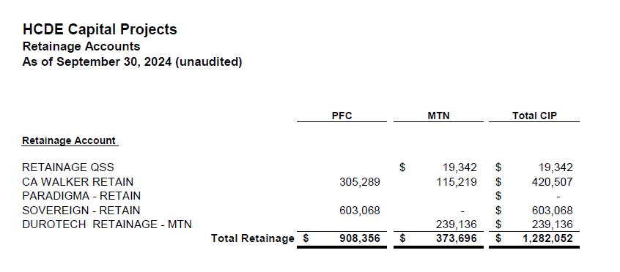
2020 MTN NOTES/2020 PFC BONDS
Pending Retainage Payable
Retainage Payable
Project Acquisition Account
As of September 30,2024

Slide 31
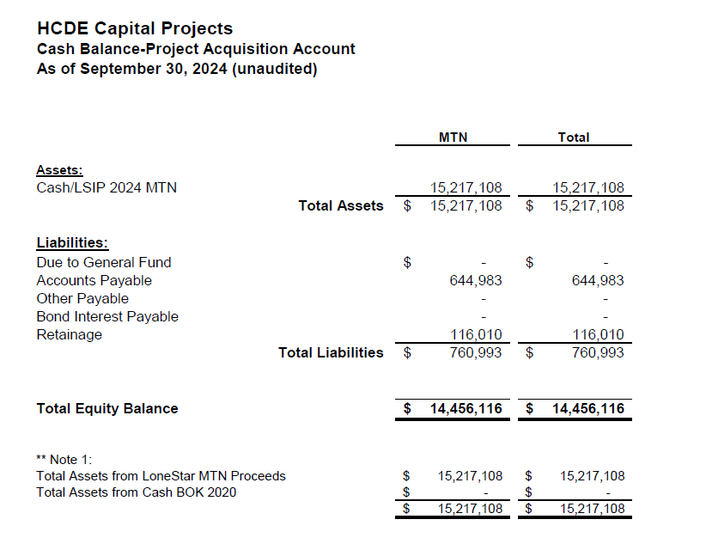
AB West $333,000 March 2024 Board Mtg
HS Barrett Station $470,000 March 2024 Board Mtg
Fortis Academy $650,000 March 2024 Board Mtg
Irvington – $9,860,000 March 2024 Board Mtg
Post Oak - $5,000,000 March 2024 Board Mtg
$16,313,000
Cash Balance –
2024 Maintenance Notes
As of September 30,2024

Slide 32
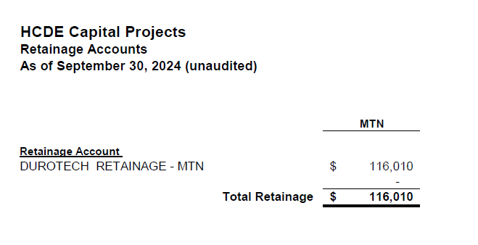
AB West $333,000 March 2024 Board Mtg
HS Barrett Station $470,000 March 2024 Board Mtg
Fortis Academy $650,000 March 2024 Board Mtg
Irvington – $9,860,000 March 2024 Board Mtg
Post Oak - $5,000,000 March 2024 Board Mtg
$16,313,000
Retainage Payable
2024 Maintenance Notes
As of September 30,2024

Slide 33
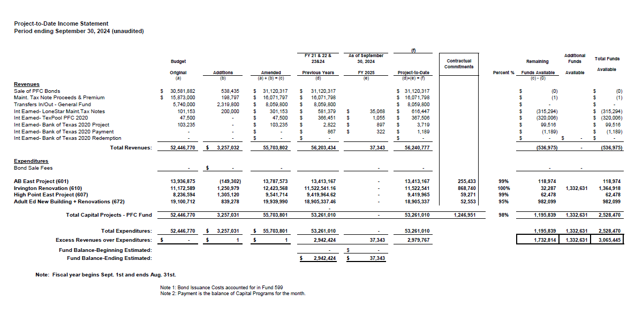
Income Statement– Project Acquisition Account
As of September 30,2024

Slide 34
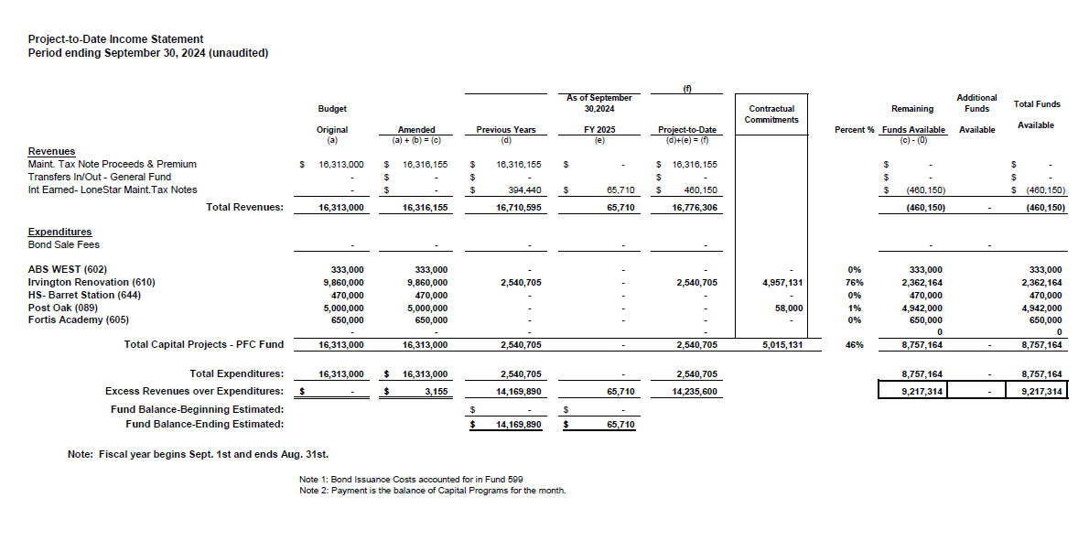
Income Statement– 2024 MNT NOTES
As of September 30,2024

Slide 35
Irvington Renovation – Funds by Source
As of September 30,2024
Irvington Renovation 2020 Maintenance Notes $ 4,781,519
Contract 2024 Maintenance Notes $ 7,000,000
Total $11,781,519
35

Slide 36
Capital Program Proposal from Aug 3, 2020
36

Slide 37
2020 Projected Capital Improvement Program
Project | Substantial Completion Date | Project Budget | Maintenance Notes Projected | Revenue Bonds Proceeds | General Funds Use of Fund Bal. | Interest Earnings Projection
Reagan Adm Bldg. | Feb 9, 2023 | $8,365,500 | $ 8,365,500 | N/A | N/A
Adult Ed Building | Oct 25, 2022 | $18,358,750 | $ 3,659,000 | $12,728,598 | $1,870,000 | $101,153
HP East Middle | Oct 25, 2022 | $7,916,645 | $ 1,089,500 | $4,909,645 | $1,870,000 | $47,500
Ab East Campus | Aug 16, 2022 | $17,805,875 | $ 2,759,000 | $12,943,640 | $2,000,000 | 103,235
 | Total | $52,446,770 | $15,873,000 | $30,581,882 | $5,740,000 | $251,888
 |  | Closed on 12-2-20 | Invested in pools.
Build a product accessible on all devices
This is our plan as we build a product accessible on all devices.
Note: The Total Public Notice was $54,000,000. ($35,000,000 for Revenue bonds and $19,000,000 for Maintenance Notes) on August 10, 2020. A transfer of $1,350,000 plus $50,000 in reimbursable expenditures was made from AB East to allocate Program Manager costs to establish the budgets.
Based on Pricing the principal amount will vary due to the premium projected in the bond sale. Revenues Bonds estimated at $27,730,000 and Maintenance Notes for $13,695,000

Slide 38
Interim Financial Report (unaudited)
I certify that the foregoing information is true and accurate to the best of my knowledge.
/s/ Jesus J. Amezcua, RTSBA,CPA, Ph.D., CPFIM, Asst. Supt. for Business Support Services
/s/ Marcia Leiva, Chief Accounting Officer

