Slide 1


Financial Highlights
As of December 31, 2024

Slide 2

Highlights of Interim Financial Report (unaudited)
December 31, 2024

Slide 3




Posted on Our Website
Finance / Monthly Finance Reports (hcde-texas.org)
Linked from State Comptroller’s website
http://www.texastransparency.org/local/schools.php

Slide 4
Top 12 Highlights points for December 2024
$3M in tax revenue this month
No Interest payments this month
Revenues at 22% Target of 32%
Expenditures at 33%
$29.2 in Equity as of Dec 2024
$37,836 in Donations
Values at $661B out of $665B Projected
Choice at $3.5M Benefit Variance
9. Ed Foundation at $541K
10. 8% small business First Qtr.
11. 87% Irvington Project
12. Phase I Projects – just pending retainage release and closeout
Outlook Trend : Finance - Positive Revenues and Stable Expenditures
Operations - Normal Operations and On Target
Policy - Stable
Legislative - On going

Slide 5

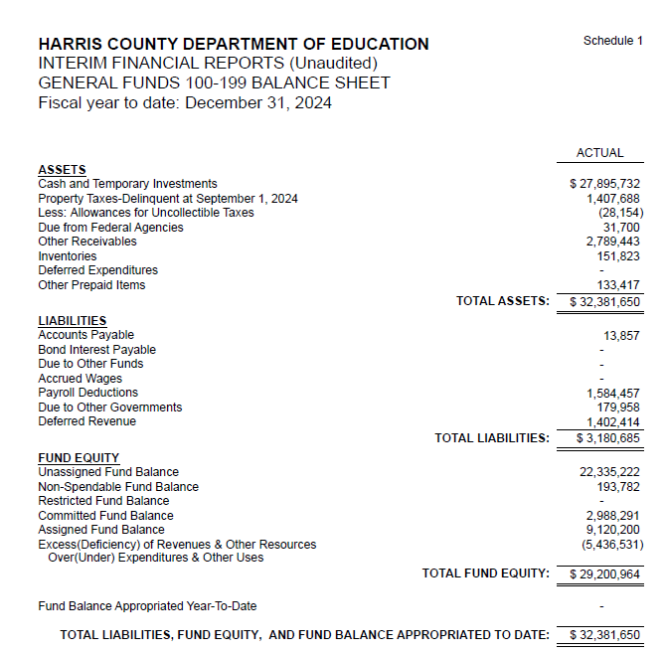
INTERIM FINANCIAL REPORT
(unaudited)
GENERAL FUND
Balance Sheet as of December 31, 2024
Total Assets:
$ 32,381,650
Total Liabilities:
$ 3,180,685
Total Fund Equity:
$ 29,200,964

Slide 6
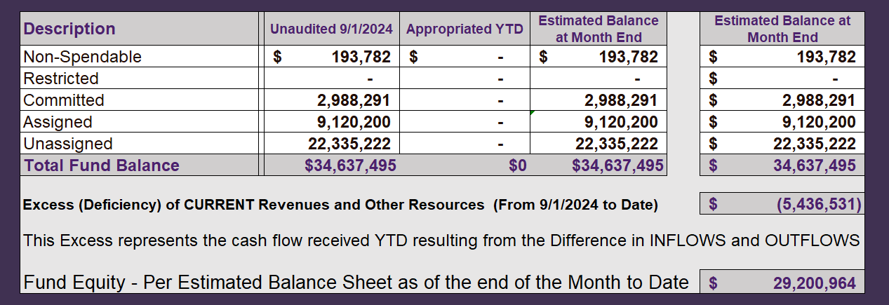
INTERIM FINANCIAL REPORT (unaudited)
ASST. SUPERINTENDENT FOR BUSINESS SERVICES MESSAGE
As of December 31, 2024
The ESTIMATED General Fund balance at 12/31/2024 is $29,200,964 after current appropriations.
As year end adjustments are completed, a budget amendment will be submitted to the board for items assigned, restricted and committed that will roll forward into FY 2025.

Slide 7
INTERIM FINANCIAL REPORT (unaudited)
As of December 31, 2024
Financial Ratios
Level One - Indicator of Financial Strength
Level Two - Indicator of Efficient Leverage
Level Three - Indicators of Efficiency
Level Four - Indicators of Revenue Growth

Slide 8
INTERIM FINANCIAL REPORT (unaudited)
As of December 31, 2024
Indicators of Financial Strength
Percent of Fund Balance to G/F
Expenditures Ratio
What is the percent of rainy-day fund balance?
(*) Unadjusted
Working Capital Ratio
What is the cash flow availability for the organization?
Unassigned Fund Balance $ 22,335,222
Total G/F Expenditures $ 20,434,013
Goal : > 30% of G/F Exp.
Benchmark: 10% to 29%
Danger: Under 10%
Goal : >$15,000,000
Benchmark : $10M to $15M
Danger : Under < $10M
Total Current Assets
Less Total Current Liabilities
$32,381,650-3,180,685=29,200,864
109% FY25
102% FY24
$29M FY25
$24M FY24
Budgeted 24%
Details on Schedule 3
Budgeted $33M
Details on Schedule 1

Slide 9
INTERIM FINANCIAL REPORT (unaudited)
As of December 31, 2024
Indicators of Efficient Leverage Reserves
Unassigned Fund Balance Ratio
How much is available in reserves?
Debt to Income Ratio
What is the ability of HCDE to cover
its debt payments?
Unassigned Fund Balance $22,335,222
Total Fund Balance $29,200,964
Annual Principal and Interest Payments on
Term Debt and Capital Leases : $0
G/F Revenue Less Facility $14,997,481-2,783,574
Charges :
Goal: <75%
Benchmark: 50% to 75%
Danger: <50%
Goal: <25% of annual revenue
Benchmark: 25% to <49%
Danger: Over > 50%
76% FY25
82% FY24
0 % FY25
0% FY24
Budgeted 71%
Details on Schedule 1
Budgeted 6%
Details on Schedule 5

Slide 10
INTERIM FINANCIAL REPORT (unaudited)
As of December 31, 2024
Indicators of Efficiency
Tax Revenue to Total Revenue Ratio
How efficient is HCDE at leveraging local
taxes? (Current)
Indirect Cost to Tax Ratio
How much dependency on indirect cost from grants?
Current Tax Revenue $3,034,744
Indirect Cost General Fund $669,033
Total Revenue $ 30,173,259
Total General Fund Revenues $14,997,481
Total General Fund Revenues $1,306,381
Goal: <20% of revenue
Benchmark: 20% to 30%
Danger: Over >30%
Goal: >5%
Benchmark: 2% to 5%
Danger: Under < 2%
Goal: >5%
Benchmark: 2% to 5%
Danger: Under < 2%
10% FY25
13% FY24
4.5% FY25
3.2% FY24
Budgeted 25%
Details on Schedule 2
Budgeted 2.5%
Details on Schedule 3

Slide 11
INTERIM FINANCIAL REPORT (unaudited)
As of December 31, 2024
Indicators of Revenue Growth
Fee for Service Revenue Ratio
How are revenues spread across all Funds?
Fee for Service Revenue Growth Ratio
What is the market growth for fee on services?
Total Fee for Service Revenues (G/F) $7,181,891
Total Revenues $30,173,259
Fee for Service Current Year Less Fee for Services Last Year $7,181,891-9,740,294
Fees for Service Last Year $9,740,294
Goal: >30% of annual revenue Benchmark: 10% to 29%
Danger: Under 10%
Goal: >3% of + growth
Benchmark: 0% to 3%
Danger: Under 0%
23% FY25
31% FY24
-26% FY25
32% FY24 ​
Budgeted 19%
Details on Schedule 14
Budgeted 17%
Details on Schedule 14

Slide 12
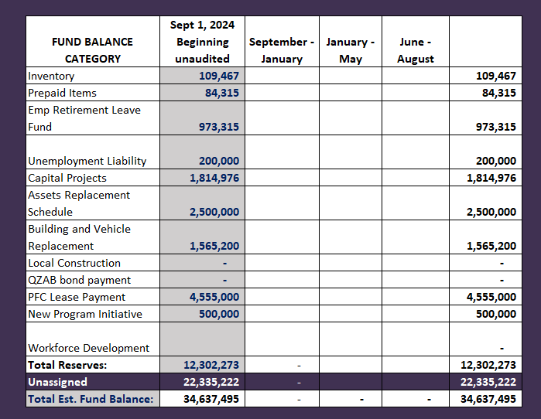
FY 2024-2025
Fund Balance
-
Budgeted Activity

Slide 13
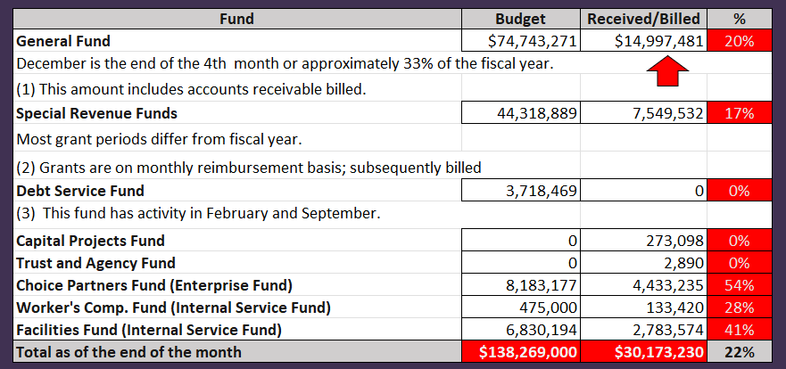
INTERIM FINANCIAL REPORT (unaudited)
GENERAL, SPECIAL REVENUE, DEBT SERVICE FUNDS, CAPITAL PROJECTS,
AND INTERNAL SERVICE FUNDS
REVENUES (INFLOWS)
Budget to Actual for period ending December 31, 2024

Slide 14
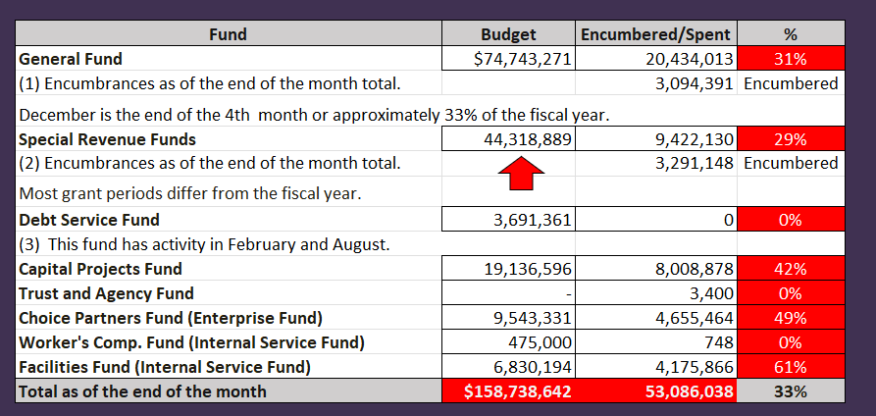
INTERIM FINANCIAL REPORT (unaudited)
GENERAL, SPECIAL REVENUE, DEBT SERVICE FUNDS, CAPITAL PROJECTS,
AND INTERNAL SERVICE FUNDS
Expenditures (OUTFLOWS)
Budget to Actual for period ending December 31, 2024

Slide 15
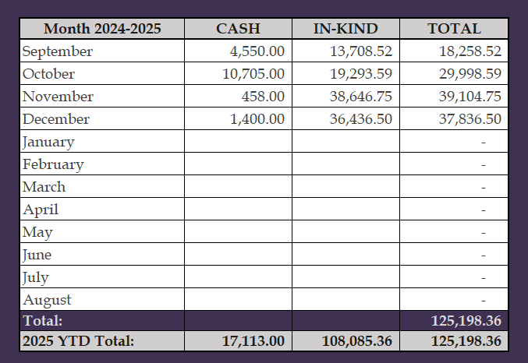
INTERIM FINANCIAL REPORT (unaudited)
FY 2024-25 Donations Report
All Funds as of December 31, 2024

Slide 16
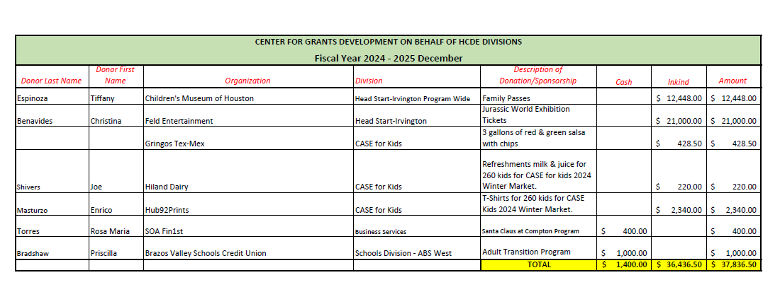
INTERIM FINANCIAL REPORT (unaudited)
FY 2024-25 Donations Report
All Funds as of December 31, 2024

Slide 17
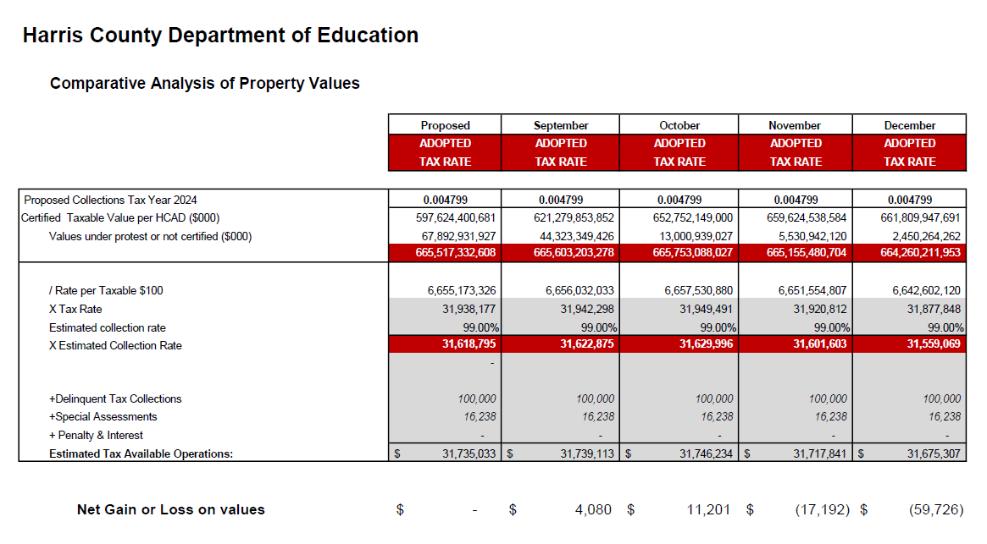
INTERIM FINANCIAL REPORT (unaudited)
TAX COLLECTIONS COMPARATIVE ANALYSIS
Fiscal Year-To-Date as of December 31, 2024
$665 B
See Tax Calculator at:
https://hcde-texas.org/transparency/tax-rate/
17

Slide 18
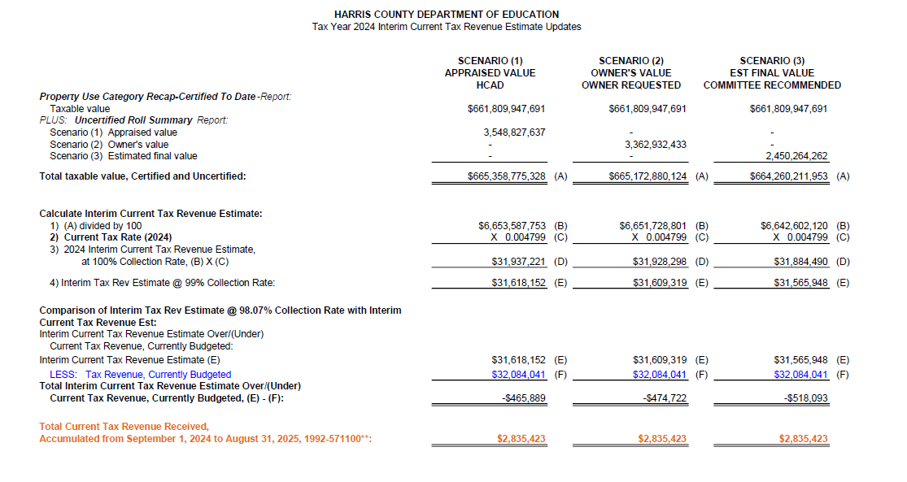
INTERIM FINANCIAL REPORT (unaudited) TAX COLLECTIONS
Fiscal Year-To-Date as of December 31, 2024
(4th month / 12 months)

Slide 19
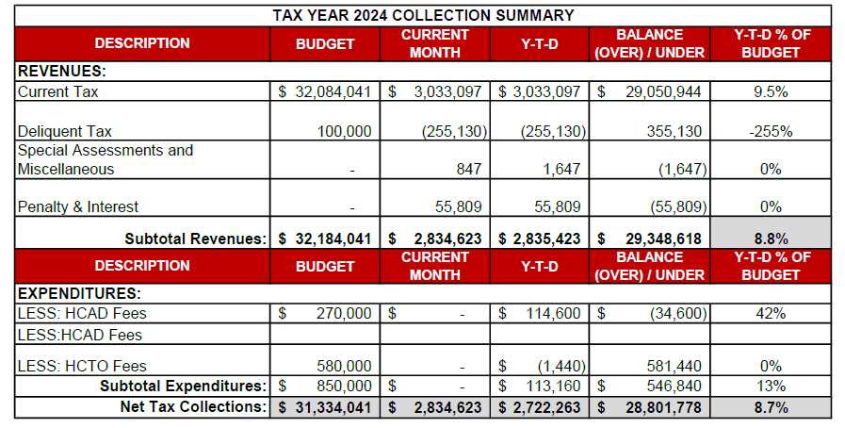
INTERIM FINANCIAL REPORT (unaudited) TAX COLLECTIONS
Fiscal Year-To-Date as of December 31, 2024
(4th month / 12 months)
a) 2024 Approved Tax Rate = $0.004799/$100 Property Assessment/Appraisal - --> Annual Tax on a $259,375 - $51,875 = $207,500/100
x .004799 = $9.958 (net of 20% homestead exception.)
b) $850,000/$32,184,041 = 2.64% Collection and assessment costs

Slide 20
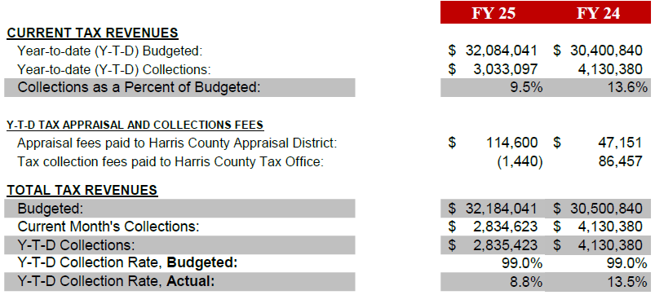
INTERIM FINANCIAL REPORT (unaudited) TAX COLLECTIONS
Fiscal Year-To-Date as of December 31, 2024
(4th month / 12 months)
a) 2024 Approved Tax Rate = $0.004799/$100 Property Assessment/Appraisal - --> Annual Tax on a $259,375 - $51,875 = $207,500/100
x .004799 = $9.958 (net of 20% homestead exception.)
b) $850,000/$32,184,041 = 2.64% Collection and assessment costs

Slide 21
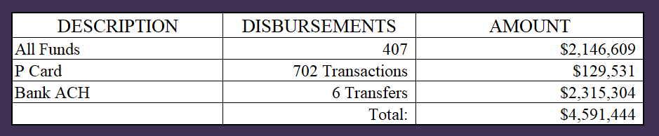
INTERIM FINANCIAL REPORT (unaudited)
DISBURSEMENT – ALL FUNDS
December 31, 2024
Notes:
All Purchase Orders and Payment Authorizations are reviewed before disbursement.
All Procurement Card charges are reviewed by cardholder, supervisor, and business office staff each month.
A report on CH Local Expenditures is included in the monthly report.

Slide 22
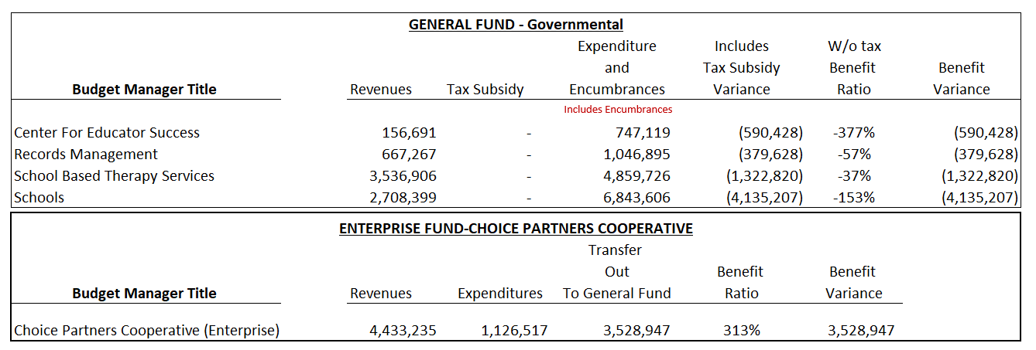
INTERIM FINANCIAL REPORT (unaudited)
Segment Division Data
As of December 31, 2024

Slide 23
HIGHLIGHTS OF BUDGET AMENDMENT REPORT
January 15th, Board Meeting
(unaudited)
No Budget Amendments

Slide 24

Education Foundation Update
December 31, 2024

Slide 25
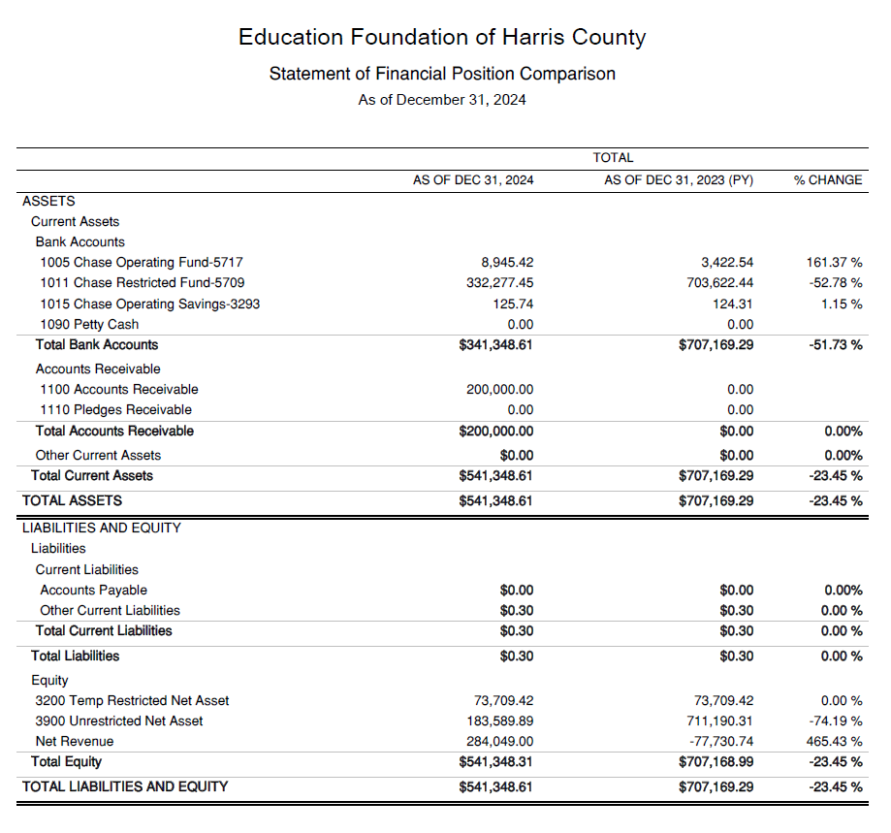
Statement of Financial Position
Net Equity $541,348

Slide 26
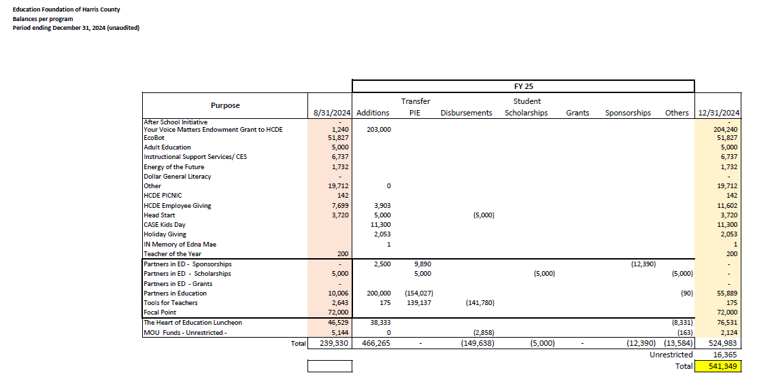
Ed Foundation Balances Per Program
Note Includes the $200K in FY 24-25

Slide 27
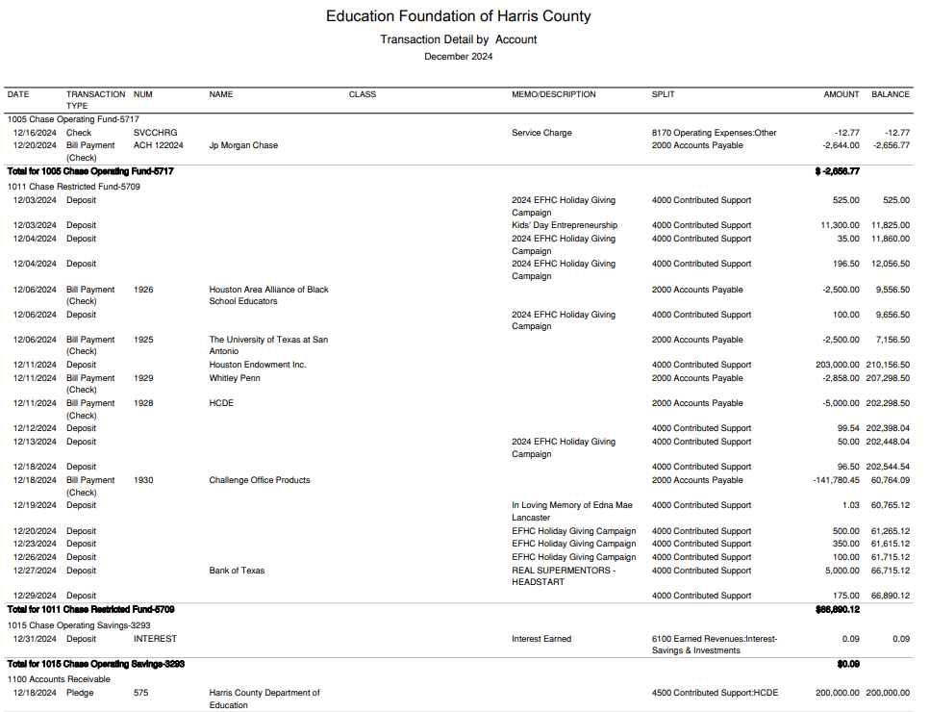
Transaction Detail by Inflow & Outflow

Slide 28
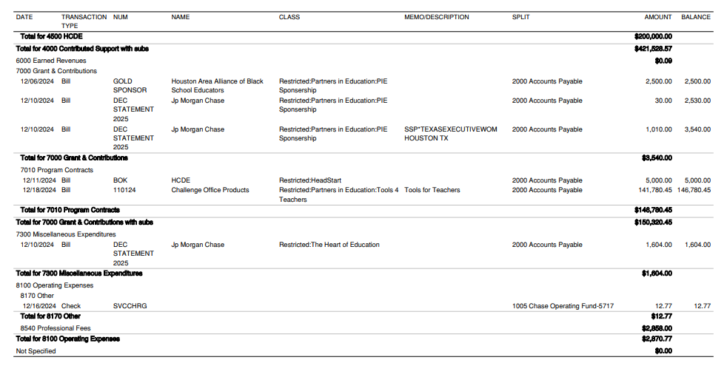
Transaction Detail by Inflow & Outflow

Slide 29

PFC & Lease Revenue Projects Update
December 31, 2024

Slide 30
Harris County Department of Education
Small Business Program
First Quarter
9/1/24 to 12/31/24
FY 2024-2025
By
Dr. Edna Johnson
Procurement Director

Slide 31
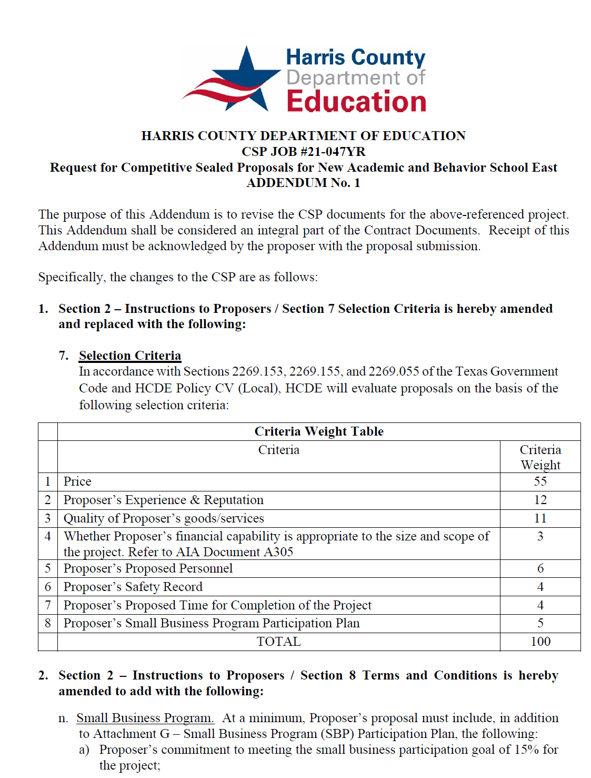
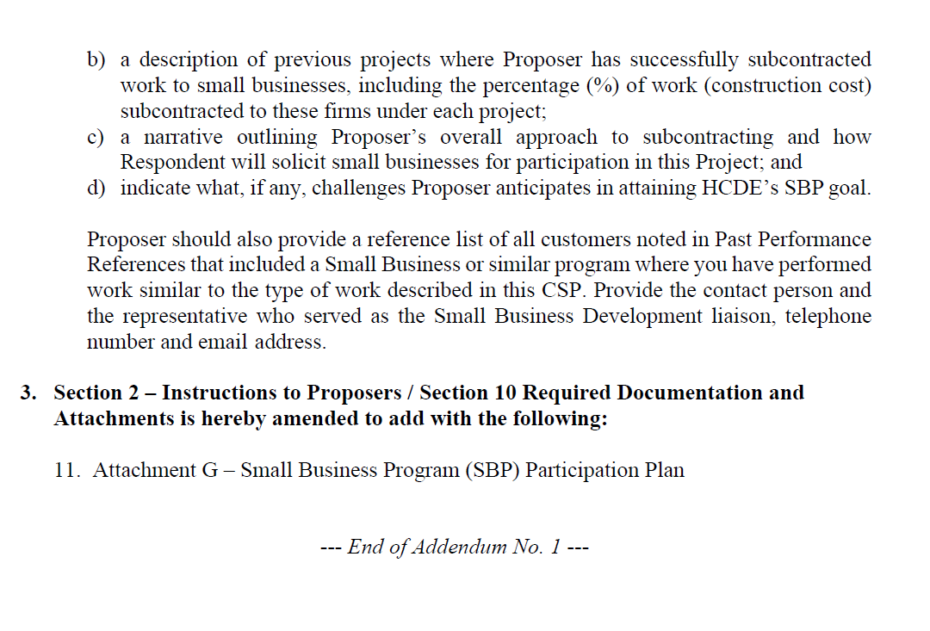
Small Business
Program for construction
Launch industry's first collaboration feature
This is our plan as we launch the industry's first collaboration feature

Slide 32
Content
Definitions
Certifying Agencies
List of Small Business Expenditures for Year to Date (9/1/24 to 12/31/24 FY24-25)
Graphics
List of Small Businesses
32

Slide 33
Definitions
HUB – Historically Underutilized Business is a business entity in which at least fifty-one percent ownership is by a woman, minority, and/or service-disabled veteran.
MBE – Minority Business Enterprise are fifty-one percent owned, operated and controlled by a minority group.
SBE – Small Business Enterprise are private corporations, partnerships, or sole proprietorships with 500 or fewer employees.
WBE – Woman Business Enterprise is fifty-one percent owned and controlled by one or more women who are U.S. citizens or Legal Resident Aliens.
33

Slide 34
Certifying Agencies
  City of Houston
  Houston Metropolitan Transit Authority
  Port of Houston
  South Central Texas Regional Certification Agency
34

Slide 35
First Quarter 9/1/24 to 12/31/24
Expenditures FY 24/25
Small Business $416,903
Non-Small Business $4,828,513
Total Business = $5,245,416
Govt and Utilities $2,122,589
Total Expenditures = $7,368,005
Small Business $416,903
divided by
Total Business $5,245,416
8% Ratio Small/Large
35

Slide 36
First Quarter
Small Business Amounts by Certifying Agency
Name of Agency
City of Houston $254,614
Port of Houston $162,289
Total $416,903
36

Slide 37
First Qtr.
Small Business by Certification Type
Certification Type
HUB Historically Underutilized Business
MBE Minority
SBE Small
WBE Women
Total $416,903
37

Slide 38
Certified Small Business for First Qtr by Ethnicity
Asian | $87,583 | 21%
Black | $115,771 | 28%
Caucasian | $11,380 | 3%
Hispanic | $202,169 | 48%
 | $416,903 | 100%
38

Slide 39
Small Business list for FY 2025
Vendor | Sum of Payments | Certifying Agency | Certification Type | Ethnic Group | Business Capabilities
BLUE KNIGHT SECURITY LLC | $ 38,305 | City of Houston | SBE | Black | Security guards and patrol services
BUTLER BUSINESS PRODUCTS | $ 63,326 | Port Houston | SBE | Hispanic | Office Supplies and Stationery Stores
DURA PIER FACILITIES SERVICES LTD | $ 11,380 | Port Houston | WBE | Caucasian | Building and Construction and Maintenance Services
EMA SPORT SOLUTIONS LLC | $ 138,844 | City of Houston | MBE | Hispanic | Sport Facilities Construction, Flooring and Turf Installation, Fence Installation, Demolition
HTS INC CONSULTANTS | $ 12,411 | City of Houston | SBE | Black | Geotechnical Laboratory Service and Other Scientific & Technical Consulting Services
INFRASTRUCTURE ASSOCIATES INC | $ 36,000 | Port Houston | SBE | Asian | Engineering Services; Design Services
QSS, L.C | $ 65,055 | City of Houston | HUB | Black | Fire/Alarm Systems Installation
SHI GOVERNMENT SOLUTIONS INC | $ 51,583 | Port Houston | MBE | Asian | Custom Computer Programming Services; Computer Accessories And Supplies
 | $ 416,903
39

Slide 40
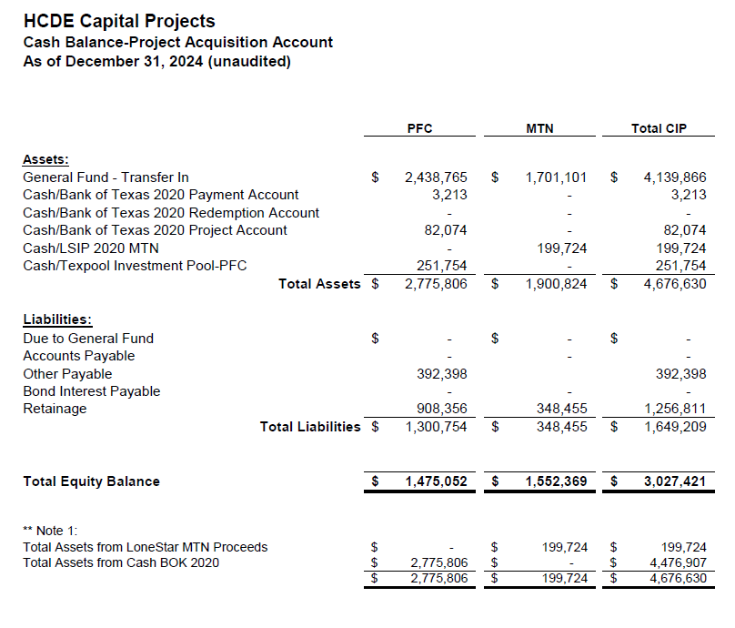

AB East School Contract $12,358,000 Awarded
Adult Ed Center Contract $15,121,000 Awarded on Oct 2021 Board Mtg
HP East Contract $7,271,000 Awarded on Nov 2021
Irvington – $11,172,589 Awarded on Jan 2024
Cash Balance –
Project Acquisition Account
As of December 31, 2024

Slide 41
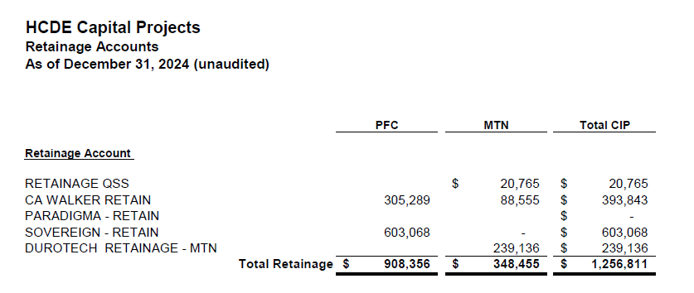
2020 MTN NOTES/2020 PFC BONDS
Pending Retainage Payable
Retainage Payable
Project Acquisition Account
As of December 31, 2024

Slide 42
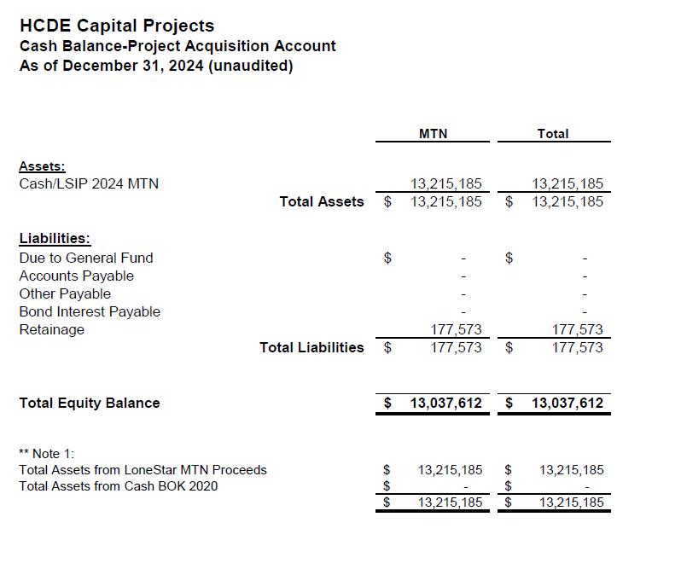
AB West $333,000 March 2024 Board Mtg
HS Barrett Station $470,000 March 2024 Board Mtg
Fortis Academy $650,000 March 2024 Board Mtg
Irvington – $9,860,000 March 2024 Board Mtg
Post Oak - $5,000,000 March 2024 Board Mtg
$16,313,000
Cash Balance –
2024 Maintenance Notes
As of December 31, 2024

Slide 43
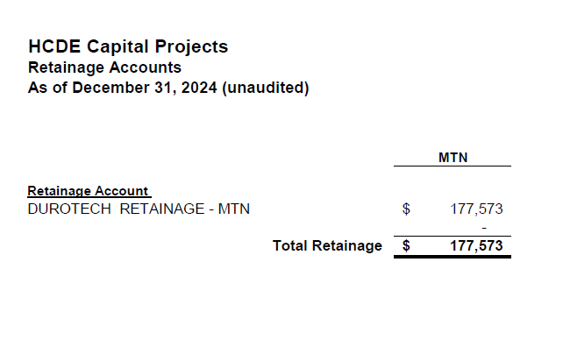
AB West $333,000 March 2024 Board Mtg
HS Barrett Station $470,000 March 2024 Board Mtg
Fortis Academy $650,000 March 2024 Board Mtg
Irvington – $9,860,000 March 2024 Board Mtg
Post Oak - $5,000,000 March 2024 Board Mtg
$16,313,000
Retainage Payable
2024 Maintenance Notes
As of December 31, 2024

Slide 44
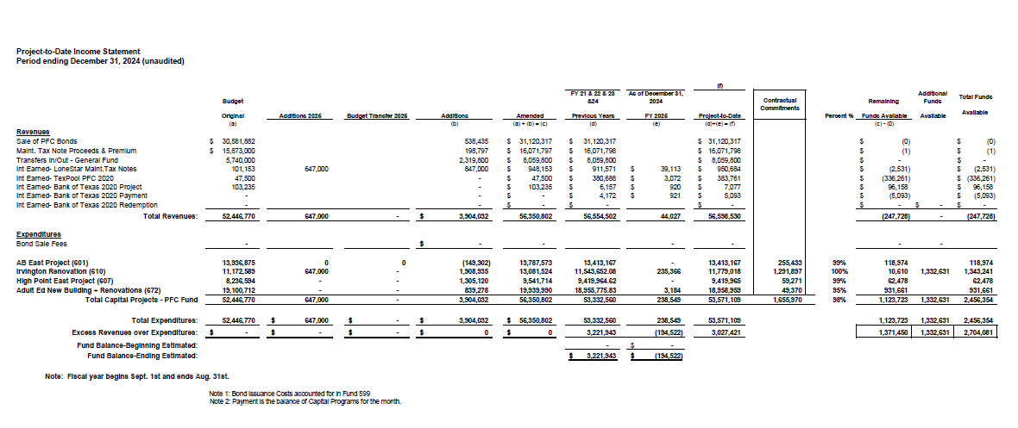
Income Statement– Project Acquisition Account
As of December 31, 2024

Slide 45
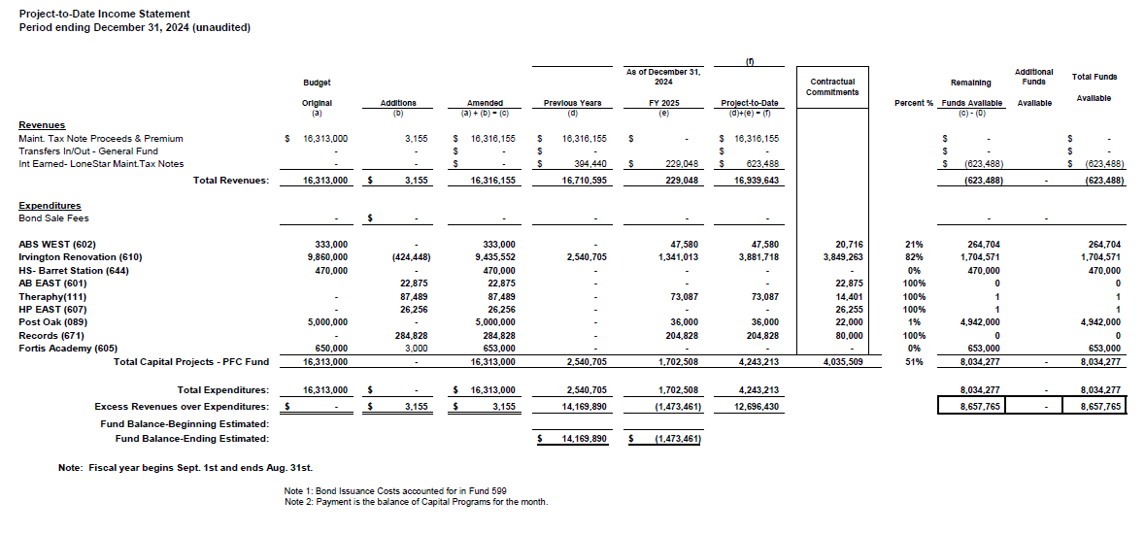
Income Statement– 2024 MNT NOTES
As of December 31, 2024

Slide 46
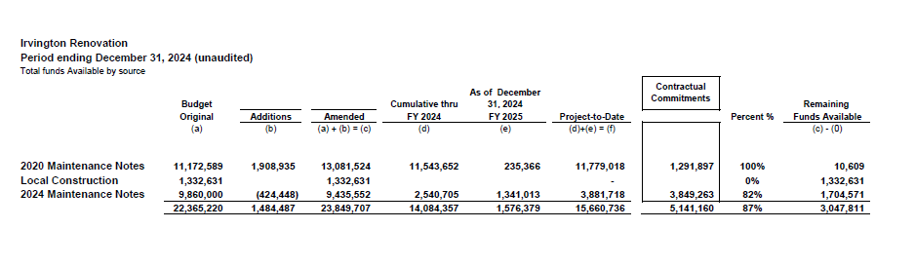
Irvington Renovation – Funds by Source
As of December 31, 2024
Irvington Renovation 2020 Maintenance Notes $ 4,781,519
Contract 2024 Maintenance Notes $ 7,000,000
Total $11,781,519
46

Slide 47

Interim Financial Report (unaudited)
I certify that the foregoing information is true and accurate to the best of my knowledge.
/s/ Jesus J. Amezcua, RTSBA,CPA, Ph.D., CPFIM, Asst. Supt. for Business Support Services
/s/ Marcia Leiva, Chief Accounting Officer

