Slide 1
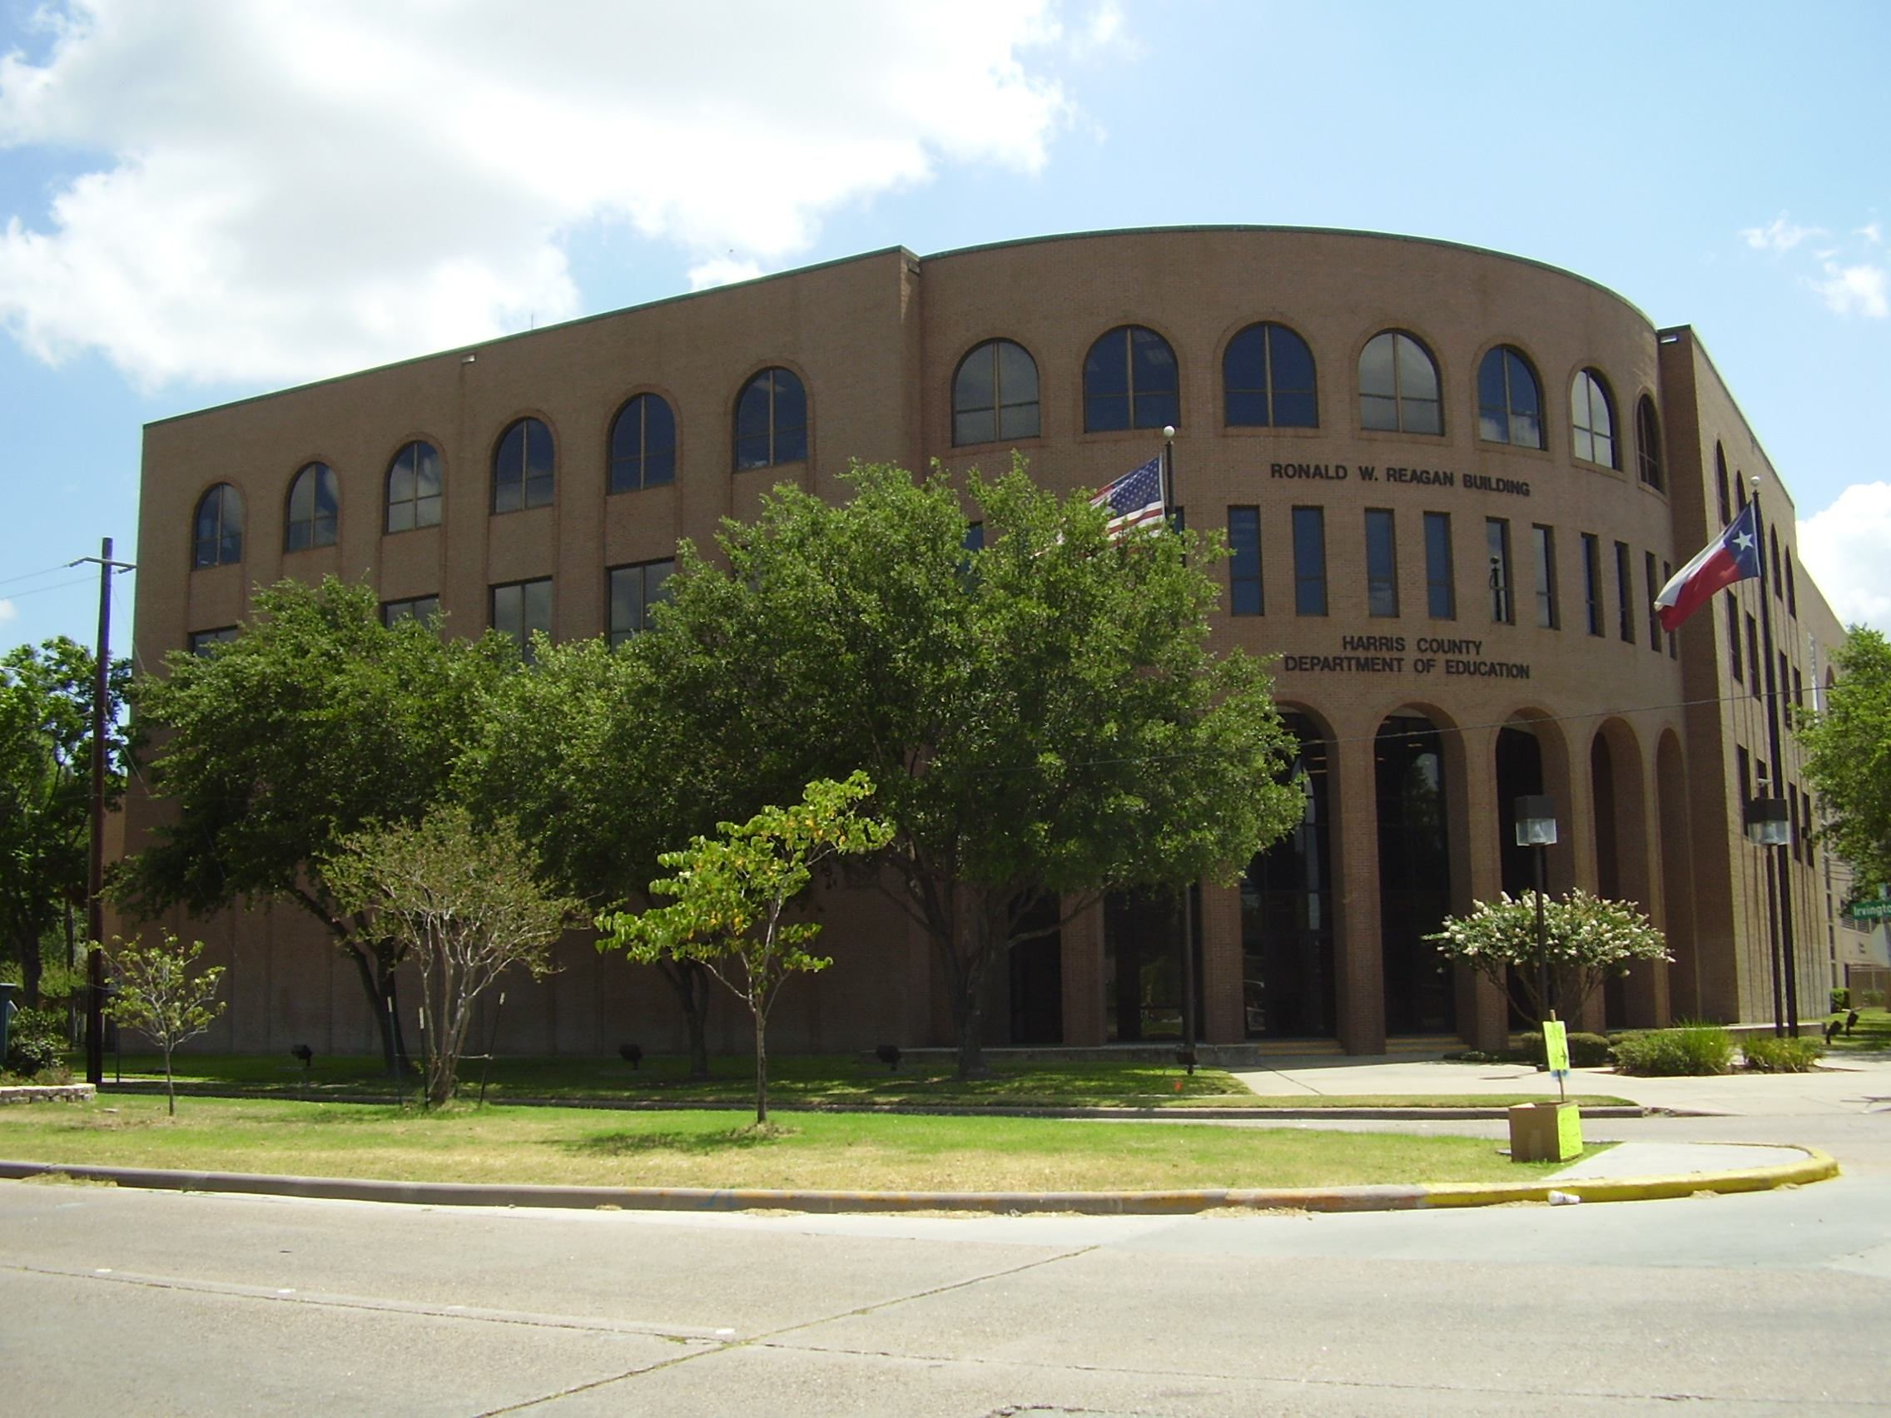
Investment Report
As of July 31, 2025

Slide 2
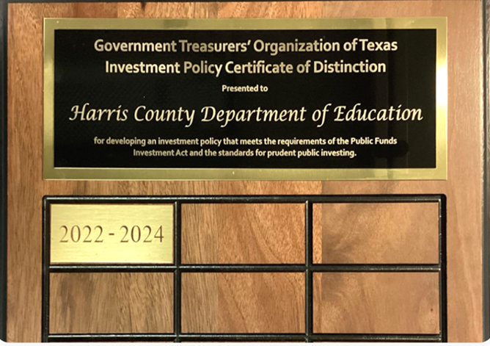
MONTHLY INVESTMENT REPORT (unaudited)
PURPOSE OF REPORT
As of July 31, 2025
State compliance with state law, HCDE policy and investment strategy.
Texas Government Code, Section 2256, Public Funds Investment Act; and
HCDE CDA (LEGAL) and CDA (LOCAL), Other Revenues: Investments
Describe investment position at report date.
HCDE Portfolio by Investment Type / PFC Portfolio by Investment Type
State account or fund for each investment asset.
HCDE Investment Earnings Reports / PFC Investment Earnings Reports
State book and market value for each investment asset at beginning and end of the period.
HCDE Inventory Report / PFC Inventory Report
Present a summary statement for each pooled fund group, including beginning market value; additions and changes to market value during the period; and ending market value.
HCDE Inventory Report / PFC Inventory Report

Slide 3
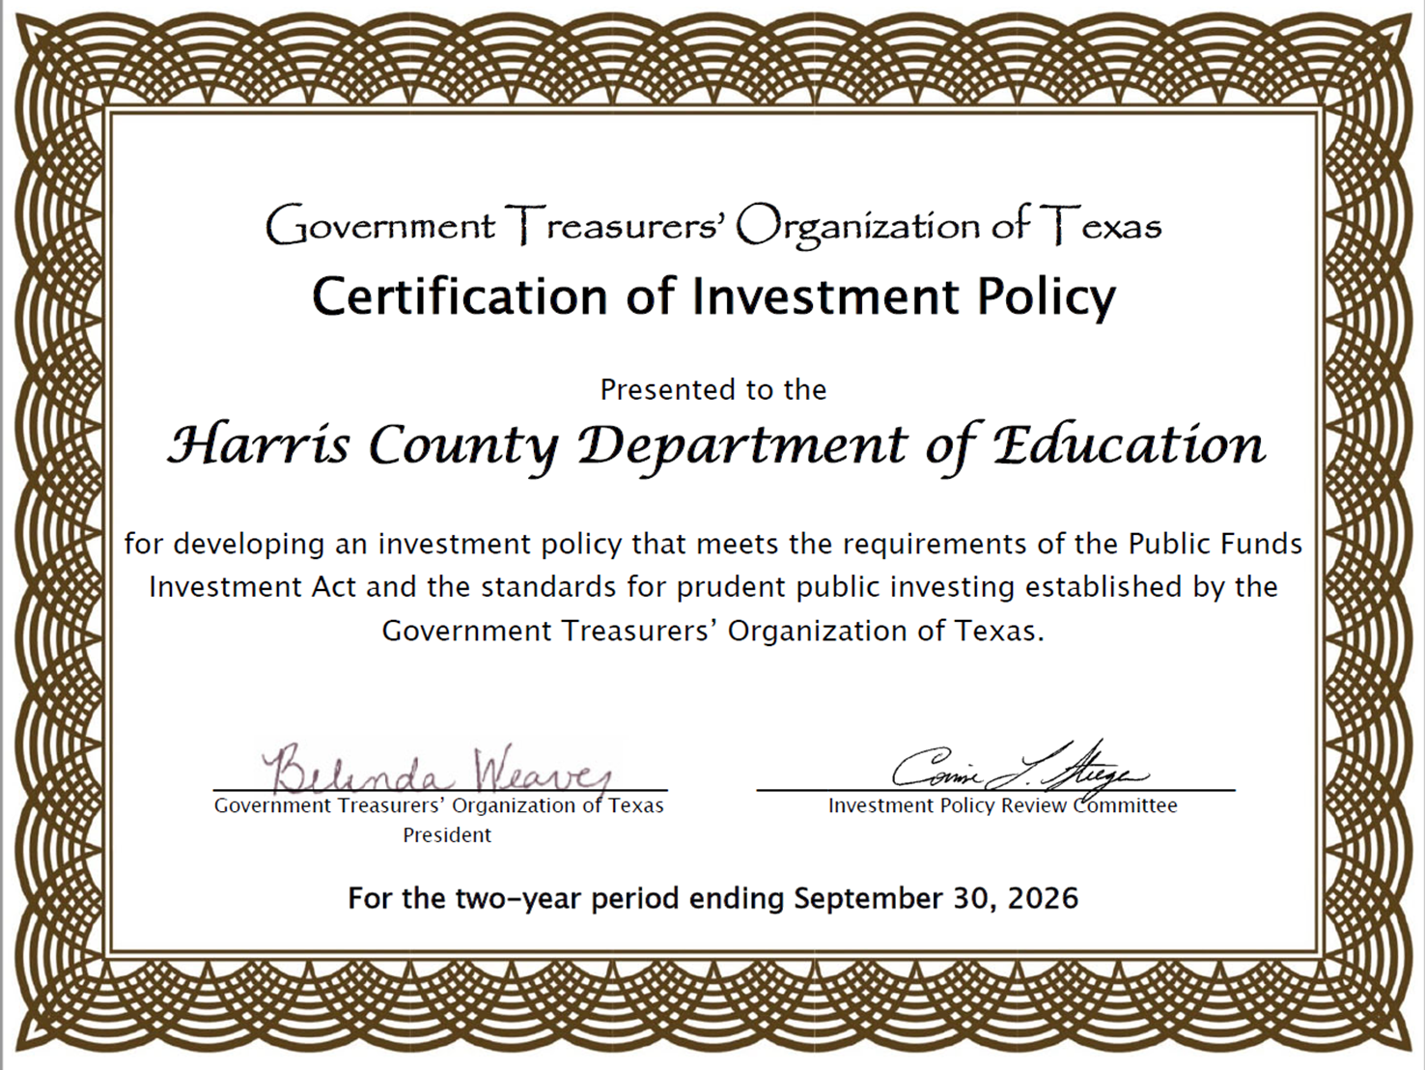

Slide 4
FEDERAL FUND RATE
The federal funds rate is the interest rate that banks charge other institutions for lending excess cash to them from their reserve balances overnight¹. It is set by the Federal Open Markets Committee and currently ranges from 4.25% to 4.50%². The Effective Federal Funds Rate is currently 4.33%, which is lower than the long-term average of 4.61%³. The Fed recently lowered the federal funds rate to a range of 4.25% to 4.5%⁵.
In January 2025, the Federal Reserve (Fed) kept the federal funds rate target at 4.25% to 4.50%, following three consecutive rate cuts at the end of 2024. The Fed now projects only two rate cuts in 2025.

Slide 5
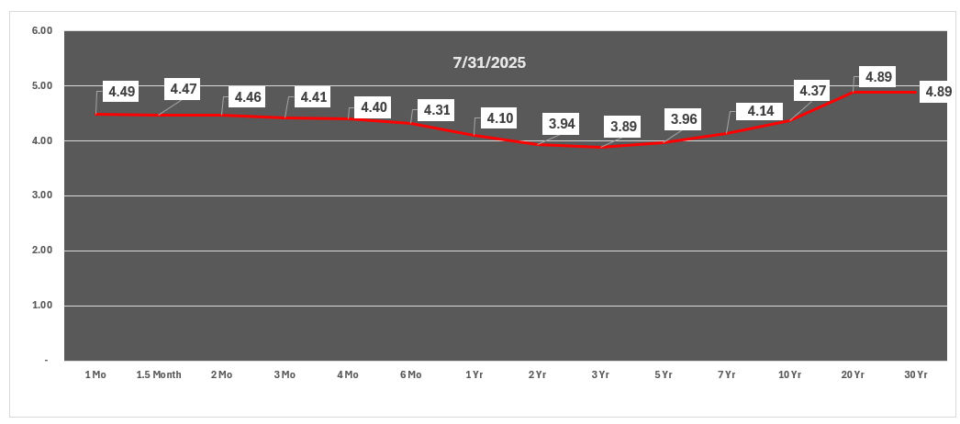
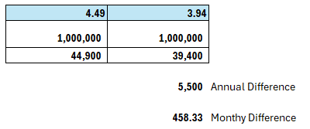
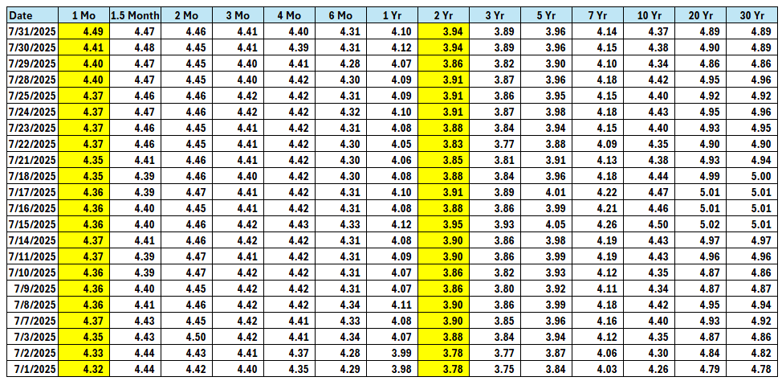
Treasury Rates

Slide 6
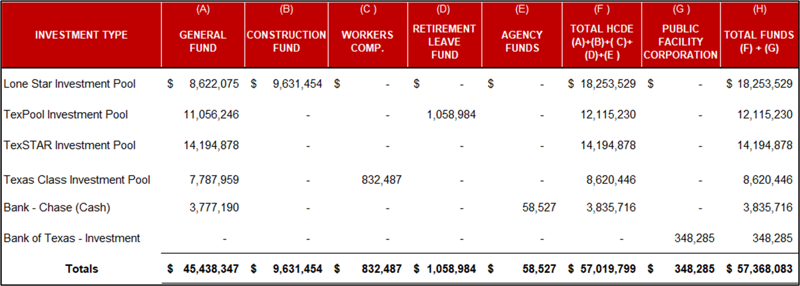
MONTHLY INVESTMENT REPORT (unaudited)
INVESTMENT BY FUND BY TYPE
As of July 31, 2025

Slide 7
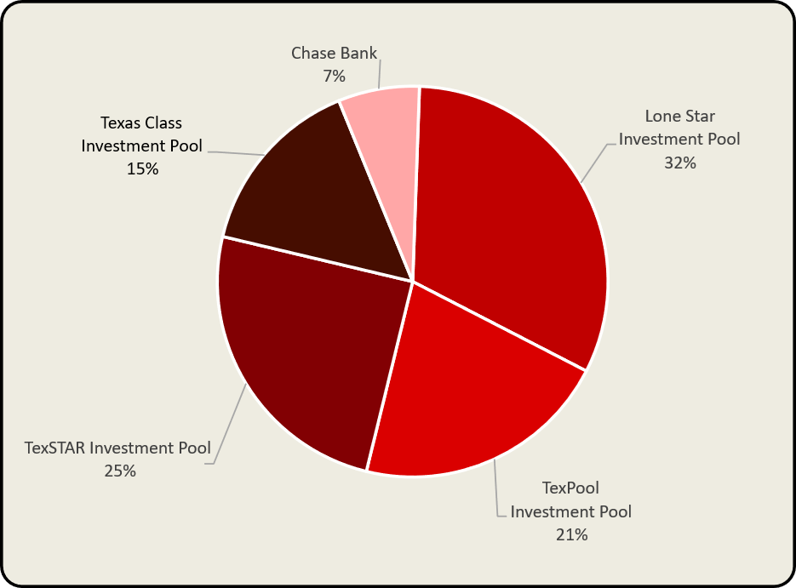
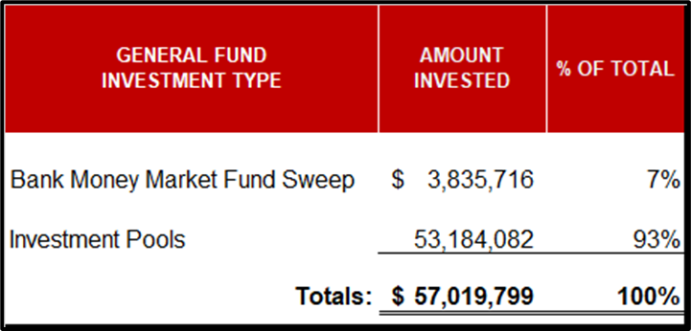
MONTHLY INVESTMENT REPORT (unaudited)
HCDE PORTFOLIO BY INVESTMENT TYPE
As of July 31, 2025

Slide 8
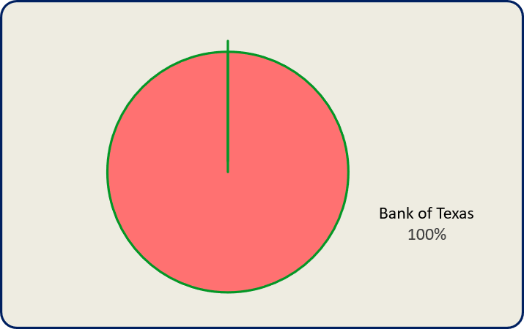
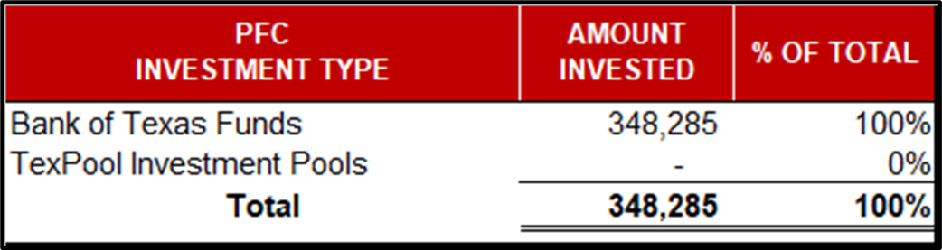
MONTHLY INVESTMENT REPORT (unaudited)
PFC PORTFOLIO BY INVESTMENT TYPE
As of July 31, 2025

Slide 9
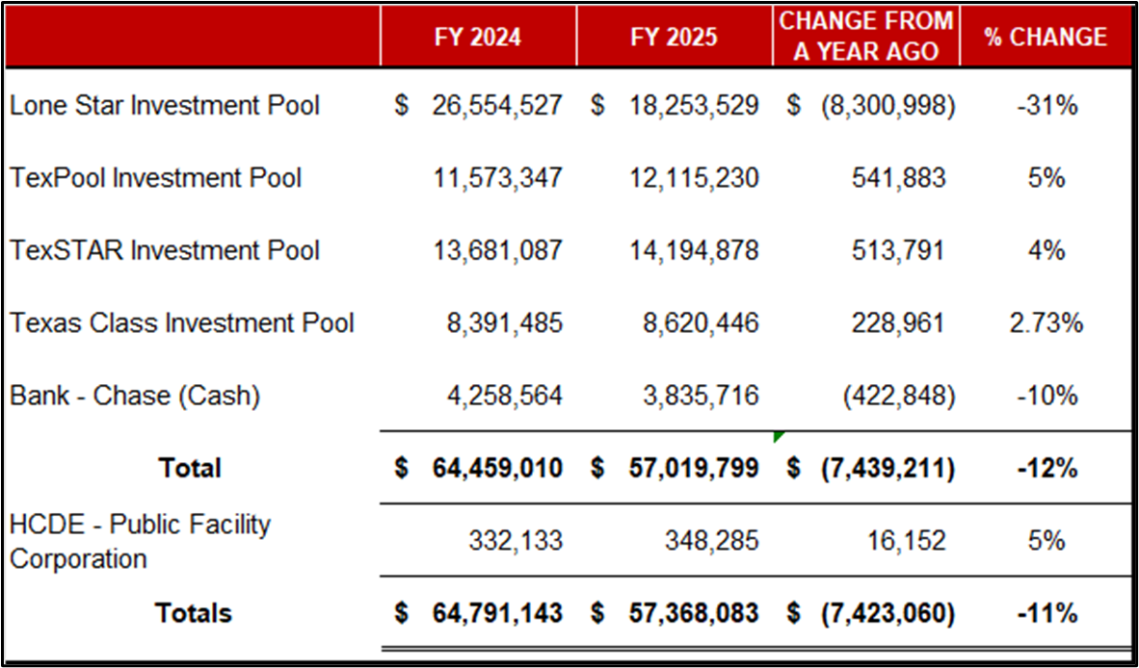
MONTHLY INVESTMENT REPORT (unaudited)
HCDE INVESTMENT PORTFOLIO COMPARISON
As of July 31, 2025

Slide 10
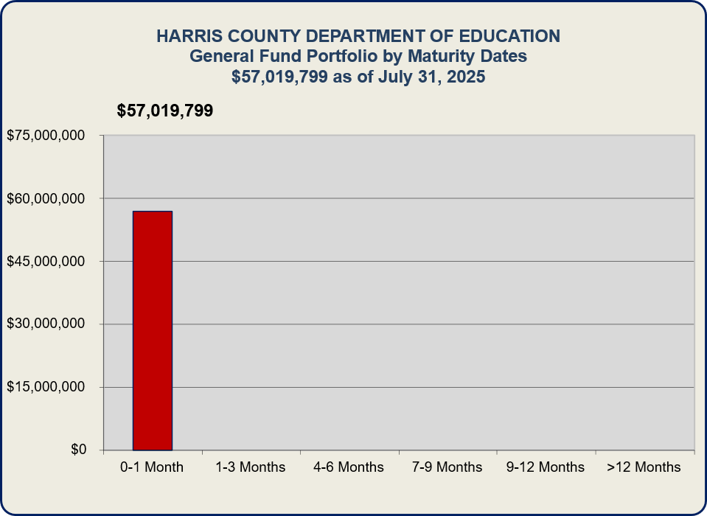
MONTHLY INVESTMENT REPORT (unaudited)
INVESTMENT PORTFOLIO MATURITY
As of July 31, 2025

Slide 11
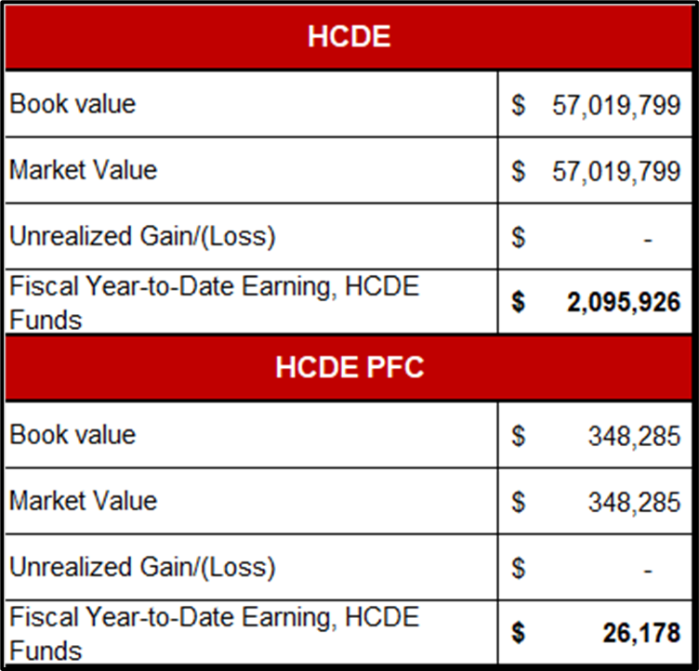
MONTHLY INVESTMENT REPORT (unaudited)
HCDE & PFC PORTFOLIO MARKET AND BOOK VALUE
As of July 31, 2025

Slide 12
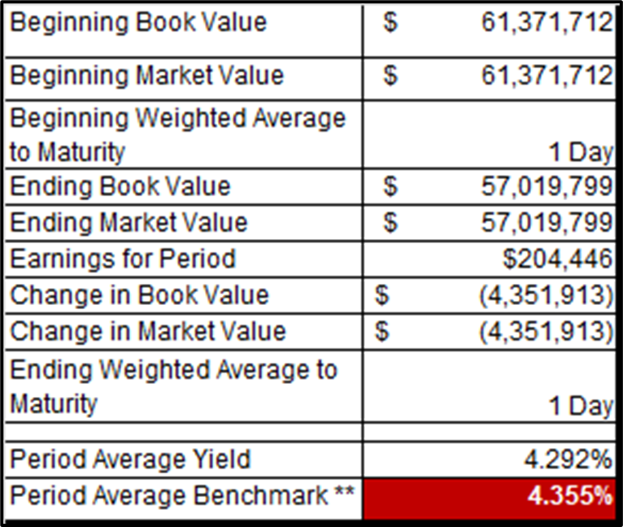
MONTHLY INVESTMENT REPORT (unaudited)
BEGINNING AND ENDING VALUES / WAM / YIELD
As of July 31, 2025
** Benchmark – 13 Week Treasury Bill at Maturity
Note: The Department also maintained an average of $3,631,694 during July 2025 to yield 4.355% in earnings credit resulting in Savings of $4,922.09

Slide 13
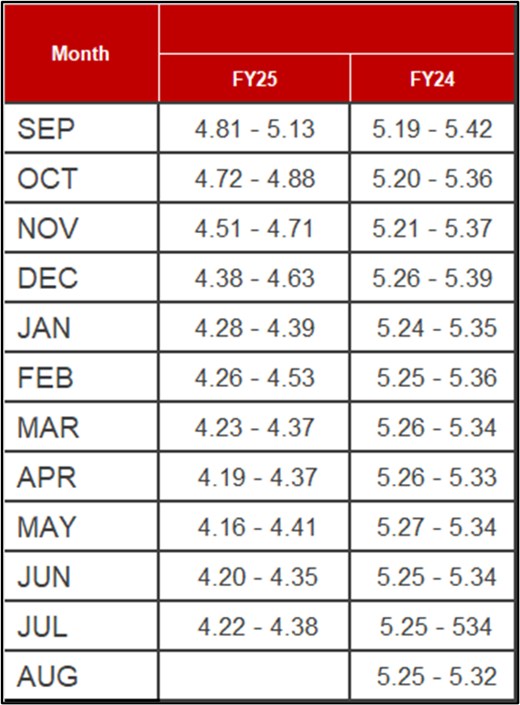
MONTHLY INVESTMENT REPORT (unaudited)
INVESTMENT INTEREST RATES AND EARNED YIELD
As of July 31, 2025

Slide 14
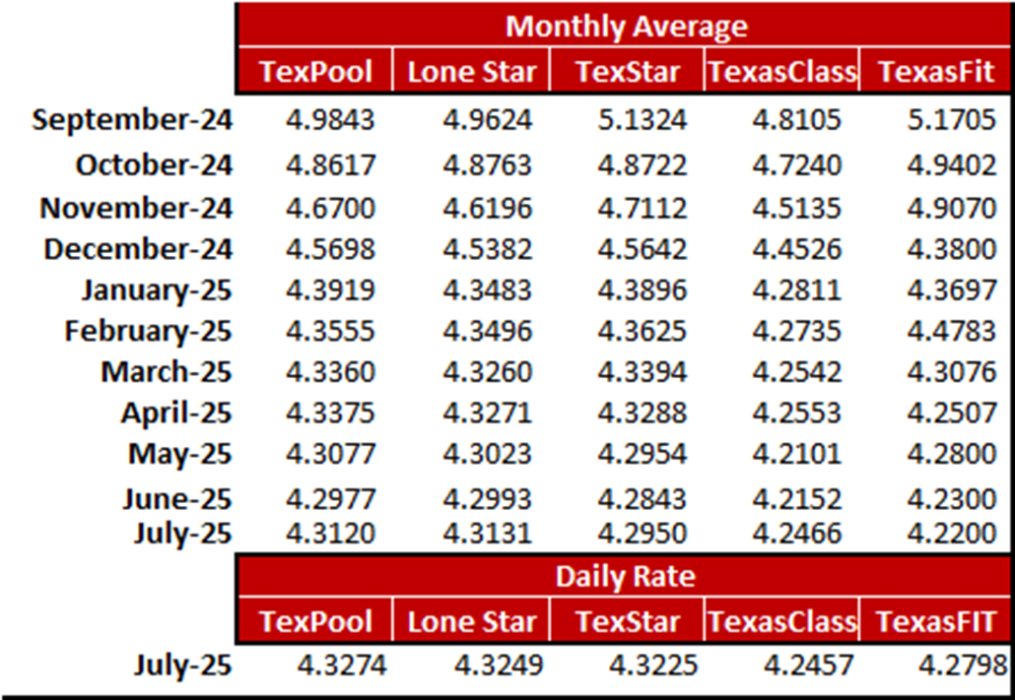
MONTHLY INVESTMENT REPORT (unaudited)
INVESTMENT INTEREST RATES AND EARNED YIELD
As of July 31, 2025

Slide 15





Q&A
I certify that the following information is true and accurate to the best of my knowledge.
/s/ Jesus Amezcua, Ph.D., CPA, RTSBA, CPFIM,
Assistant Superintendent for Business Services
/s/ Marcia Leiva, Chief Accounting Officer

