Slide 1


Financial Highlights
As of March 31, 2025

Slide 2

Highlights of Interim Financial Report (unaudited)
March 31, 2025

Slide 3




Posted on Our Website
Finance / Monthly Finance Reports (hcde-texas.org)
Linked from State Comptroller’s website
http://www.texastransparency.org/local/schools.php
3

Slide 4
Top 12 Highlights points for January 2025
9. Ed Foundation at $335K in Equity
10. 11% small business-March ‘25
11. 93% Irvington Project
12. Phase I Projects – just pending retainage release and closeout
13. Budget Process underway
$17.6M in tax revenue this month
Next Debt Svc payment in August
TOT Revenues at 60% Target of 58%
TOT Expenditures at 51% Target of 58%
$52.7M in Equity(F Bal) as of March 2025
$13,654 March Donations
Values at $661B out of $665B Projected
Choice at $6M Benefit Variance
Outlook Trend : Finance - Tax Revenues being received
Revenues and exp. Below target
Operations - Normal Operations and On Target
Policy - Stable
Legislative - On going
4

Slide 5

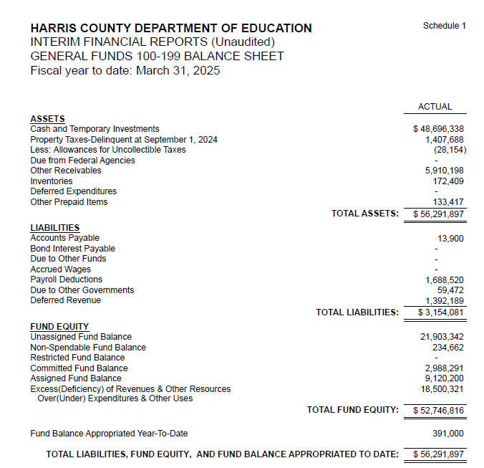
INTERIM FINANCIAL REPORT
(unaudited)
GENERAL FUND
Balance Sheet as of March 31, 2025
Total Assets:
$ 56,291,897
Total Liabilities:
$ 3,154,081
Total Fund Equity:
$ 52,746,816

Slide 6
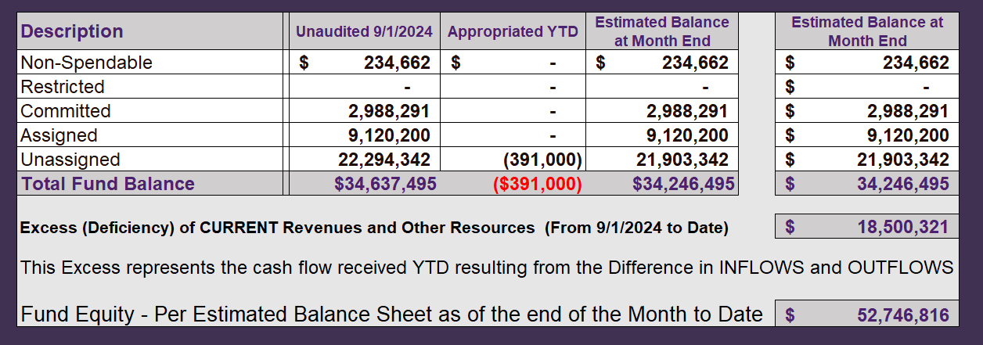
INTERIM FINANCIAL REPORT (unaudited)
ASST. SUPERINTENDENT FOR BUSINESS SERVICES MESSAGE
As of March 31, 2025
The ESTIMATED General Fund balance at 03/31/2025 is $52,746,816 after current appropriations.
As year end adjustments are completed, a budget amendment will be submitted to the board for items assigned, restricted and committed that will roll forward into FY 2025.
6

Slide 7
INTERIM FINANCIAL REPORT (unaudited)
As of March 31, 2025
Financial Ratios
Level One - Indicator of Financial Strength
Level Two - Indicator of Efficient Leverage
Level Three - Indicators of Efficiency
Level Four - Indicators of Revenue Growth

Slide 8
INTERIM FINANCIAL REPORT (unaudited)
As of March 31, 2025
Indicators of Financial Strength
Percent of Fund Balance to G/F
Expenditures Ratio
What is the percent of rainy-day fund balance?
(*) Unadjusted
Working Capital Ratio
What is the cash flow availability for the organization?
Unassigned Fund Balance $ 21,903,342
Total G/F Expenditures $ 38,315,775
Goal : > 30% of G/F Exp.
Benchmark: 10% to 29%
Danger: Under 10%
Goal : >$15,000,000
Benchmark : $10M to $15M
Danger : Under < $10M
Total Current Assets
Less Total Current Liabilities
$56,291,897-$3,154,081 =$53,137,816
57% FY25
45% FY24
$53M FY25
$46M FY24
Budgeted 29%
Details on Schedule 3
Budgeted $33M
Details on Schedule 1

Slide 9
INTERIM FINANCIAL REPORT (unaudited)
As of March 31, 2025
Indicators of Efficient Leverage Reserves
Unassigned Fund Balance Ratio
How much is available in reserves?
Debt to Income Ratio
What is the ability of HCDE to cover
its debt payments?
Unassigned Fund Balance $21,903,342
Total Fund Balance $53,137,816
Annual Principal and Interest Payments on
Term Debt and Capital Leases : $2,598,038
G/F Revenue Less Facility $56,816,093-4,145,268
Charges :
Goal: <75%
Benchmark: 50% to 75%
Danger: <50%
Goal: <25% of annual revenue
Benchmark: 25% to <49%
Danger: Over > 50%
41% FY25
35% FY24
4.93% FY25
4.21% FY24
Budgeted 65%
Details on Schedule 1
Budgeted 5%
Details on Schedule 5

Slide 10
INTERIM FINANCIAL REPORT (unaudited)
As of March 31, 2025
Indicators of Efficiency
Tax Revenue to Total Revenue Ratio
How efficient is HCDE at leveraging local
taxes? (Current)
Indirect Cost to Tax Ratio
How much dependency on indirect cost from grants?
Current Tax Revenue $30,371,414
Indirect Cost General Fund $1,352,696
Total Revenue $ 88,220,589
Total General Fund Revenues $56,816,093
Total General Fund Revenues $1,306,381
Goal: <20% of revenue
Benchmark: 20% to 30%
Danger: Over >30%
Goal: >5%
Benchmark: 2% to 5%
Danger: Under < 2%
Goal: >5%
Benchmark: 2% to 5%
Danger: Under < 2%
34% FY25
29% FY24
2.4% FY25
1.9% FY24
Budgeted 22%
Details on Schedule 2
Budgeted 3.6%
Details on Schedule 3

Slide 11
INTERIM FINANCIAL REPORT (unaudited)
As of March 31, 2025
Indicators of Revenue Growth
Fee for Service Revenue Ratio
How are revenues spread across all Funds?
Fee for Service Revenue Growth Ratio
What is the market growth for fee on services?
Total Fee for Service Revenues (G/F) $17,599,495
Total Revenues $88,220,589
Fee for Service Current Year Less Fee for Services Last Year $17,599,495-19,911,564
Fees for Service Last Year $19,911,564
Goal: >30% of annual revenue Benchmark: 10% to 29%
Danger: Under 10%
Goal: >3% of + growth
Benchmark: 0% to 3%
Danger: Under 0%
19% FY25
19% FY24
-11% FY25
28% FY24 ​
Budgeted 39%
Details on Schedule 14
Budgeted 17%
Details on Schedule 14

Slide 12
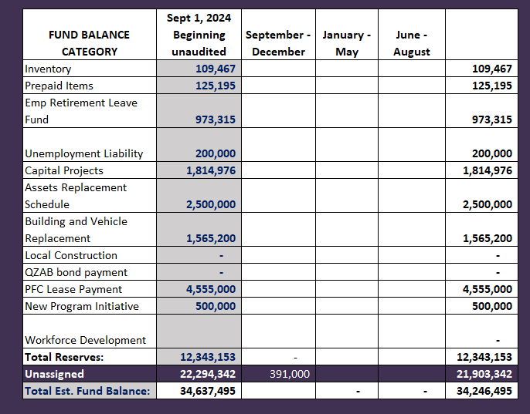
FY 2024-2025
Fund Balance
-
Budgeted Activity

Slide 13
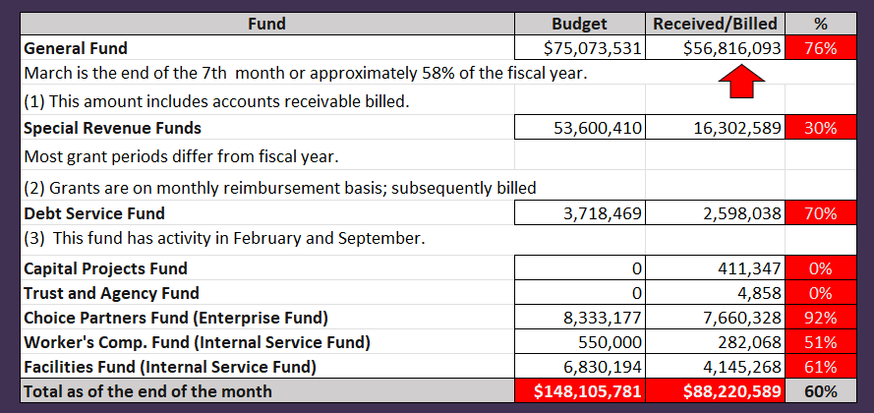
INTERIM FINANCIAL REPORT (unaudited)
GENERAL, SPECIAL REVENUE, DEBT SERVICE FUNDS, CAPITAL PROJECTS,
AND INTERNAL SERVICE FUNDS
REVENUES (INFLOWS)
Budget to Actual for period ending March 31, 2025

Slide 14
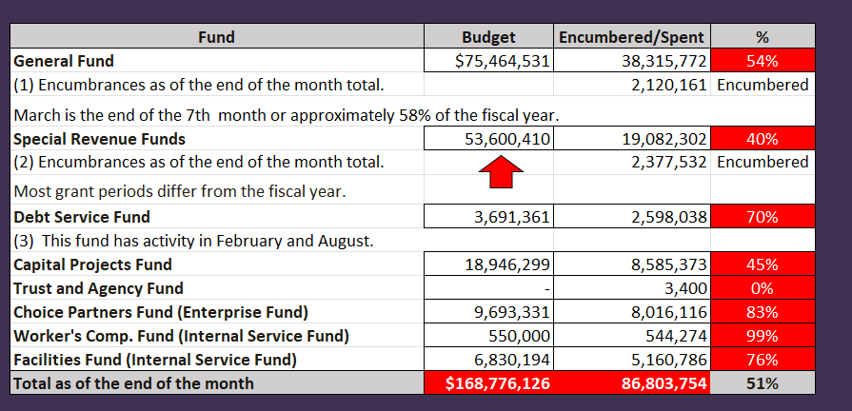
INTERIM FINANCIAL REPORT (unaudited)
GENERAL, SPECIAL REVENUE, DEBT SERVICE FUNDS, CAPITAL PROJECTS,
AND INTERNAL SERVICE FUNDS
Expenditures (OUTFLOWS)
Budget to Actual for period ending March 31, 2025

Slide 15
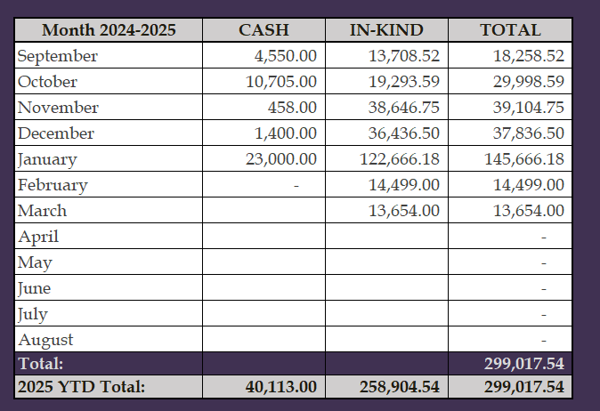
INTERIM FINANCIAL REPORT (unaudited)
FY 2024-25 Donations Report
All Funds as of March 31, 2025

Slide 16
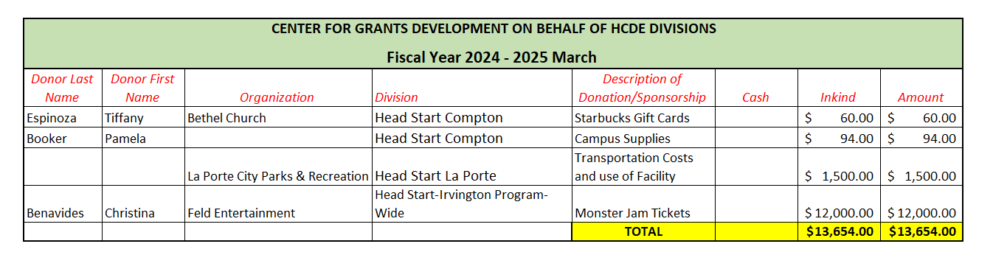
INTERIM FINANCIAL REPORT (unaudited)
FY 2024-25 Donations Report
All Funds as of March 31, 2025

Slide 17
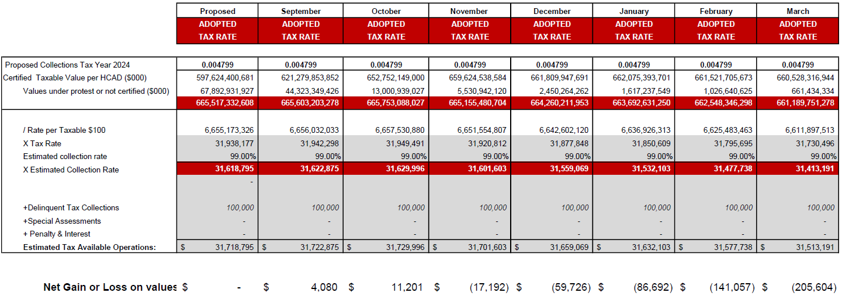
INTERIM FINANCIAL REPORT (unaudited)
TAX COLLECTIONS COMPARATIVE ANALYSIS
Fiscal Year-To-Date as of March 31, 2025
$661 B
See Tax Calculator at:
https://hcde-texas.org/transparency/tax-rate/

Slide 18
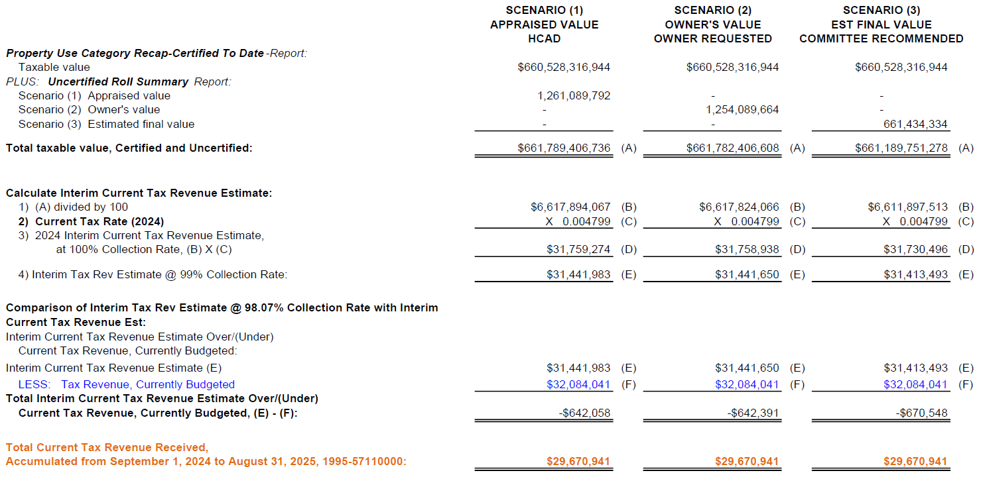
INTERIM FINANCIAL REPORT (unaudited) TAX COLLECTIONS
Fiscal Year-To-Date as of March 31, 2025
(7th month / 12 months)

Slide 19
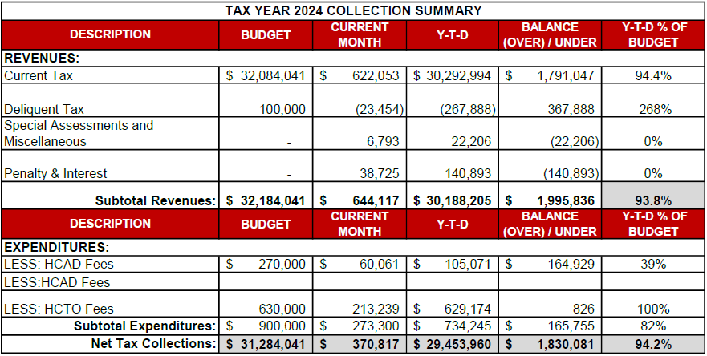
INTERIM FINANCIAL REPORT (unaudited) TAX COLLECTIONS
Fiscal Year-To-Date as of March 31, 2025
(7th month / 12 months)
a) 2024 Approved Tax Rate = $0.004799/$100 Property Assessment/Appraisal - --> Annual Tax on a $259,375 - $51,875 = $207,500/100
x .004799 = $9.958 (net of 20% homestead exception.)
b) $850,000/$32,184,041 = 2.64% Collection and assessment costs

Slide 20
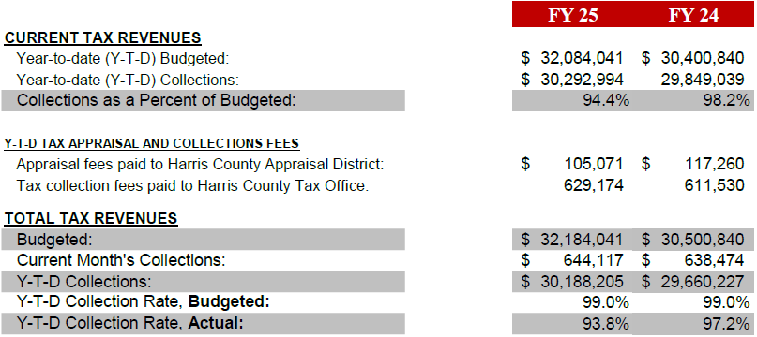
INTERIM FINANCIAL REPORT (unaudited) TAX COLLECTIONS
Fiscal Year-To-Date as of March 31, 2025
(7th month / 12 months)
a) 2024 Approved Tax Rate = $0.004799/$100 Property Assessment/Appraisal - --> Annual Tax on a $259,375 - $51,875 = $207,500/100
x .004799 = $9.958 (net of 20% homestead exception.)
b) $850,000/$32,184,041 = 2.64% Collection and assessment costs

Slide 21
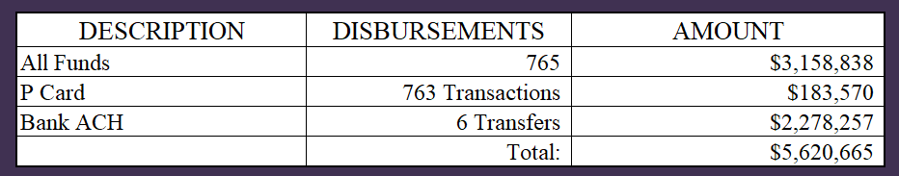
INTERIM FINANCIAL REPORT (unaudited)
DISBURSEMENT – ALL FUNDS
March 31, 2025
Notes:
All Purchase Orders and Payment Authorizations are reviewed before disbursement.
All Procurement Card charges are reviewed by cardholder, supervisor, and business office staff each month.
A report on CH Local Expenditures is included in the monthly report.

Slide 22
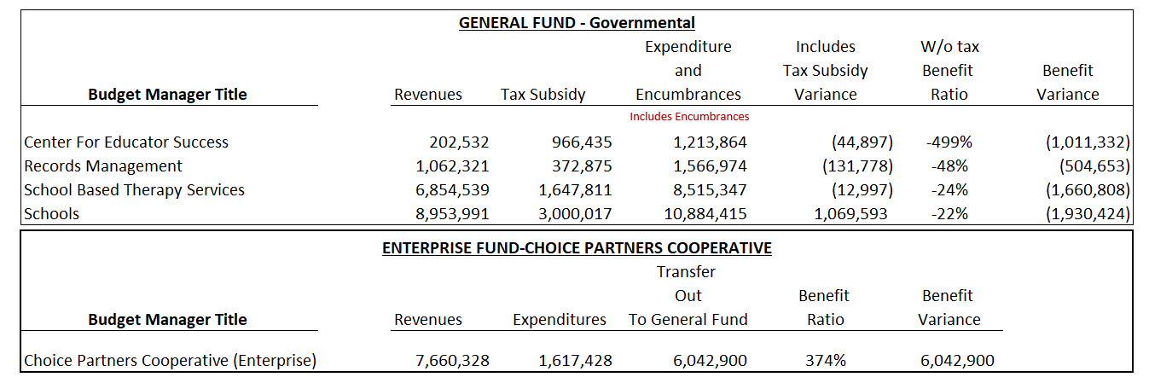
INTERIM FINANCIAL REPORT (unaudited)
Segment Division Data
As of March 31, 2025

Slide 23

HIGHLIGHTS OF BUDGET AMENDMENT REPORT
April 16th, Board Meeting
(unaudited)

Slide 24

Education Foundation Update
March 31, 2025
24

Slide 25
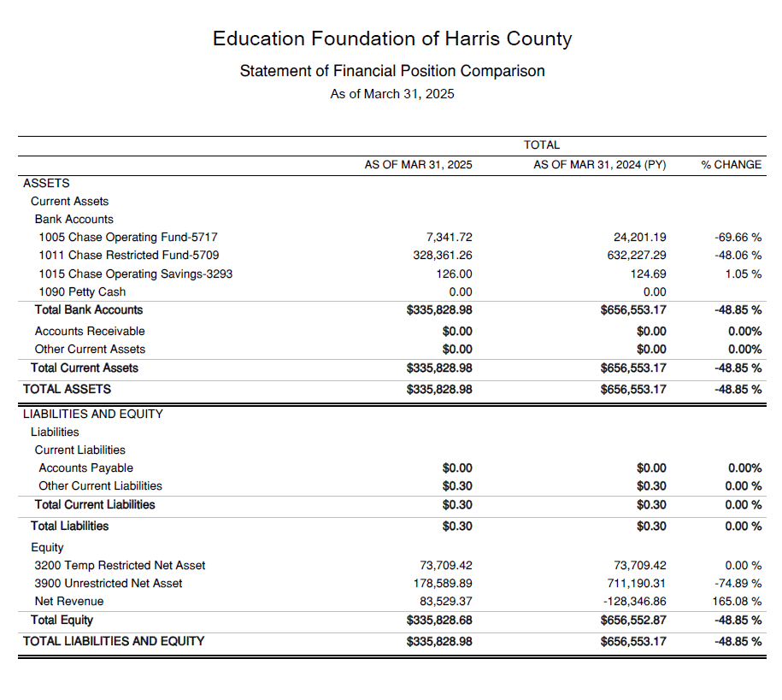
Statement of Financial Position
Net Equity
$335,828

Slide 26
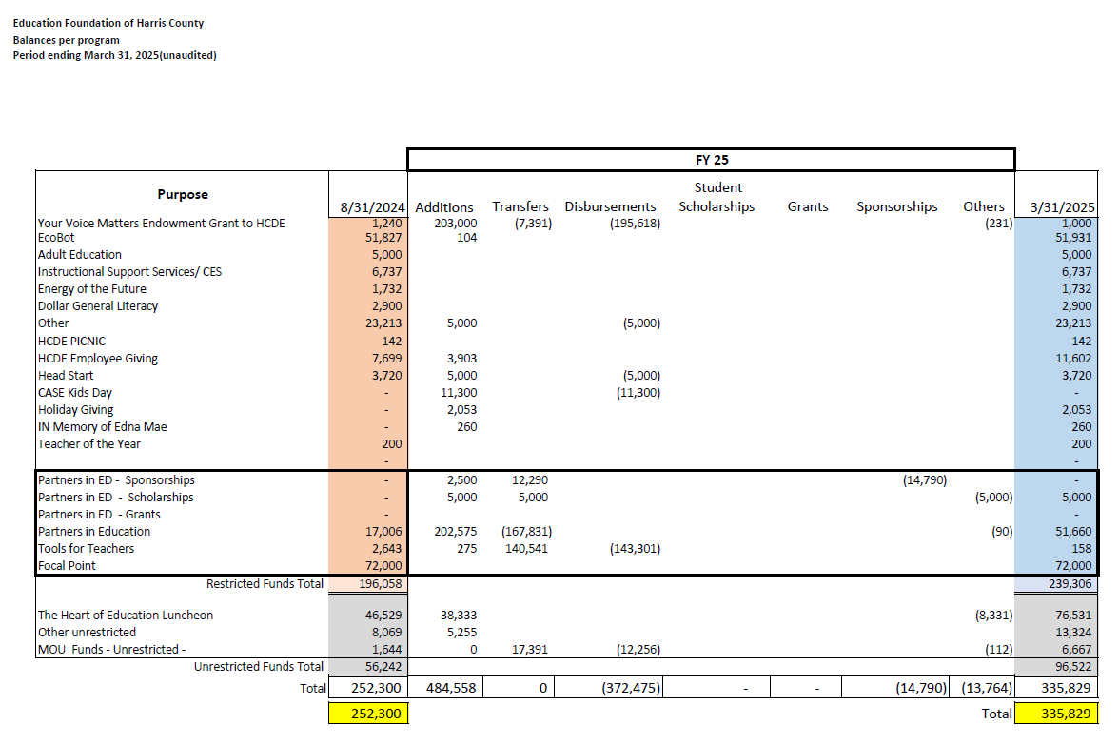
Ed Foundation Balances Per Program

Slide 27
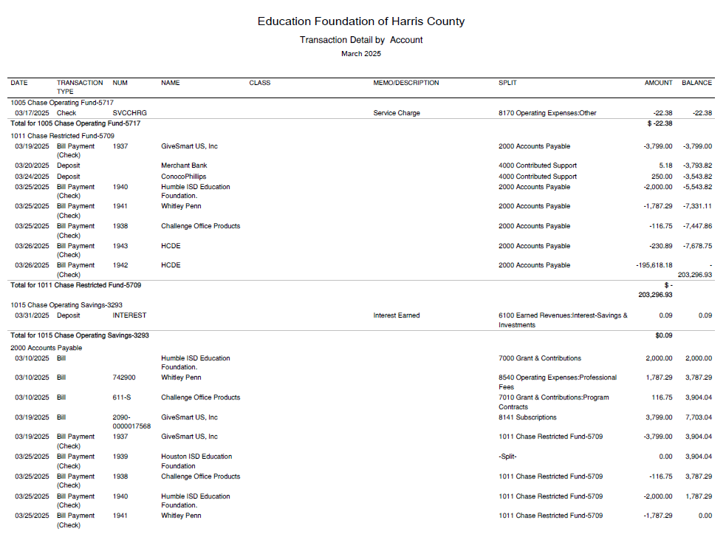
Transaction Detail by Inflow & Outflow

Slide 28
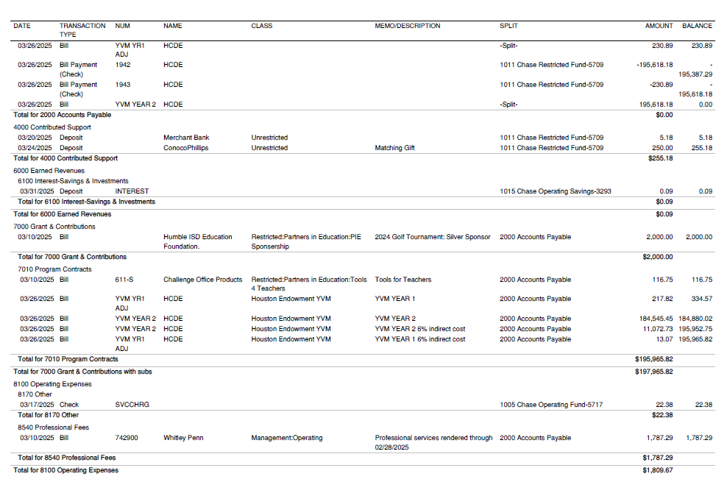
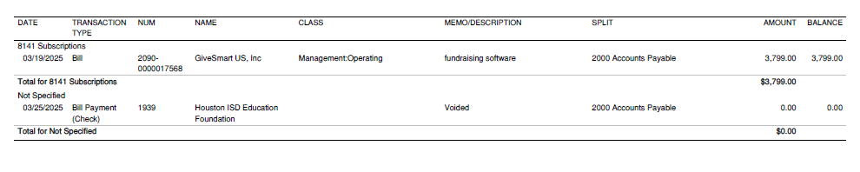
Transaction Detail by Inflow & Outflow

Slide 29

PFC & Lease Revenue Projects Update
March 31, 2025
29

Slide 30

Small Business Report
09/01/24 to 03/31/25
FY 2024-2025
By
Dr. Edna E. Johnson
Procurement Director

Slide 31
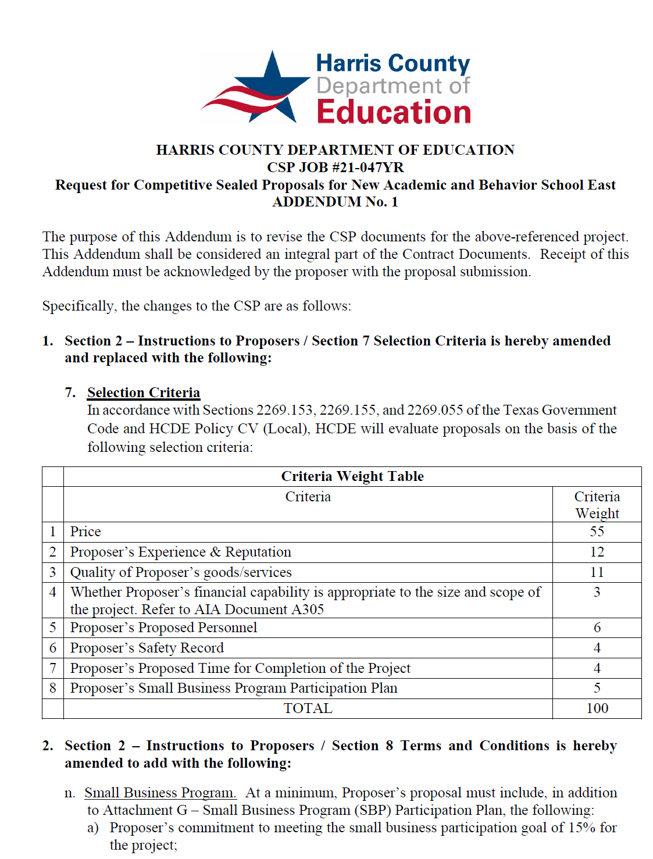
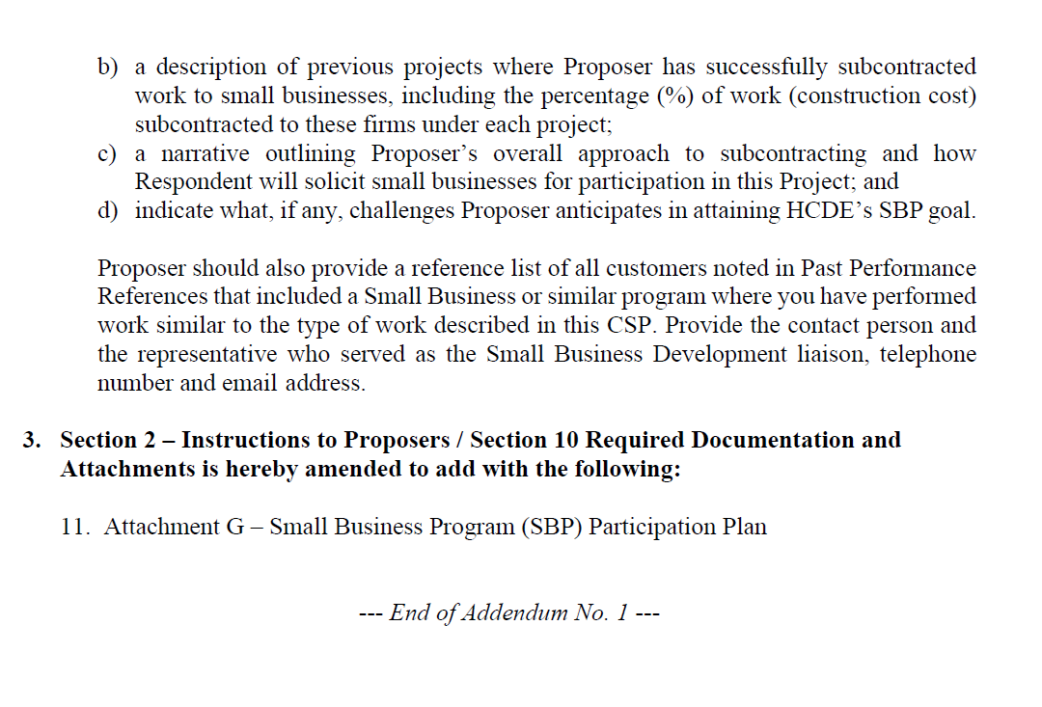
Small Business
for Construction
Launch industry's first collaboration feature
This is our plan as we launch the industry's first collaboration feature

Slide 32
Content
Definitions
Certifying Agencies
Small Business Expenditures for Year to Date (09/01/24 to 03/31/25 FY24-25)
Participation Graphics
List of Small Business Activity
32

Slide 33
Definitions
HUB – Historically Underutilized Business is a business entity in which at least fifty-one percent ownership is by a woman, minority, and/or service-disabled veteran.
MBE – Minority Business Enterprise are fifty-one percent owned, operated and controlled by a minority group.
SBE – Small Business Enterprise are private corporations, partnerships, or sole proprietorships with 500 or fewer employees.
WBE – Woman Business Enterprise is fifty-one percent owned and controlled by one or more women who are U.S. citizens or Legal Resident Aliens.
33

Slide 34
Certifying Agencies
  City of Houston
  Houston Metropolitan Transit Authority
  Port of Houston
  South Central Texas Regional Certification Agency
  Note: HCDE is not a certifying agency. HCDE accepts the certification processed through the 4 agencies above. HCDE has a small participation program for construction only. This report is to report participation from small business and all other entities.
34

Slide 35
09/01/24 to 03/31/25
Expenditures FY 24-25
Small Business $1,463,812
Non-Small Business $11,711,864
Total Business = $13,175,676
Govt and Utilities $3,627,011
Total Expenditures = $16,802,687
Small Business $1,463,812
divided by
Total Business $13,175,676
11% Ratio Small/Large
35

Slide 36
09/01/2024 – 03/31/2025
Small Business Amounts by Certifying Agency
Name of Agency
City of Houston $861,876
Houston Metropolitan Transit Authority $265,199
Port of Houston $336,737
Total $1,463,812
36

Slide 37
09/01/24 – 03/31/25
Small Business Participation by Certification Type
Certification Type
SBE | $851,807
HUB | $45,848
MBE | $533,815
WBE | $32,342
 | $1,463,812
37

Slide 38
09/01/24 – 03/31/25
Small Business Participation by Ethnicity
Certified Small Business by Ethnicity
Asian $286,976 20%
Black $373,134 25%
Caucasian $54,494 4%
Hispanic $749,208 51%
$1,463,812
38

Slide 39
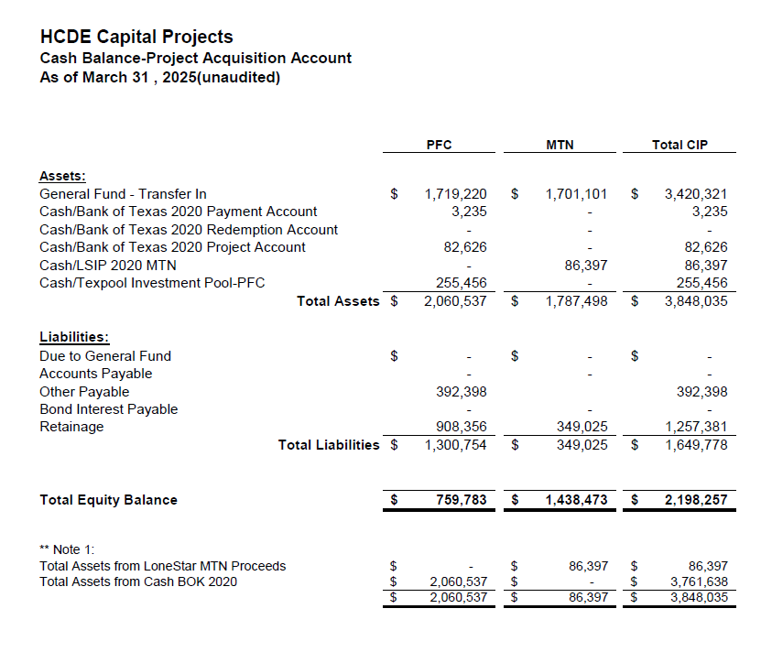

AB East School Contract $12,358,000 Awarded
Adult Ed Center Contract $15,121,000 Awarded on Oct 2021 Board Mtg
HP East Contract $7,271,000 Awarded on Nov 2021
Irvington – $11,172,589 Awarded on Jan 2024
Cash Balance –
Project Acquisition Account
As of March 31, 2025
39

Slide 40
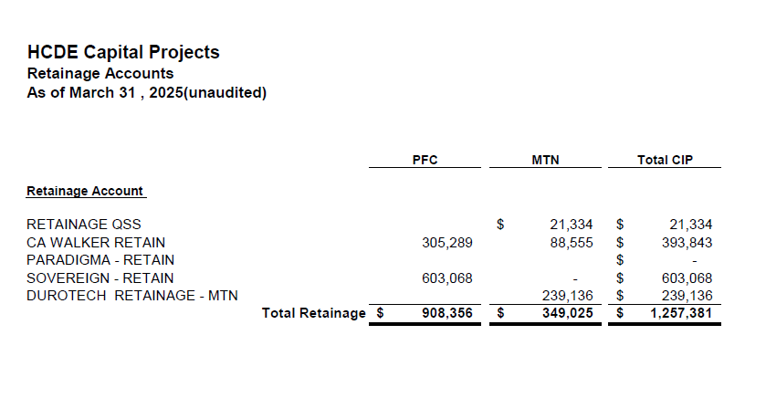
2020 MTN NOTES/2020 PFC BONDS
Pending Retainage Payable
Retainage Payable
Project Acquisition Account
As of March 31, 2025
40

Slide 41
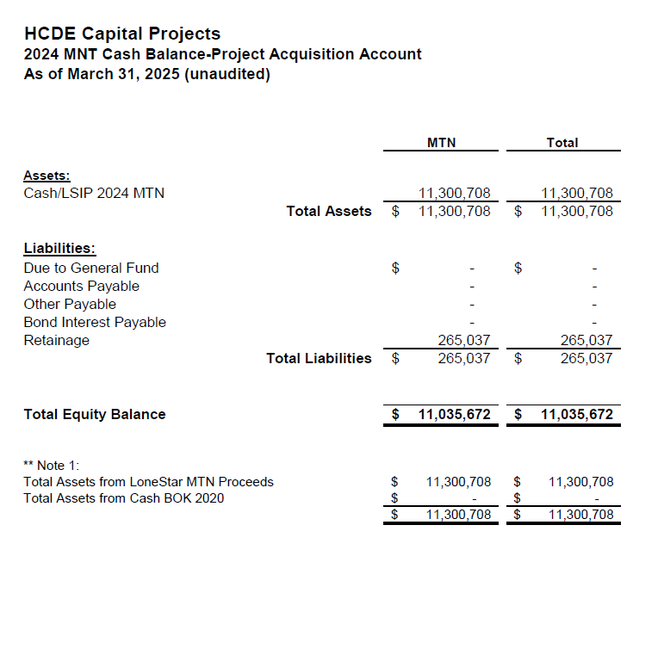
AB West $333,000 March 2024 Board Mtg
HS Barrett Station $470,000 March 2024 Board Mtg
Fortis Academy $650,000 March 2024 Board Mtg
Irvington – $9,860,000 March 2024 Board Mtg
Post Oak - $5,000,000 March 2024 Board Mtg
$16,313,000
Cash Balance –
2024 Maintenance Notes
As of March 31, 2025
41

Slide 42
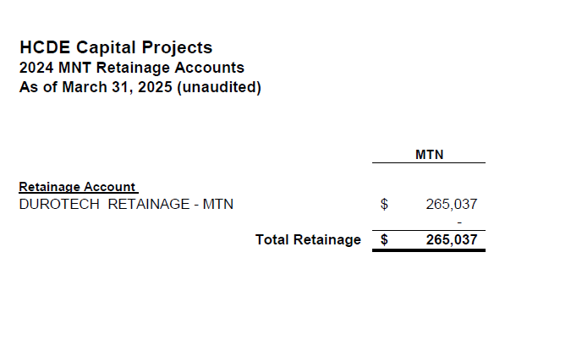
AB West $333,000 March 2024 Board Mtg
HS Barrett Station $470,000 March 2024 Board Mtg
Fortis Academy $650,000 March 2024 Board Mtg
Irvington – $9,860,000 March 2024 Board Mtg
Post Oak - $5,000,000 March 2024 Board Mtg
$16,313,000
Retainage Payable
2024 Maintenance Notes
As of March 31, 2025
42

Slide 43
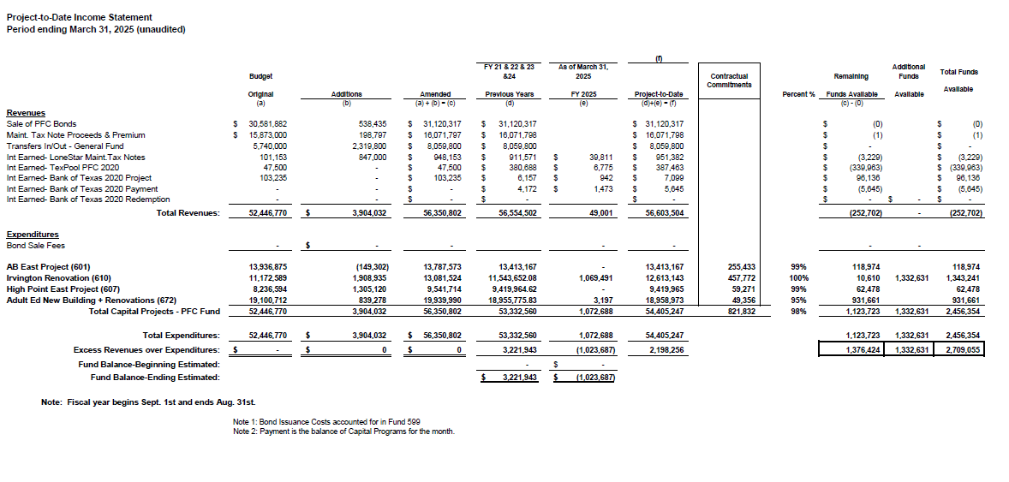
Income Statement– Project Acquisition Account
As of March 31, 2025
43

Slide 44
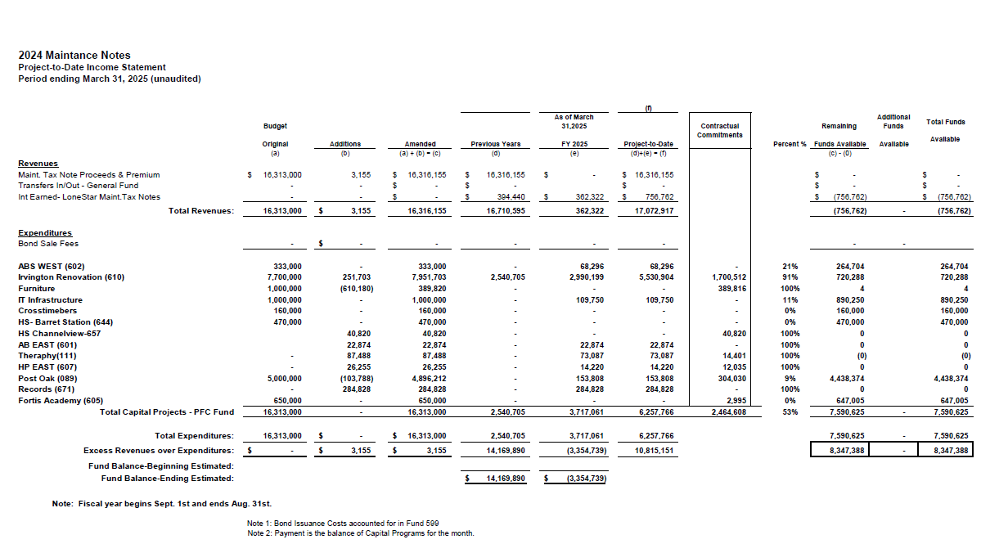
Income Statement– 2024 MNT NOTES
As of March 31, 2025
44

Slide 45
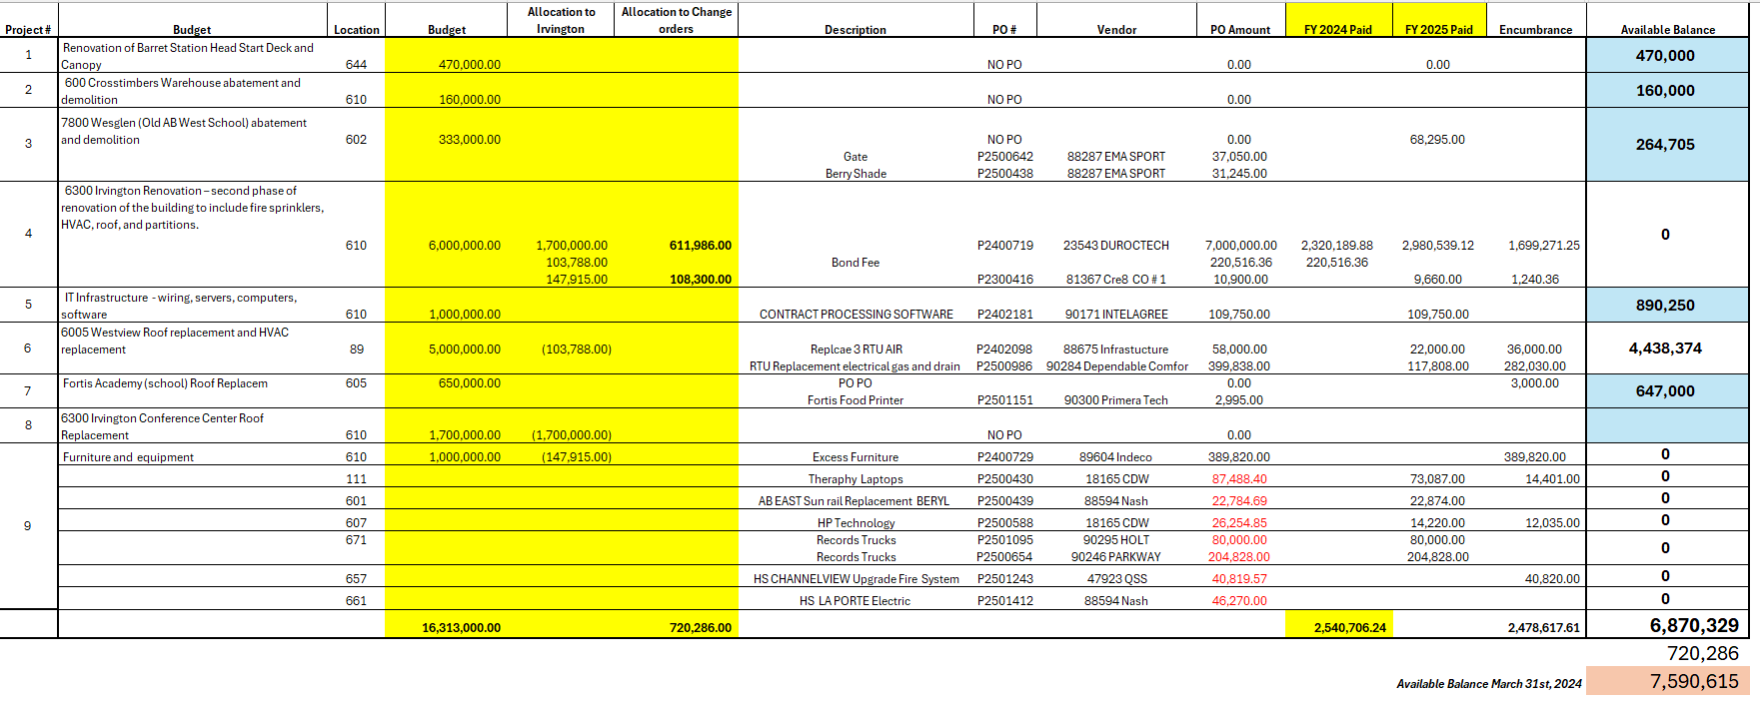
Maintenance Notes 2024 – Projects

Slide 46
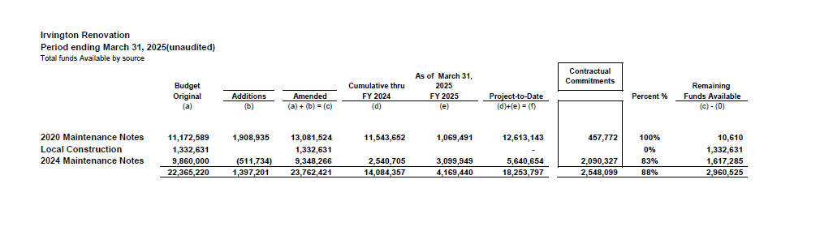
Irvington Renovation – Funds by Source
As of March 31, 2025
Irvington Renovation 2020 Maintenance Notes $ 4,781,519
Contract 2024 Maintenance Notes $ 7,000,000
Total $11,781,519
46

Slide 47

Interim Financial Report (unaudited)
I certify that the foregoing information is true and accurate to the best of my knowledge.
/s/ Jesus J. Amezcua, RTSBA,CPA, Ph.D., CPFIM, Asst. Supt. for Business Support Services
/s/ Marcia Leiva, Chief Accounting Officer

