Slide 1


Financial Highlights
As of November 30, 2024

Slide 2

Highlights of Interim Financial Report (unaudited)
November 30, 2024

Slide 3




Posted on Our Website
Finance / Monthly Finance Reports (hcde-texas.org)
Linked from State Comptroller’s website
http://www.texastransparency.org/local/schools.php

Slide 4

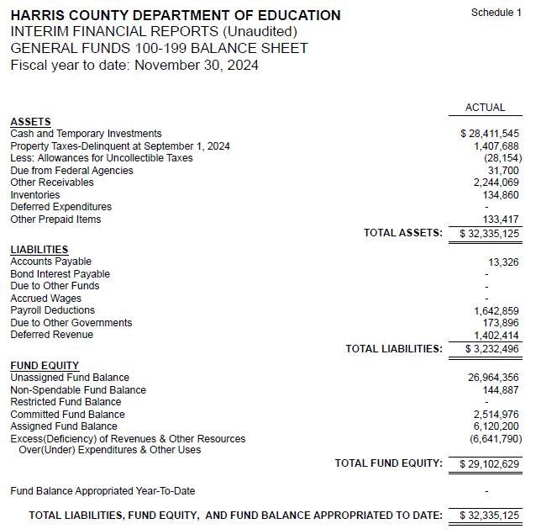
INTERIM FINANCIAL REPORT
(unaudited)
GENERAL FUND
Balance Sheet as of November 30, 2024
Total Assets:
$ 32,335,125
Total Liabilities:
$ 3,232,496
Total Fund Equity:
$ 29,102,629

Slide 5
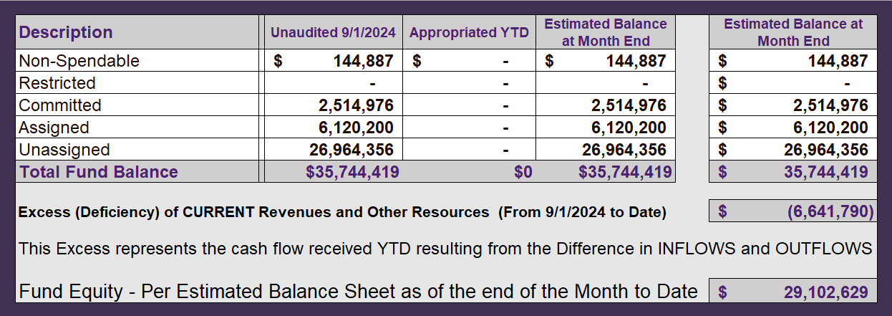
INTERIM FINANCIAL REPORT (unaudited)
ASST. SUPERINTENDENT FOR BUSINESS SERVICES MESSAGE
As of November 30, 2024
The ESTIMATED General Fund balance at 10/31/2024 is $29,102,629 after current appropriations.
As year end adjustments are completed, a budget amendment will be submitted to the board for items assigned, restricted and committed that will roll forward into FY 2025.

Slide 6
INTERIM FINANCIAL REPORT (unaudited)
As of November 30, 2024
Financial Ratios
Level One - Indicator of Financial Strength
Level Two - Indicator of Efficient Leverage
Level Three - Indicators of Efficiency
Level Four - Indicators of Revenue Growth

Slide 7
INTERIM FINANCIAL REPORT (unaudited)
As of November 30, 2024
Indicators of Financial Strength
Percent of Fund Balance to G/F
Expenditures Ratio
What is the percent of rainy-day fund balance?
(*) Unadjusted
Working Capital Ratio
What is the cash flow availability for the organization?
Unassigned Fund Balance $ 26,964,356
Total G/F Expenditures $ 15,528,269
Goal : > 30% of G/F Exp.
Benchmark: 10% to 29%
Danger: Under 10%
Goal : >$15,000,000
Benchmark : $10M to $15M
Danger : Under < $10M
Total Current Assets
Less Total Current Liabilities
$32,335,125-3,232,496=29,102,629
173% FY25
138% FY24
$29M FY25
$23M FY24
Budgeted 24%
Details on Schedule 3
Budgeted $33M
Details on Schedule 1

Slide 8
INTERIM FINANCIAL REPORT (unaudited)
As of November 30, 2024
Indicators of Efficient Leverage Reserves
Unassigned Fund Balance Ratio
How much is available in reserves?
Debt to Income Ratio
What is the ability of HCDE to cover
its debt payments?
Unassigned Fund Balance $26,964,356
Total Fund Balance $29,102,629
Annual Principal and Interest Payments on
Term Debt and Capital Leases : $0
G/F Revenue Less Facility $8,886,479-2,203,975
Charges :
Goal: <75%
Benchmark: 50% to 75%
Danger: <50%
Goal: <25% of annual revenue
Benchmark: 25% to <49%
Danger: Over > 50%
93% FY25
86% FY24
0 % FY25
0% FY24
Budgeted 71%
Details on Schedule 1
Budgeted 6%
Details on Schedule 5

Slide 9
INTERIM FINANCIAL REPORT (unaudited)
As of November 30, 2024
Indicators of Efficiency
Tax Revenue to Total Revenue Ratio
How efficient is HCDE at leveraging local
taxes? (Current)
Indirect Cost to Tax Ratio
How much dependency on indirect cost from grants?
Current Tax Revenue $ 800
Indirect Cost General Fund $425,306
Total Revenue $ 19,582,240
Total General Fund Revenues $8,886,479
Total General Fund Revenues $1,306,381
Goal: <20% of revenue
Benchmark: 20% to 30%
Danger: Over >30%
Goal: >5%
Benchmark: 2% to 5%
Danger: Under < 2%
Goal: >5%
Benchmark: 2% to 5%
Danger: Under < 2%
0% FY25
0% FY24
4.8% FY25
3.3% FY24
Budgeted 25%
Details on Schedule 2
Budgeted 2.5%
Details on Schedule 3

Slide 10
INTERIM FINANCIAL REPORT (unaudited)
As of November 30, 2024
Indicators of Revenue Growth
Fee for Service Revenue Ratio
How are revenues spread across all Funds?
Fee for Service Revenue Growth Ratio
What is the market growth for fee on services?
Total Fee for Service Revenues (G/F) $4,679,690
Total Revenues $19,582,240
Fee for Service Current Year Less Fee for Services Last Year $4,679,690 - 8,659,807
Fees for Service Last Year $8,659,807
Goal: >30% of annual revenue Benchmark: 10% to 29%
Danger: Under 10%
Goal: >3% of + growth
Benchmark: 0% to 3%
Danger: Under 0%
23% FY25
41% FY24
-45% FY25
46% FY24 ​
Budgeted 19%
Details on Schedule 14
Budgeted 17%
Details on Schedule 14

Slide 11
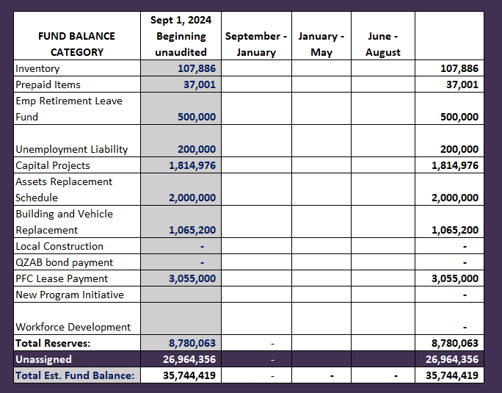
FY 2024-2025
Fund Balance
-
Budgeted Activity

Slide 12
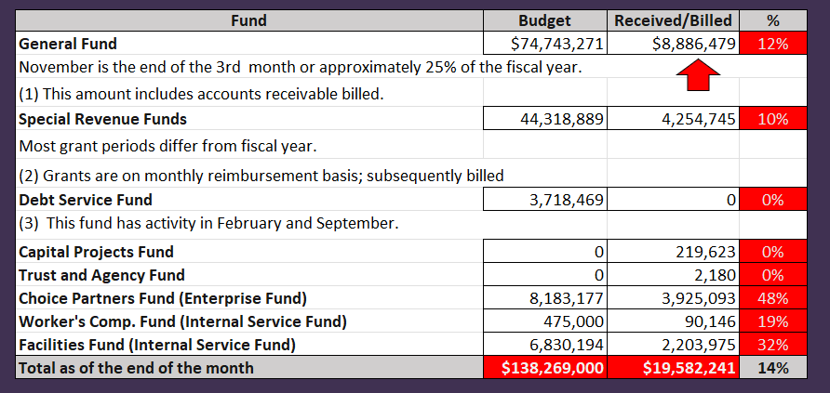
INTERIM FINANCIAL REPORT (unaudited)
GENERAL, SPECIAL REVENUE, DEBT SERVICE FUNDS, CAPITAL PROJECTS,
AND INTERNAL SERVICE FUNDS
REVENUES (INFLOWS)
Budget to Actual for period ending November 30, 2024

Slide 13
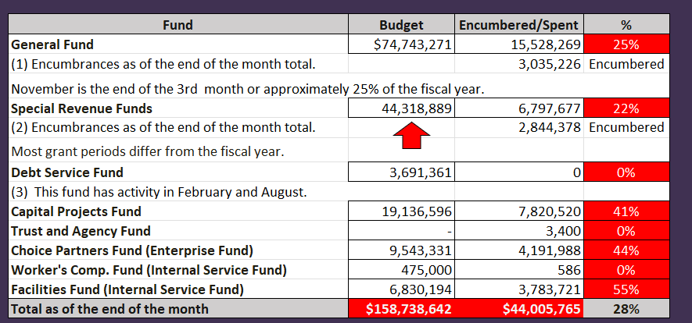
INTERIM FINANCIAL REPORT (unaudited)
GENERAL, SPECIAL REVENUE, DEBT SERVICE FUNDS, CAPITAL PROJECTS,
AND INTERNAL SERVICE FUNDS
Expenditures (OUTFLOWS)
Budget to Actual for period ending November 30, 2024

Slide 14
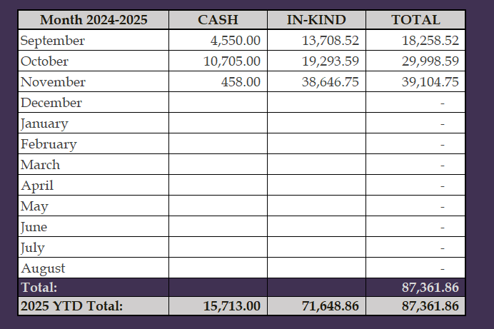
INTERIM FINANCIAL REPORT (unaudited)
FY 2024-25 Donations Report
All Funds as of November 30, 2024

Slide 15
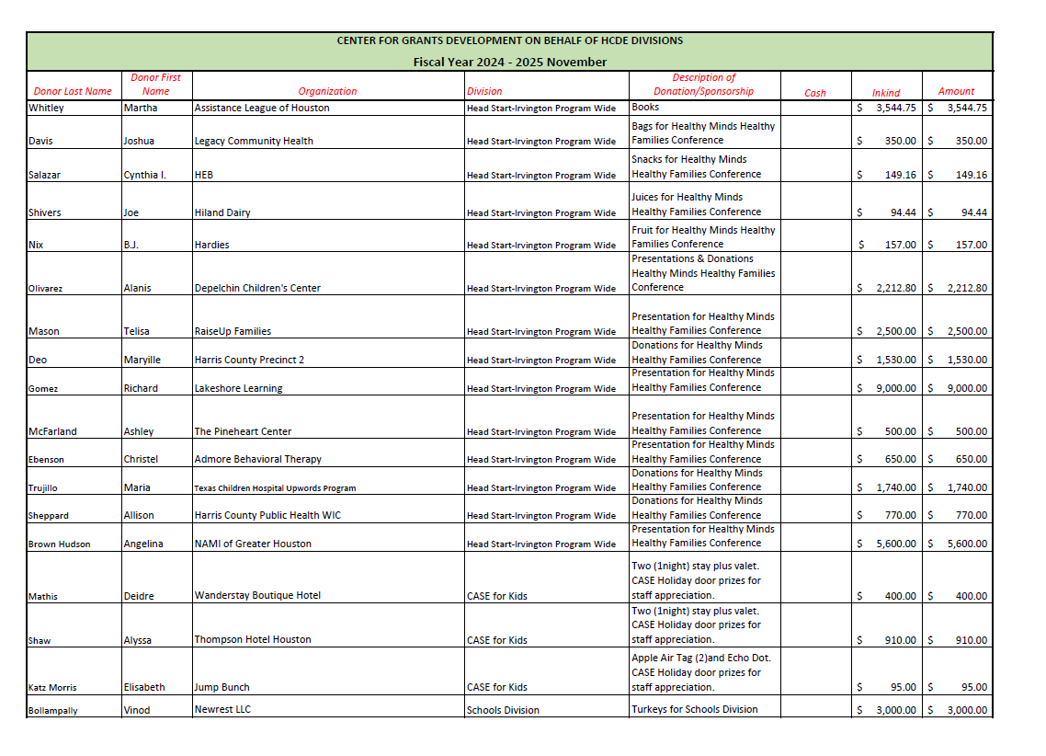
INTERIM FINANCIAL REPORT (unaudited)
FY 2024-25 Donations Report
All Funds as of November 30, 2024

Slide 16
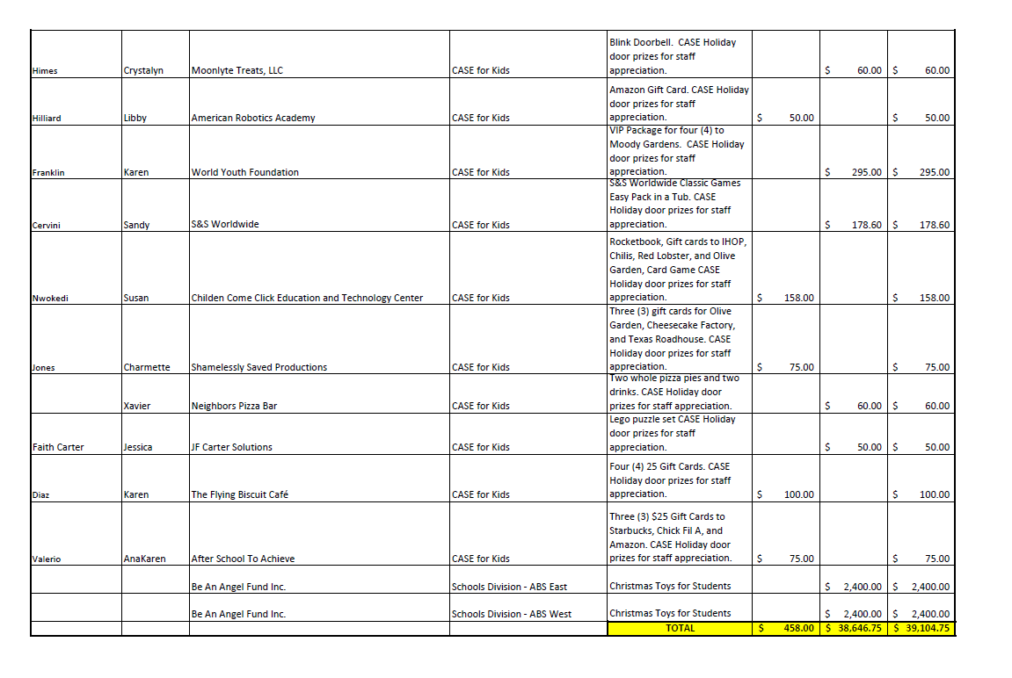
INTERIM FINANCIAL REPORT (unaudited)
FY 2024-25 Donations Report
All Funds as of November 30, 2024

Slide 17
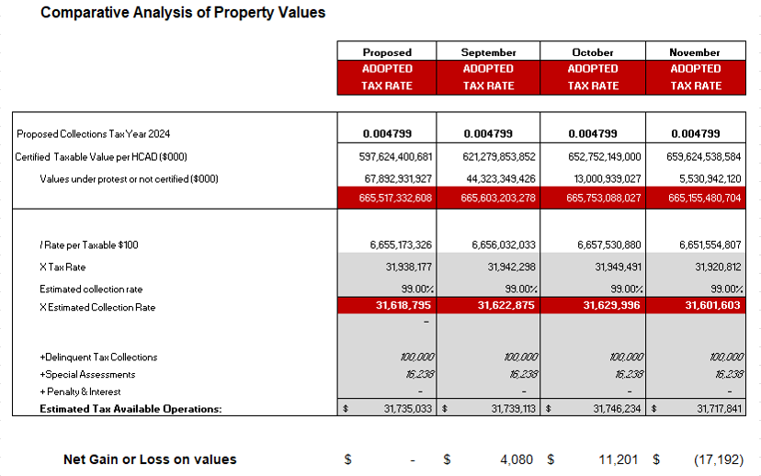
INTERIM FINANCIAL REPORT (unaudited)
TAX COLLECTIONS COMPARATIVE ANALYSIS
Fiscal Year-To-Date as of November 30, 2024
$665 B
See Tax Calculator at:
https://hcde-texas.org/transparency/tax-rate/
17

Slide 18
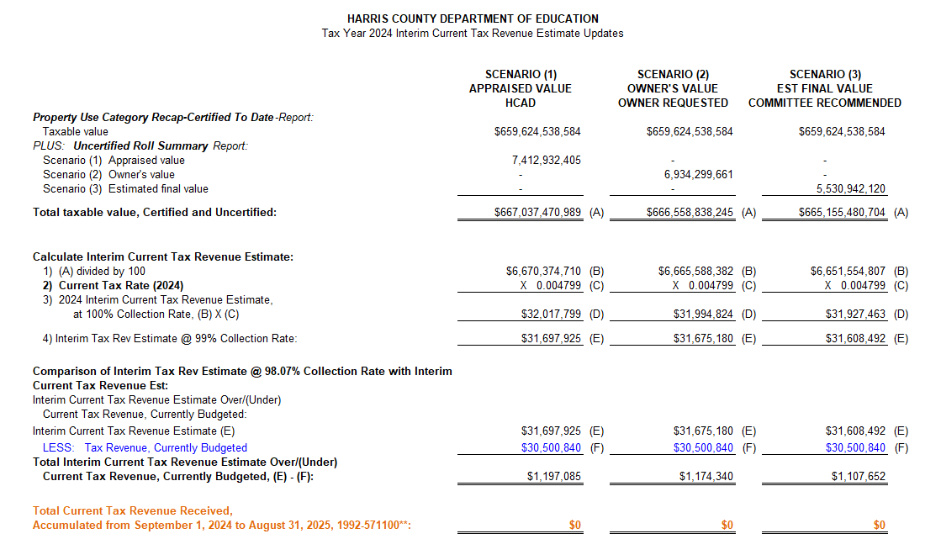
INTERIM FINANCIAL REPORT (unaudited) TAX COLLECTIONS
Fiscal Year-To-Date as of November 30, 2024
(3rd month / 12 months)

Slide 19
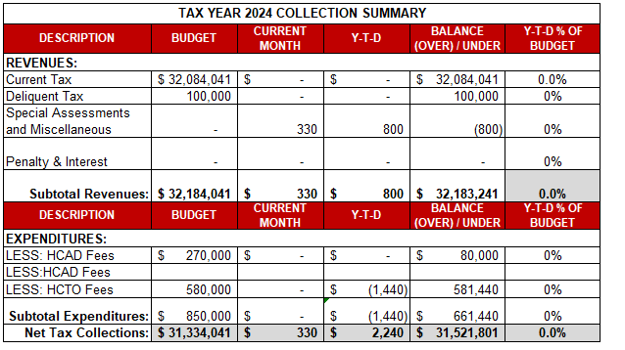
INTERIM FINANCIAL REPORT (unaudited) TAX COLLECTIONS
Fiscal Year-To-Date as of November 30, 2024
(3rd month / 12 months)
a) 2024 Approved Tax Rate = $0.004799/$100 Property Assessment/Appraisal - --> Annual Tax on a $259,375 - $51,875 = $207,500/100
x .004799 = $9.958 (net of 20% homestead exception.)
b) $850,000/$32,184,041 = 2.64% Collection and assessment costs

Slide 20
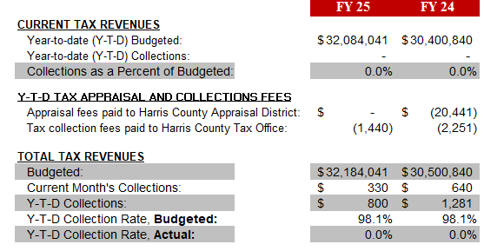
INTERIM FINANCIAL REPORT (unaudited) TAX COLLECTIONS
Fiscal Year-To-Date as of November 30, 2024
(3rd month / 12 months)
a) 2024 Approved Tax Rate = $0.004799/$100 Property Assessment/Appraisal - --> Annual Tax on a $259,375 - $51,875 = $207,500/100
x .004799 = $9.958 (net of 20% homestead exception.)
b) $850,000/$32,184,041 = 2.64% Collection and assessment costs

Slide 21
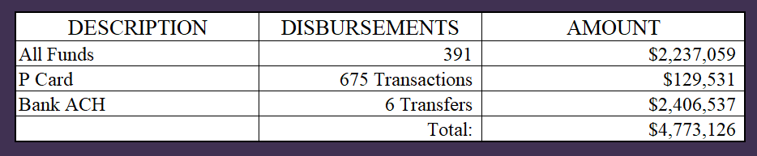
INTERIM FINANCIAL REPORT (unaudited)
DISBURSEMENT – ALL FUNDS
November 30, 2024
Notes:
All Purchase Orders and Payment Authorizations are reviewed before disbursement.
All Procurement Card charges are reviewed by cardholder, supervisor, and business office staff each month.
A report on CH Local Expenditures is included in the monthly report.

Slide 22
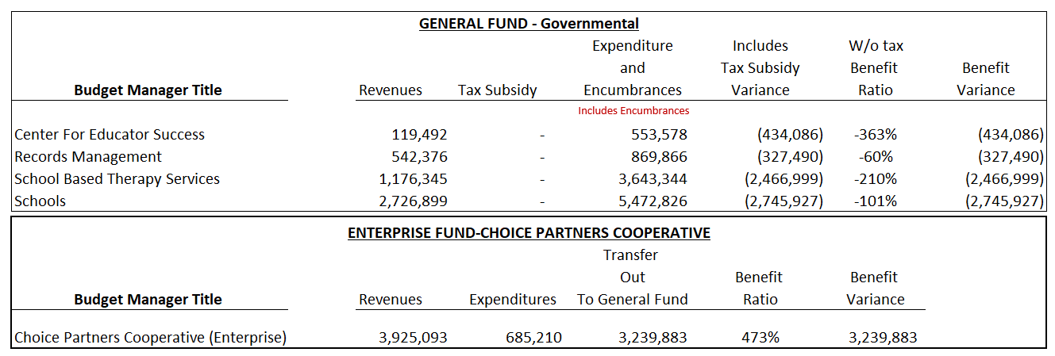
INTERIM FINANCIAL REPORT (unaudited)
Segment Division Data
As of November 30, 2024

Slide 23
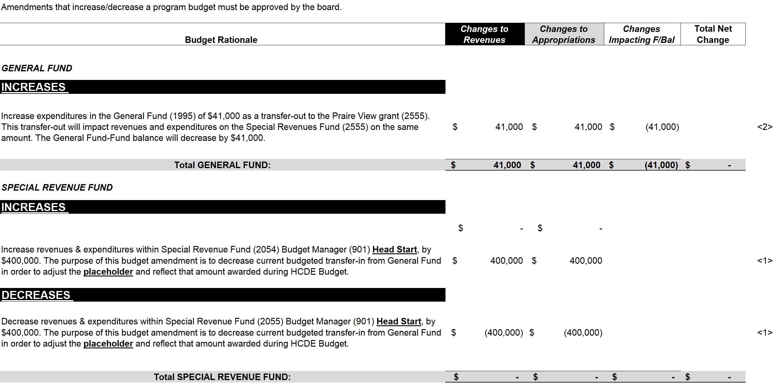
HIGHLIGHTS OF BUDGET AMENDMENT REPORT
December 18th, Board Meeting
(unaudited)

Slide 24

Education Foundation Update
November 30, 2024

Slide 25
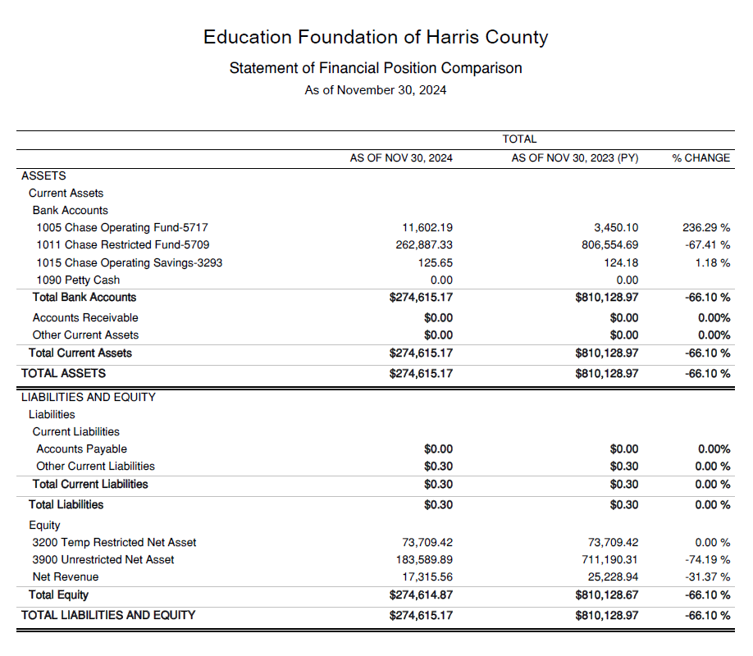
Statement of Financial Position
Net Equity 274,614

Slide 26
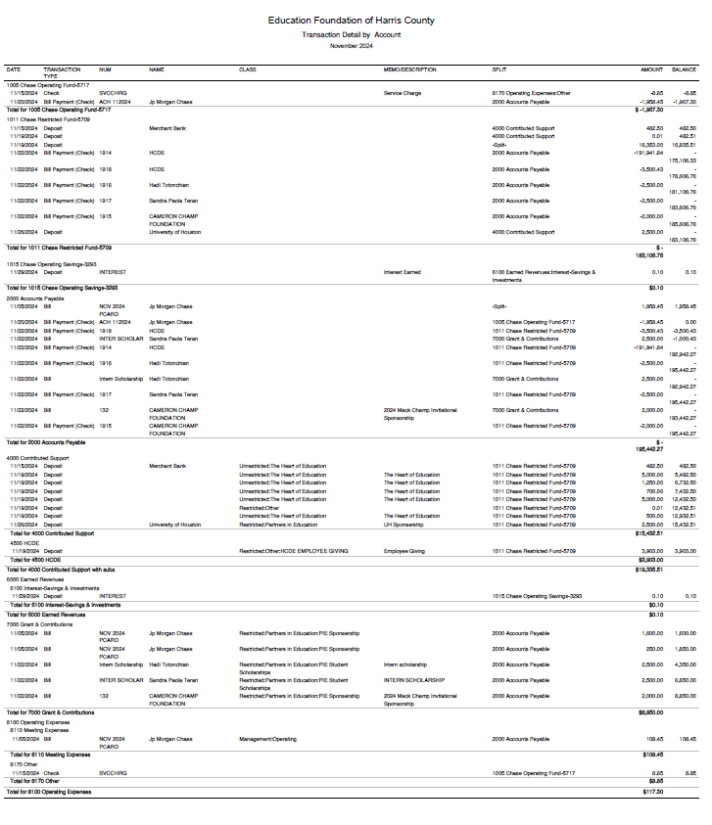
Transaction Detail by Inflow & Outflow

Slide 27
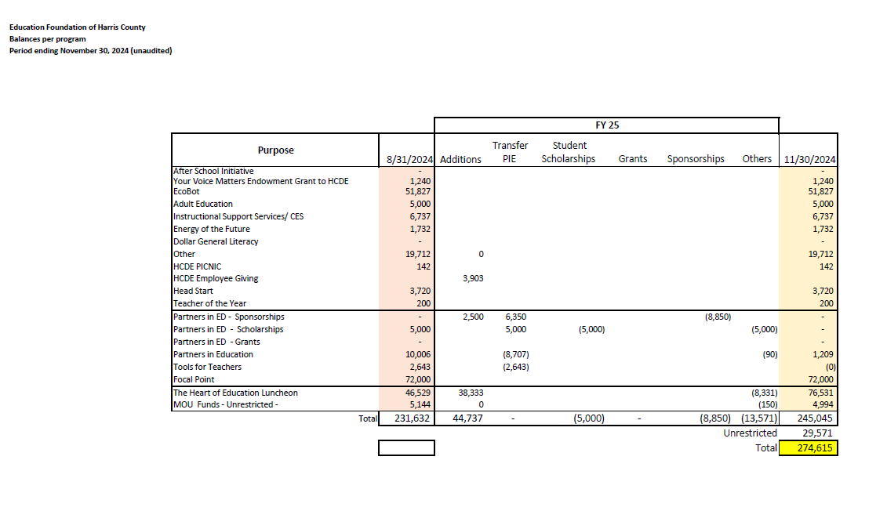
Ed Foundation Balances Per Program

Slide 28

PFC & Lease Revenue Projects Update
November 30, 2024

Slide 29
Harris County Department of Education
Small Business Program FY2024

Slide 30
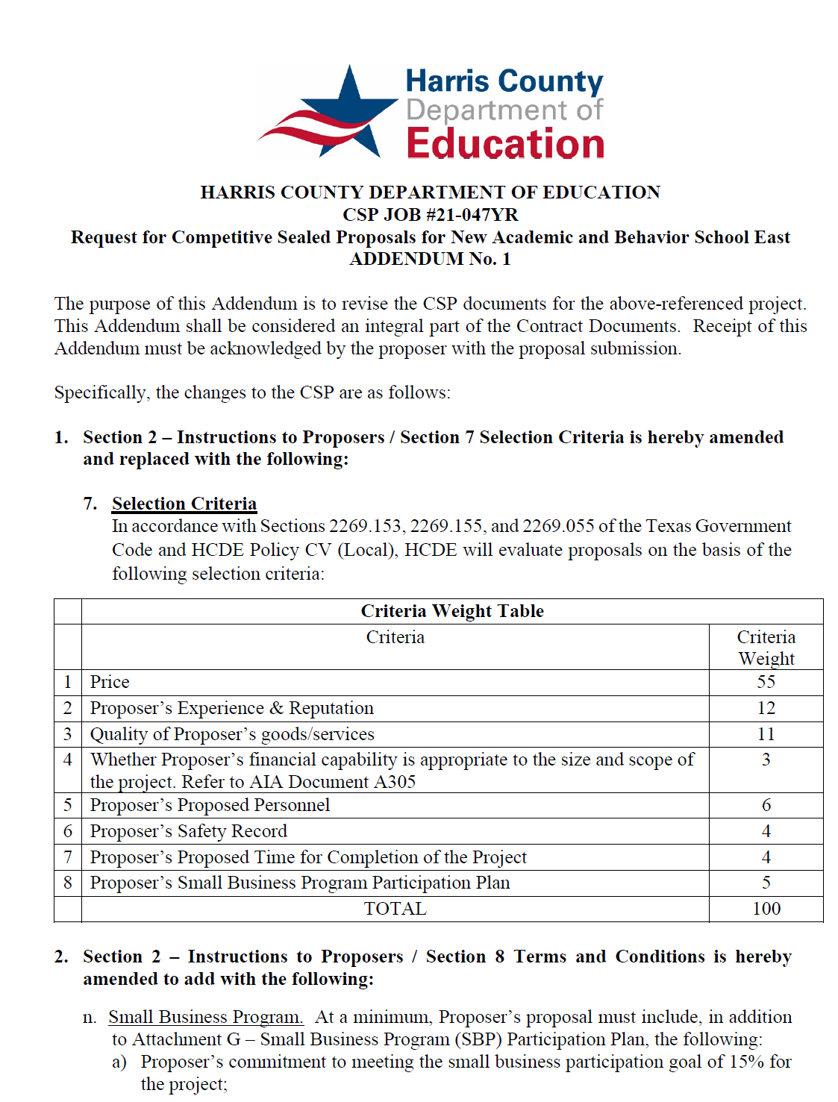
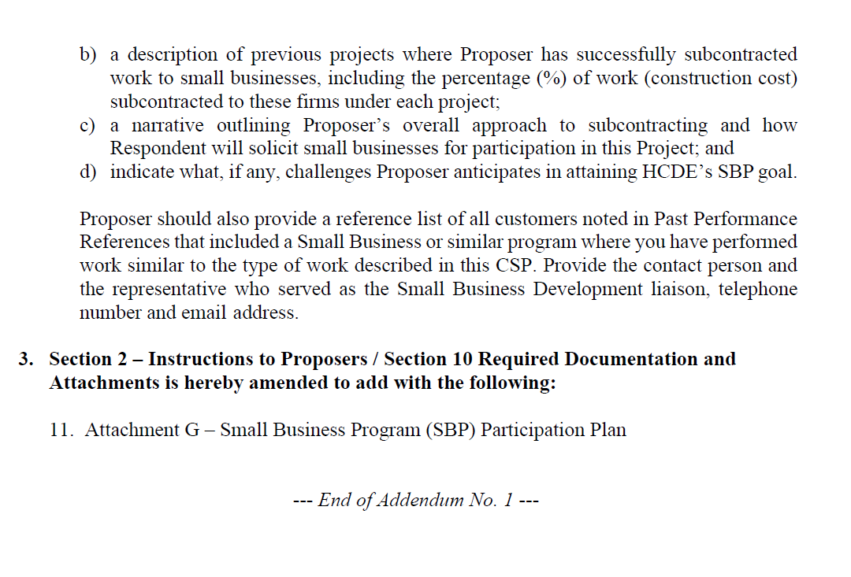
Small Business
Program for construction
Launch industry's first collaboration feature
This is our plan as we launch the industry's first collaboration feature

Slide 31
Content
Definitions
Certifying Agencies
List of Small Business Expenditures for FY2024
Visual aids
List of Small Businesses for FY2024

Slide 32
Definitions
DBE – Disadvantage Business Enterprise are fifty-one percent owned, managed and controlled by one or more socially and economically disadvantaged individual(s).
MBE – Minority Business Enterprise are fifty-one percent owned, operated and controlled by a minority group.
SBE – Small Business Enterprise are private corporations, partnerships, or sole proprietorships with 500 or fewer employees.
WBE – Woman Business Enterprise is fifty-one percent owned and controlled by one or more women who are U.S. citizens or Legal Resident Aliens.

Slide 33
Certifying agencies
  City of Houston
  Houston Metropolitan Transit Authority
  Port of Houston
  South Central Texas Regional Certification Agency

Slide 34
Expenditures for fy 2024
Total Expenditures $40,019,379
Small Business $2,683,850
Govt and Utilities $7,742,369
Non-Small Business $29,593,160
$2,683,850 /$32,770,010 =
8% Ratio Small/Large

Slide 35
Expenditures for FY 2024 by certifying agency
Name of Agency
City of Houston $1,463,545
Houston Metropolitan Transit Authority $468,346
Port of Houston
$722,484
S. Central Texas Regional Certification Agency/Austin
$29,475
Total $2,683,850

Slide 36
Expenditures for FY 2024 by certification type
Certification Type
DBE -Disadvantaged
MBE - Minority
SBE - Small
WBE - Women
Total $2,683,850

Slide 37
Certified Small Business Expenditures for FY 2024 by Ethnicity
Asian |  | $548,913 | 20%
Black |  | $776,549 | 29%
Caucasian |  | $576,494 | 21%
Hispanic |  | $781,894 | 29%
 |  | $2,683,850 | 100%

Slide 38
Small business list for fy2024
Vendor | Total Payments | Certifying Agency |  | Certification Type | Certification Date | Renewal Date | Expiration Date | Ethnicity | Business Capabilities
APPDDICTION STUDIO LLC | $ 29,475.16 | South Central Texas Regional Certification Agency | SCTRCA | DBE | 4/17/2023 | 4/17/2024 | 4/17/2024 | Black | Computer program or software development
A-ROCKET MOVING & STORAGE | $14,367.00 | City of Houston | Houston | MBE | 9/26/2024 | 6/30/2027 | 6/30/2027 | Black | General Freight Trucking
BLUE KNIGHT SECURITY LLC | $177,654.48 | City of Houston | Houston | SBE | 1/5/2023 | 10/31/2025 | 10/31/2025 | Black | Security guards and patrol services
BRAINBUZZED TUTORING INC | $37,500.00 | City of Houston | Houston | WBE | 8/16/2021 | 8/31/2024 | 8/31/2024 | Black | Academic Tutoring and Exam Preparation
BUTLER BUSINESS PRODUCTS | $457,115.08 | City of Houston | Houston | MBE | 9/5/2023 | 7/31/2026 | 7/31/2026 | Hispanic | Office Supplies and Stationery Stores
CRE8 INCORPORATED | $402,926.83 | Houston Metropolitan Transit Authority | Houston Metro | SBE | 9/25/2023 | 9/25/2026 | 9/25/2026 | Asian | Architecture and LEED Design Services
DURA PIER FACILITIES SERVICES LTD | $337,158.00 | Port Houston | PH | WBE | 1/24/2023 | 1/31/2024 | 4/30/2024 | Caucasian | Building and Construction and Maintenance Services
EMA SPORT SOLUTIONS LLC | $259,643.18 | City of Houston | Houston | MBE | 5/16/2023 | 5/31/2026 | 5/31/2026 | Hispanic | Sport Facilities Construction, Flooring and Turf Installation, Fence Installation, Demolition
ENGLISH + ASSOCIATES ARCHITECTS INC | $48,919.11 | Houston Metropolitan Transit Authority | Houston Metro | SBE | 5/17/2023 | 5/17/2026 | 5/17/2026 | Hispanic | Architectural And Interior Design: Architectural Services
ERC ENVIRONMENTAL & CONST SERV INC | $28,324.69 | City of Houston | Houston | SBE | 12/19/2023 | 7/31/2026 | 7/31/2026 | Asian | Environmental Services & Consulting; Construction Management, Site Work, Project Development/Project Management, Concrete, Masonry, Metals, Woods, & Thermal Finishes
FRENCH CORNER CATERING INC | $23,622.79 | Port Houston | PH | WBE | 6/27/2022 | 6/30/2026 | 9/30/2026 | Caucasian | Miscellaneous Food Manufacturing, Catering Services
J.F. CARTER SOLUTIONS LLC | $16,500.00 | Houston Metropolitan Transit Authority | Houston Metro | SBE | 8/12/2024 | 8/12/2027 | 8/12/2027 | Black | Educational support services
MATH-A-MATICS TUTORING, LLC | $17,650.00 | City of Houston | Houston | WBE | 11/18/2022 | 3/31/2025 | 3/31/2025 | Black | Exam Preparation and Tutoring
NASH INDUSTRIES INC | $168,881.68 | Port Houston | PH | SBE | 2/21/2024 | 12/17/2025 | 3/31/2026 | Caucasian | Building Construction, Educational; General Construction
NETSYNC NETWORK SOLUTIONS | $16,216.20 | Port Houston | PH | WBE | 5/23/2022 | 9/30/2025 | 12/31/2025 | Hispanic American | Data Communications Equipment; Local Area Network (LAN) Communications Equipment; Wide Area Network Communications Equipment
PS LIGHTWAVE INC | $ 46,831.92 | Port Houston | PH | SBE | 8/1/2023 | 4/30/2024 | 7/31/2024 | Caucasian | Electrical Contractors and Other Wiring Installation Contractors
QSS, L.C | $ 461,290.48 | City of Houston | Houston | MBE | 5/15/2024 | 2/28/2027 | 2/28/2027 | Black | Burglar, Fire, CCTV Systems Installation
SHI GOVERNMENT SOLUTIONS INC | $ 117,661.47 | Port Houston | PH | MBE | 5/31/2024 | 1/2/2025 | 4/30/2025 | Asian Pacific | Custom Computer Programming Services; Computer Accessories And Supplies
SISTEM TUTORING AGENCY | $ 10,000.00 | City of Houston | Houston | WBE | 5/12/2021 | 5/31/2024 | 5/31/2024 | Black | Tutoring Services
SPEARHEAD GROUP INC | $ 12,111.97 | Port Houston | PH | SBE | 12/21/2021 | 7/31/2024 | 10/31/2024 | Black American | Human Resources & Executive Search Consulting Services; Temporary Employment Services
 | $ 2,683,850.04

Slide 39
Small business list for FY 2024
Vendor | Total Payments | Certifying Agency | F | Certification Type | Certification Date | Renewal Date | Expiration Date | Ethnicity | Business Capabilities
NETSYNC NETWORK SOLUTIONS | $16,216.20 | Port Houston | PH | WBE | 5/23/2022 | 9/30/2025 | 12/31/2025 | Hispanic American | Data Communications Equipment; Local Area Network (LAN) Communications Equipment; Wide Area Network Communications Equipment
PS LIGHTWAVE INC | $ 46,831.92 | Port Houston | PH | SBE | 8/1/2023 | 4/30/2024 | 7/31/2024 | Caucasian | Electrical Contractors and Other Wiring Installation Contractors
QSS, L.C | $ 461,290.48 | City of Houston | Houston | MBE | 5/15/2024 | 2/28/2027 | 2/28/2027 | Black | Burglar, Fire, CCTV Systems Installation
SHI GOVERNMENT SOLUTIONS INC | $ 117,661.47 | Port Houston | PH | MBE | 5/31/2024 | 1/2/2025 | 4/30/2025 | Asian Pacific | Custom Computer Programming Services; Computer Accessories And Supplies
SISTEM TUTORING AGENCY | $ 10,000.00 | City of Houston | Houston | WBE | 5/12/2021 | 5/31/2024 | 5/31/2024 | Black | Tutoring Services
SPEARHEAD GROUP INC | $ 12,111.97 | Port Houston | PH | SBE | 12/21/2021 | 7/31/2024 | 10/31/2024 | Black American | Human Resources & Executive Search Consulting Services; Temporary Employment Services
 | $ 2,683,850.04

Slide 40
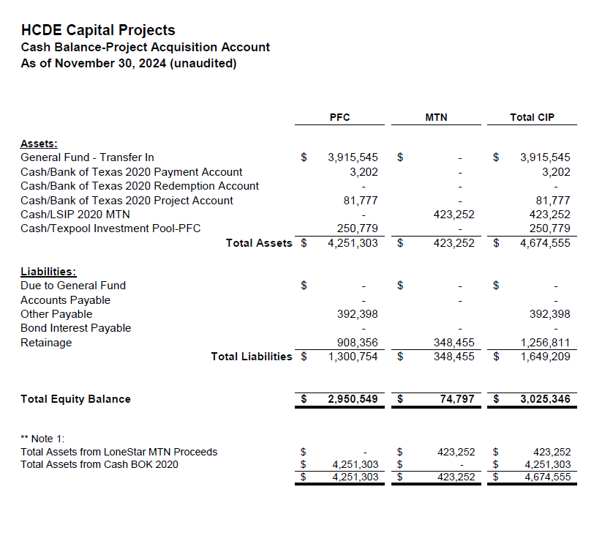

AB East School Contract $12,358,000 Awarded
Adult Ed Center Contract $15,121,000 Awarded on Oct 2021 Board Mtg
HP East Contract $7,271,000 Awarded on Nov 2021
Irvington – $11,172,589 Awarded on Jan 2024
Cash Balance –
Project Acquisition Account
As of November 30, 2024

Slide 41
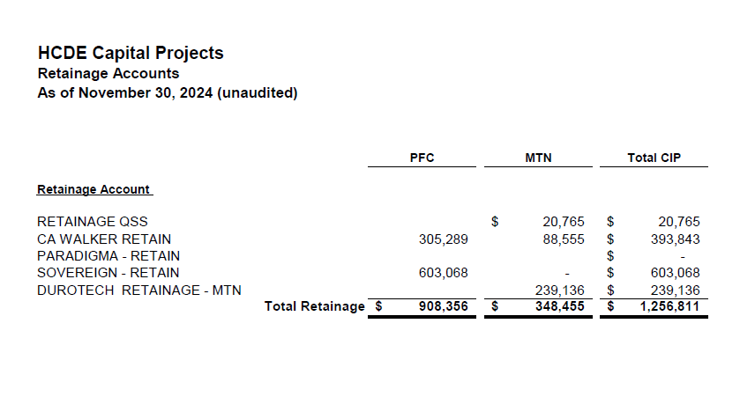
2020 MTN NOTES/2020 PFC BONDS
Pending Retainage Payable
Retainage Payable
Project Acquisition Account
As of November 30, 2024

Slide 42
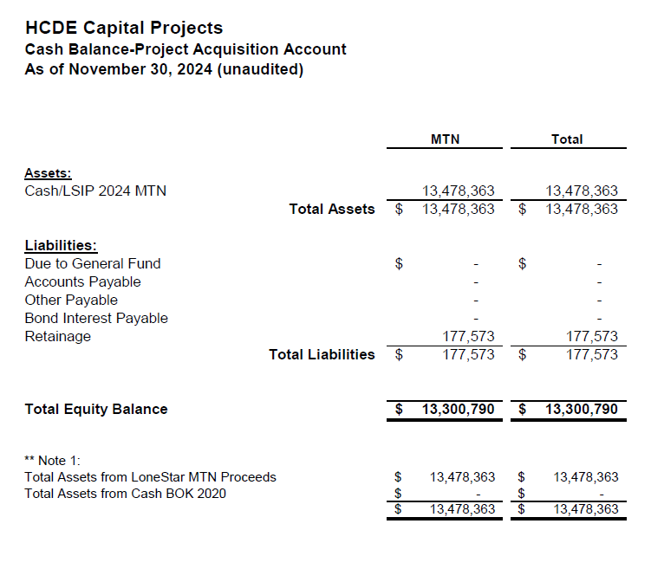
AB West $333,000 March 2024 Board Mtg
HS Barrett Station $470,000 March 2024 Board Mtg
Fortis Academy $650,000 March 2024 Board Mtg
Irvington – $9,860,000 March 2024 Board Mtg
Post Oak - $5,000,000 March 2024 Board Mtg
$16,313,000
Cash Balance –
2024 Maintenance Notes
As of November 30, 2024

Slide 43
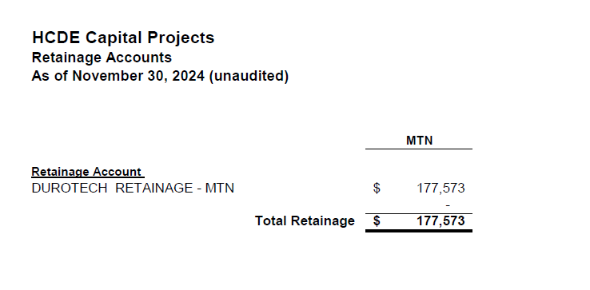
AB West $333,000 March 2024 Board Mtg
HS Barrett Station $470,000 March 2024 Board Mtg
Fortis Academy $650,000 March 2024 Board Mtg
Irvington – $9,860,000 March 2024 Board Mtg
Post Oak - $5,000,000 March 2024 Board Mtg
$16,313,000
Retainage Payable
2024 Maintenance Notes
As of November 30, 2024

Slide 44
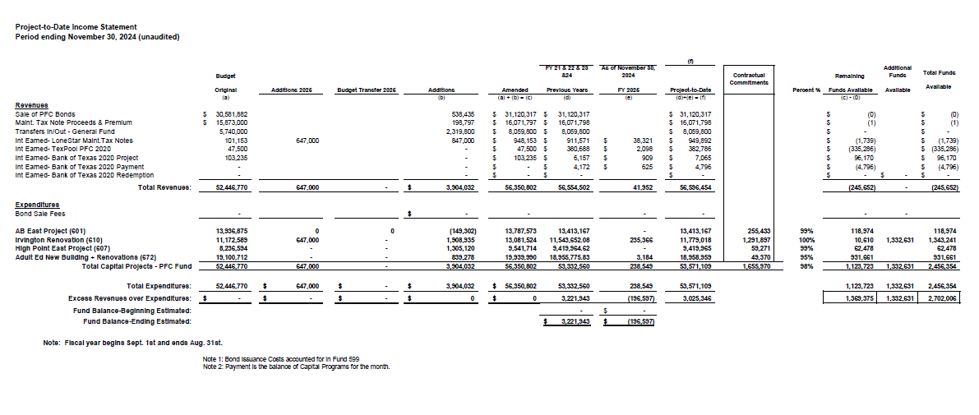
Income Statement– Project Acquisition Account
As of November 30, 2024

Slide 45
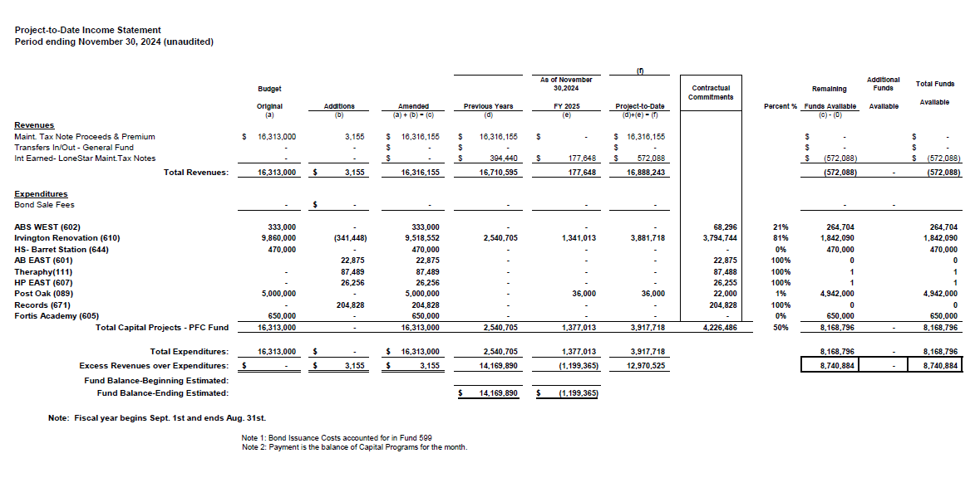
Income Statement– 2024 MNT NOTES
As of November 30, 2024

Slide 46
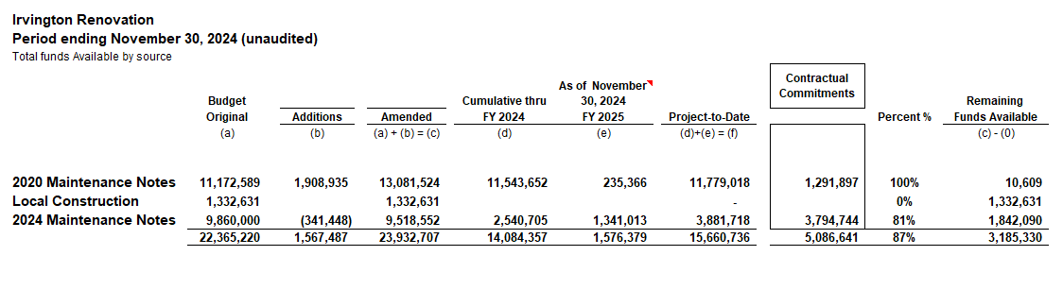
Irvington Renovation – Funds by Source
As of November 30, 2024
Irvington Renovation 2020 Maintenance Notes $ 4,781,519
Contract 2024 Maintenance Notes $ 7,000,000
Total $11,781,519
46

Slide 47

Interim Financial Report (unaudited)
I certify that the foregoing information is true and accurate to the best of my knowledge.
/s/ Jesus J. Amezcua, RTSBA,CPA, Ph.D., CPFIM, Asst. Supt. for Business Support Services
/s/ Marcia Leiva, Chief Accounting Officer

