Slide 1
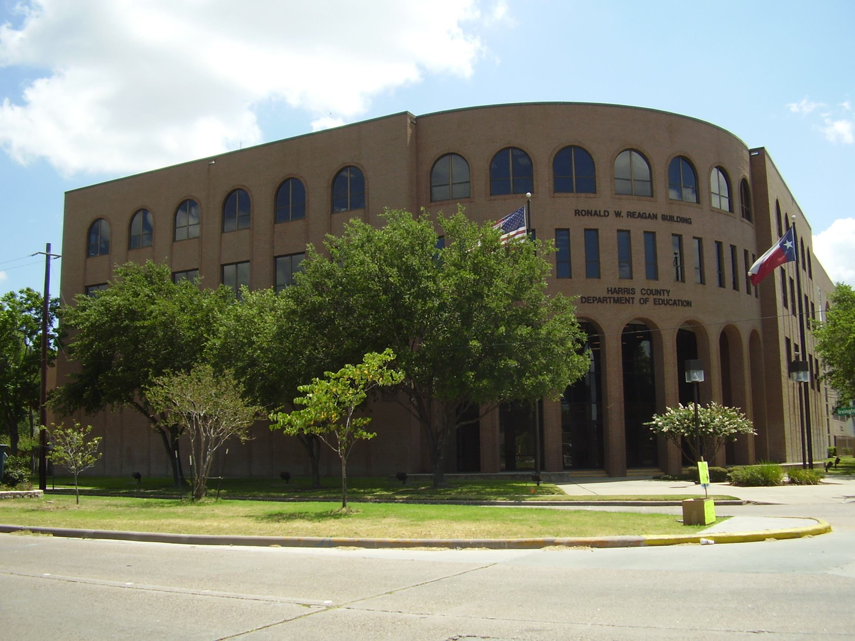
Investment Report
As of September 30, 2025

Slide 2
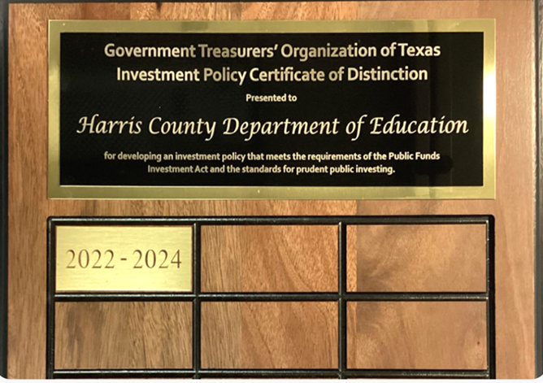
MONTHLY INVESTMENT REPORT (unaudited) PURPOSE OF REPORT As of September 30, 2025
State compliance with state law, HCDE policy and investment strategy.
Texas Government Code, Section 2256, Public Funds Investment Act; and
HCDE CDA (LEGAL) and CDA (LOCAL), Other Revenues: Investments
Describe investment position at report date.
HCDE Portfolio by Investment Type / PFC Portfolio by Investment Type
State account or fund for each investment asset.
HCDE Investment Earnings Reports / PFC Investment Earnings Reports
State book and market value for each investment asset at beginning and end of the period.
HCDE Inventory Report / PFC Inventory Report
Present a summary statement for each pooled fund group, including beginning market value; additions and changes to market value during the period; and ending market value.
HCDE Inventory Report / PFC Inventory Report

Slide 3
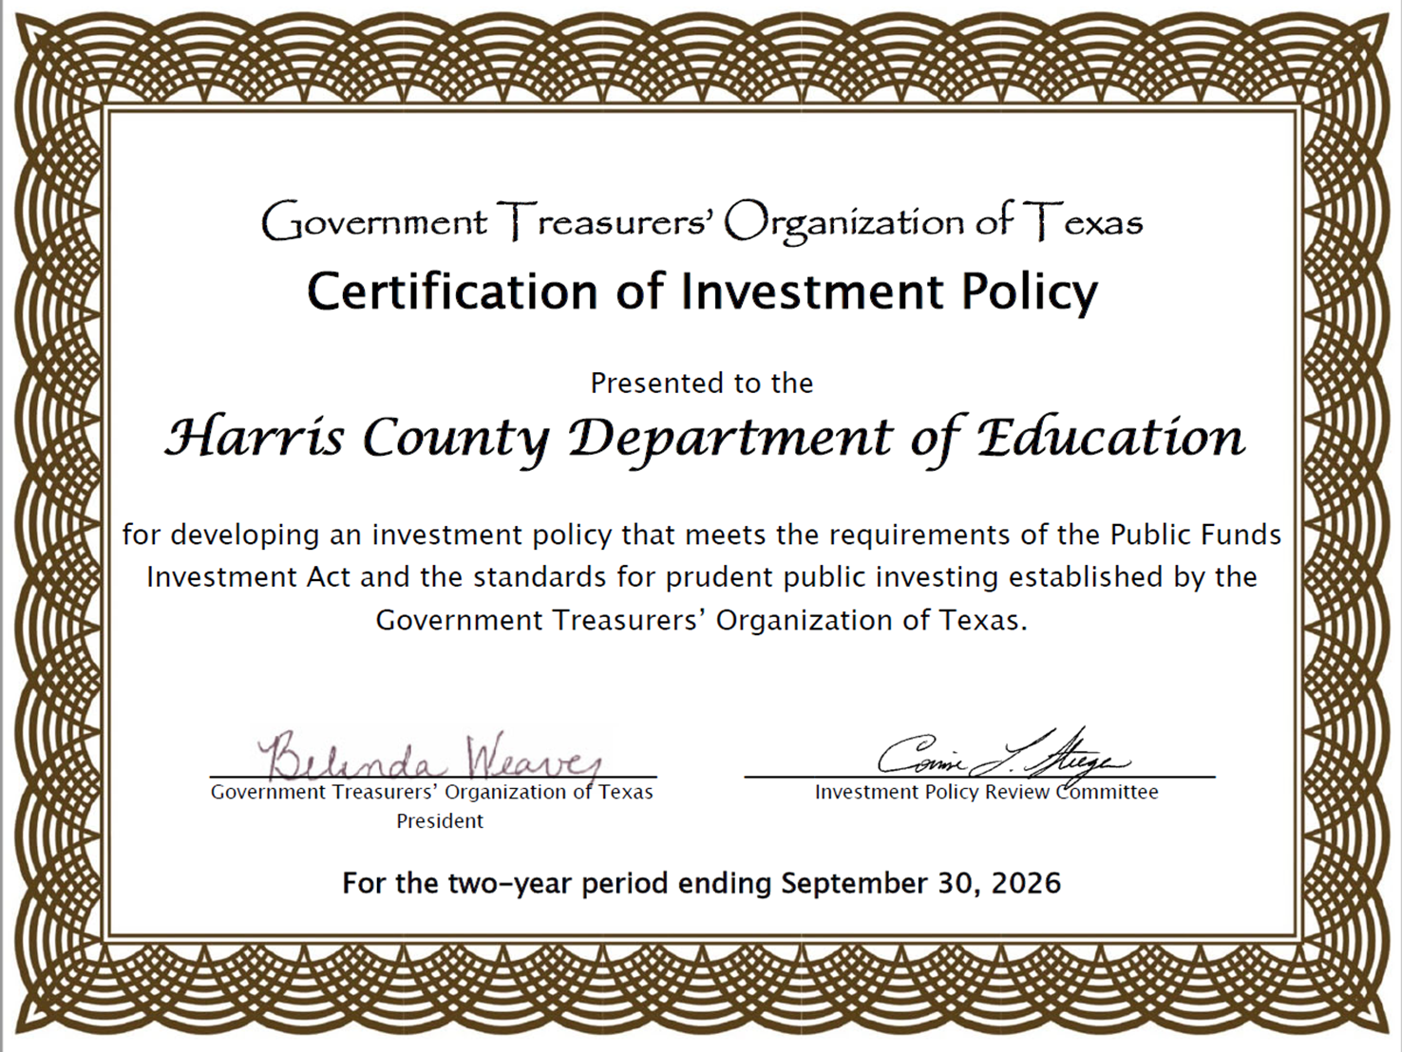

Slide 4
FEDERAL FUND RATE
The federal funds rate is the interest rate that banks charge other institutions for lending excess cash to them from their reserve balances overnight¹. It is set by the Federal Open Markets Committee and currently ranges from 4.00% to 4.25%². The Effective Federal Funds Rate is currently 4.33%, which is lower than the long-term average of 4.61%³. The Fed recently lowered the federal funds rate to a range of 4.25% to 4.0%⁵.
On Sept. 17, the Federal Open Market Committee (FOMC) announced that it would lower the Federal Funds rate for the first time since December—and most believe that it won’t be the only cut to short-term interest rates this year. Although inflation remains over the Fed’s 2% target, the job market is now the bigger concern, which is prompting the cuts. “Though it’s not at recessionary levels, the job market is showing signs of deteriorating,” said BOK Financial® Chief Investment Officer Brian Henderson. “Job growth has slowed down to a trickle and the unemployment rate is starting to move up. Once unemployment starts to rise, it has had a tendency to gather a lot of momentum and can feed on itself, so it then often rises even further.”

Slide 5
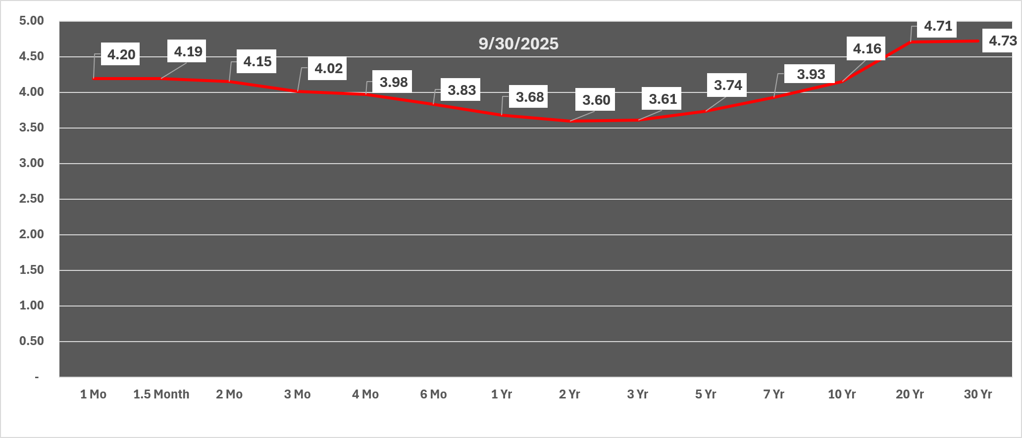
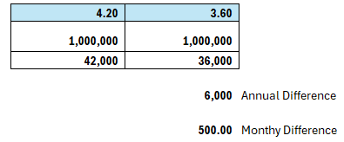
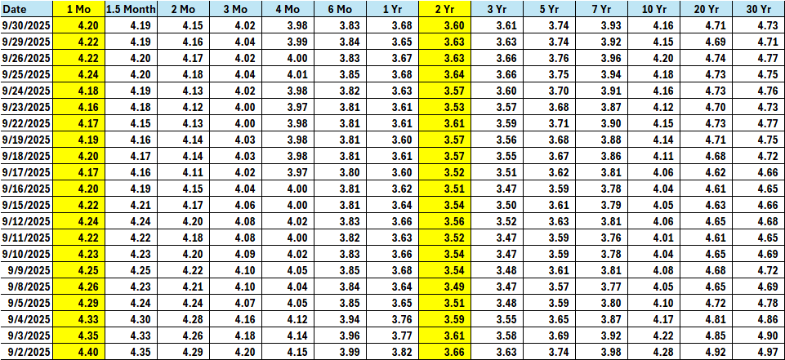
Treasury Rates

Slide 6
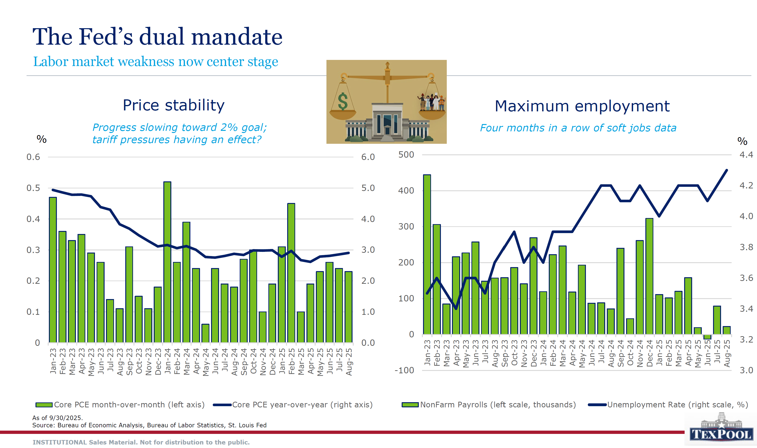

Slide 7
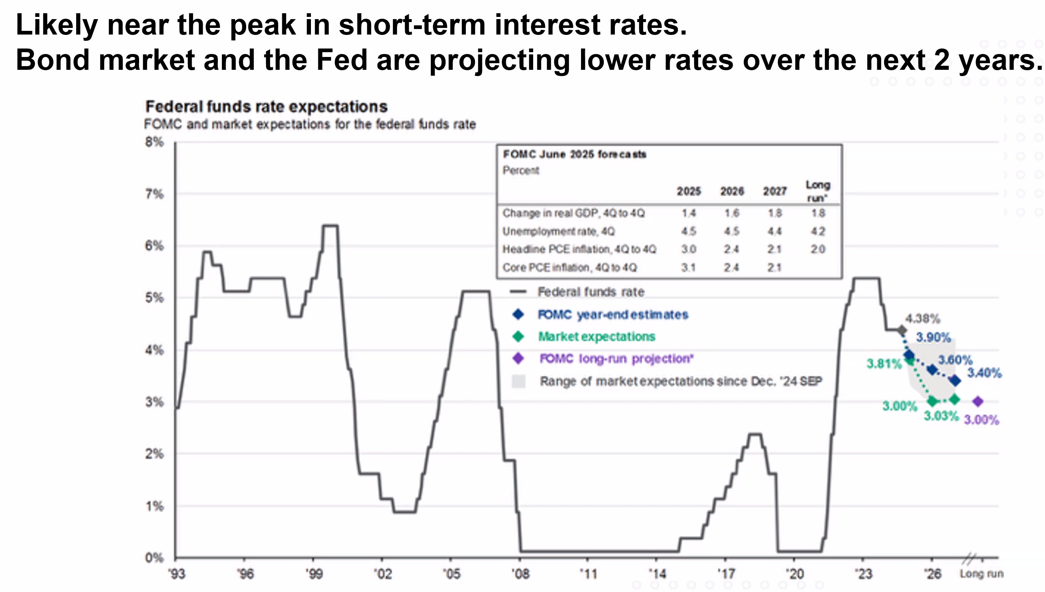

Slide 8
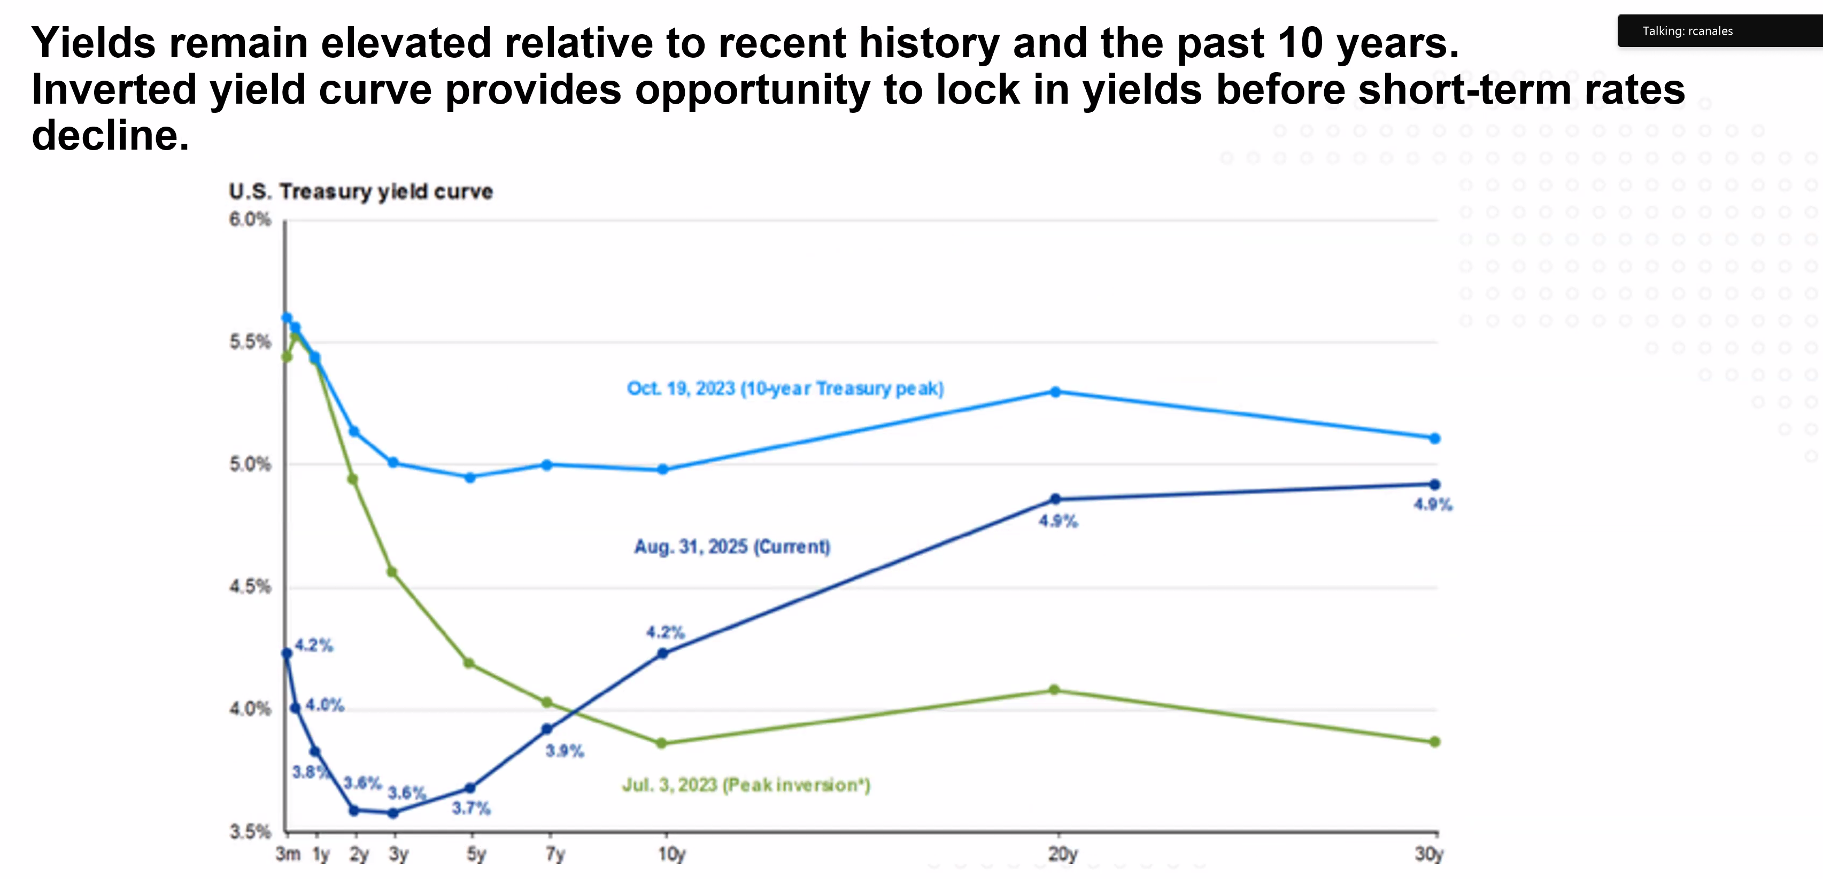
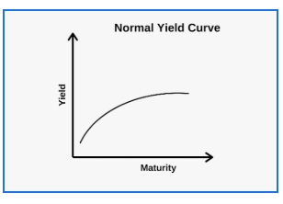
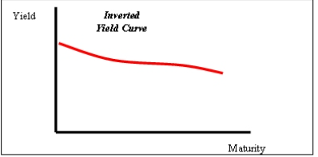

Slide 9
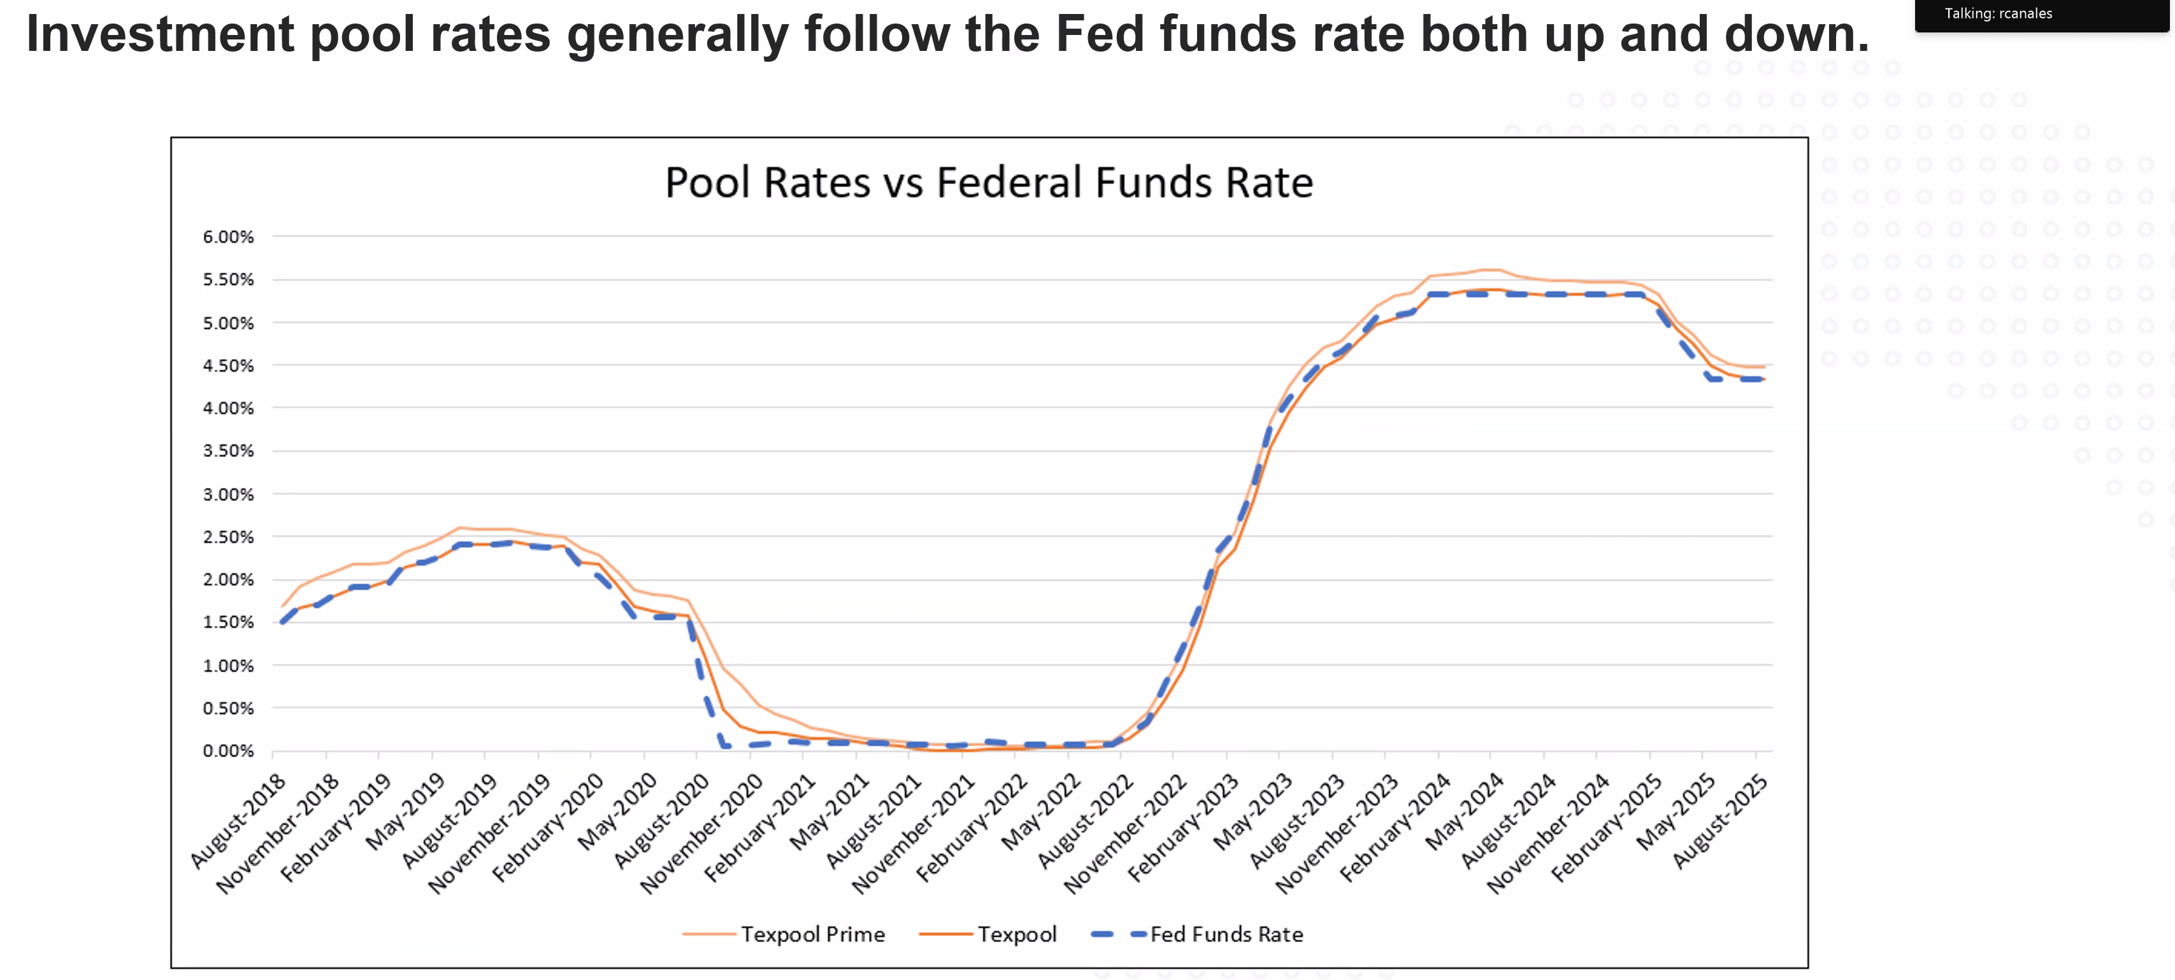
Jul 2019
2.25%
To 0%
March 2020
.25%
COVID
Mar 22 to Jul 23
Increase
.25%
T0
5.5%
Sep 24
To
Sept
25
4.75%
To
4.25%

Slide 10
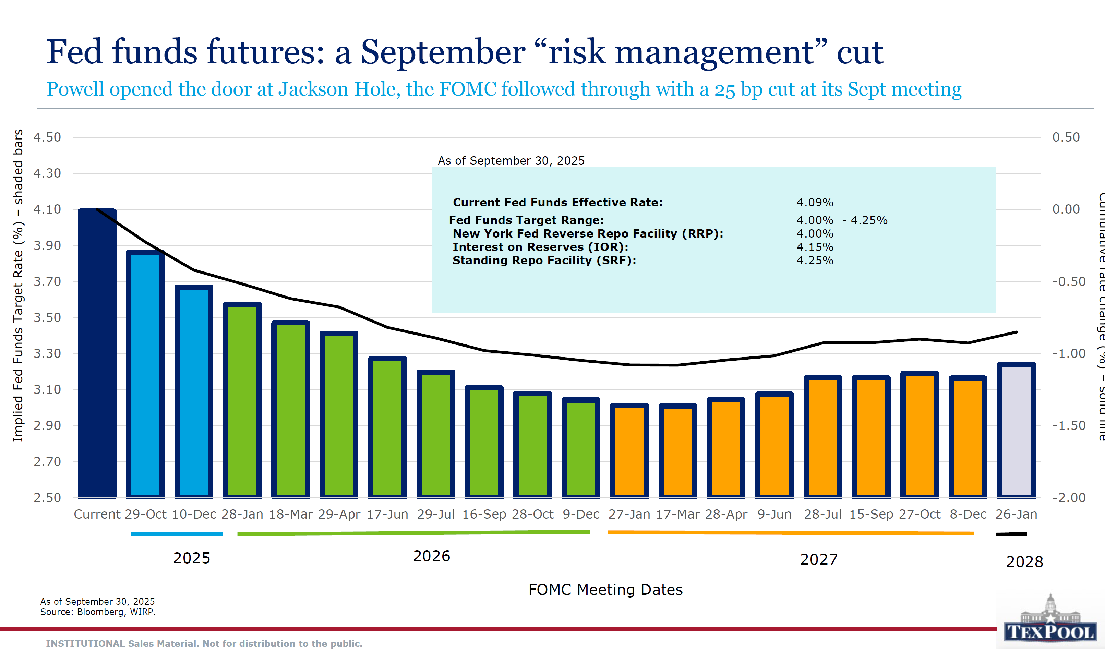

Slide 11
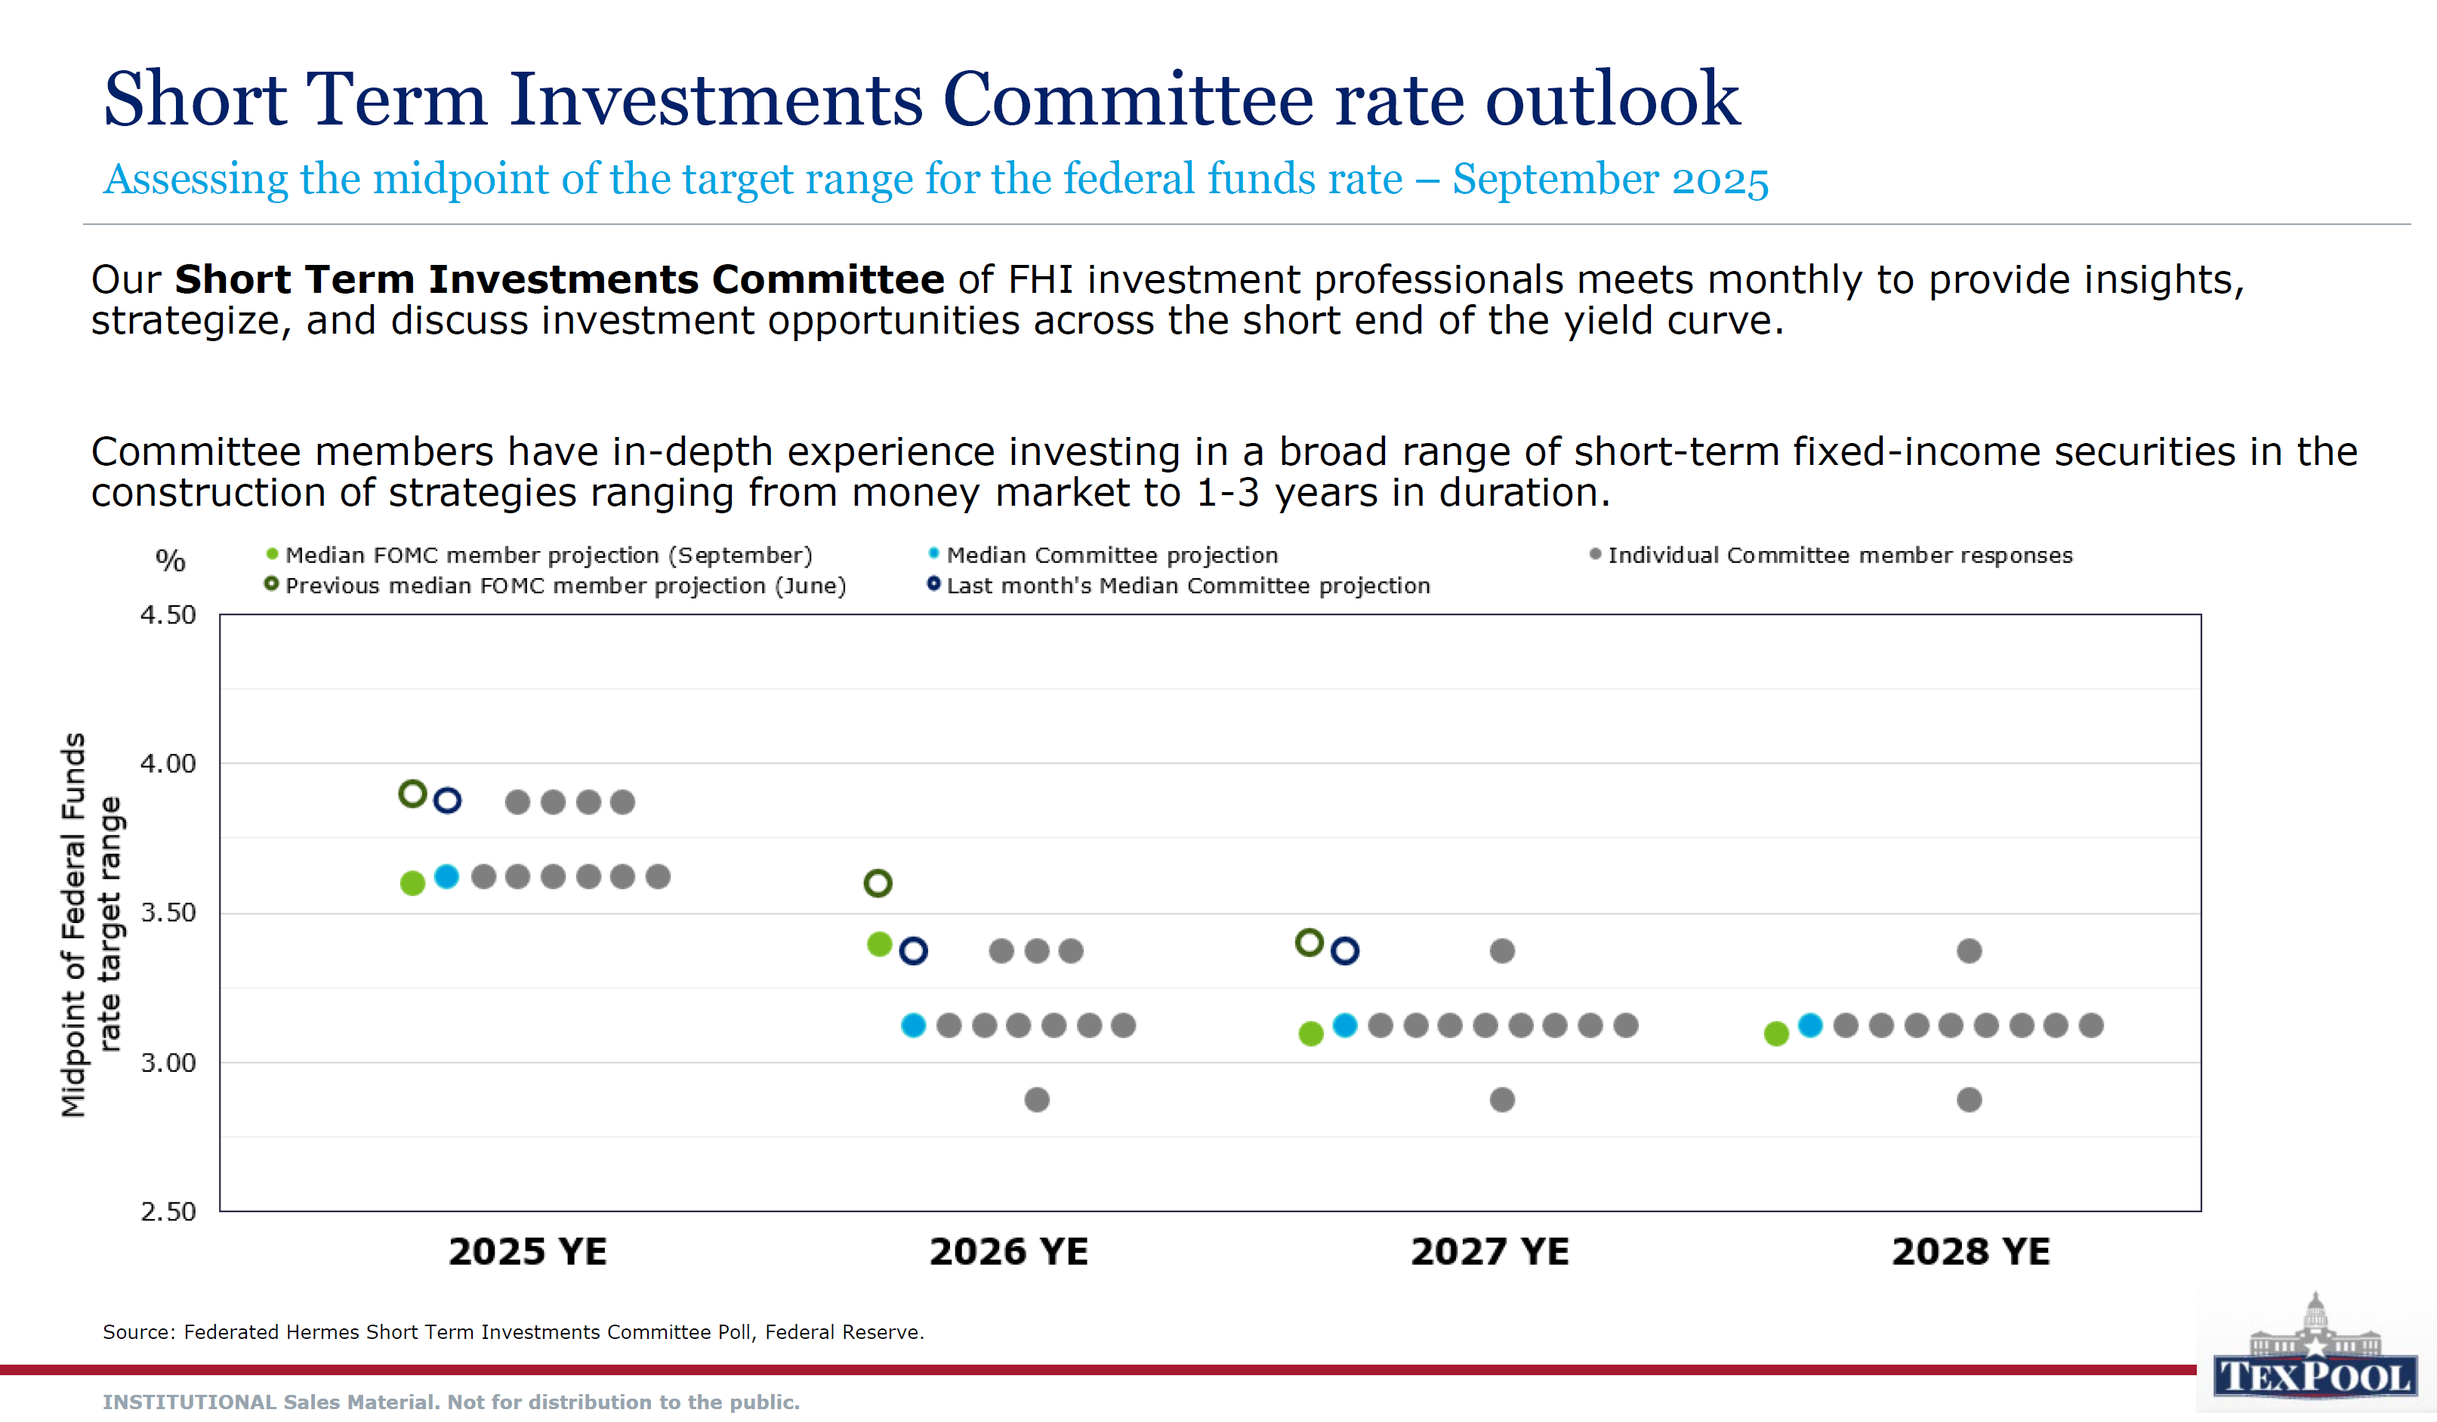

Slide 12
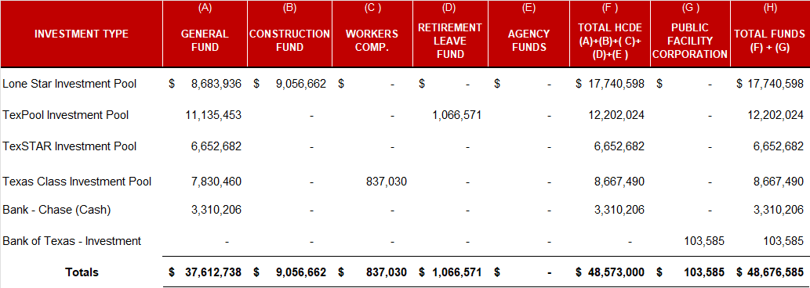
MONTHLY INVESTMENT REPORT (unaudited) INVESTMENT BY FUND BY TYPE As of September 30, 2025

Slide 13
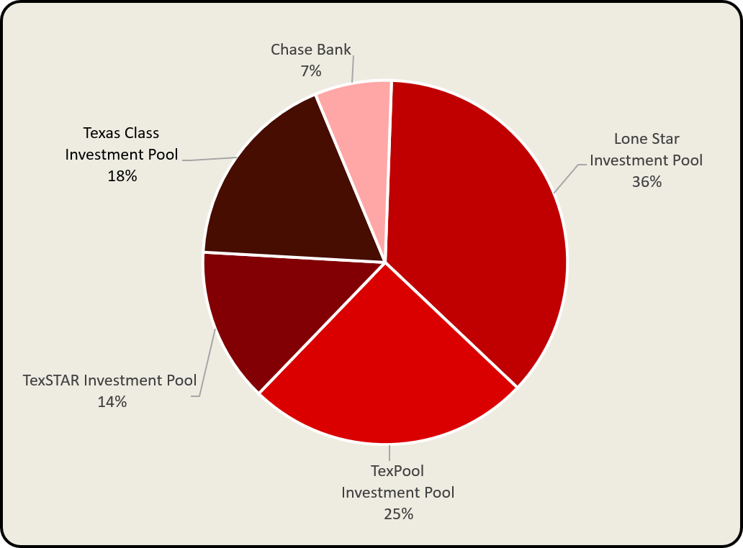
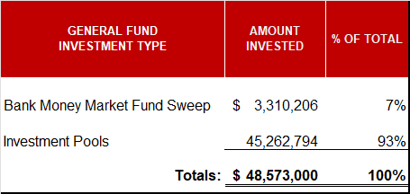
MONTHLY INVESTMENT REPORT (unaudited) HCDE PORTFOLIO BY INVESTMENT TYPE As of September 30, 2025

Slide 14
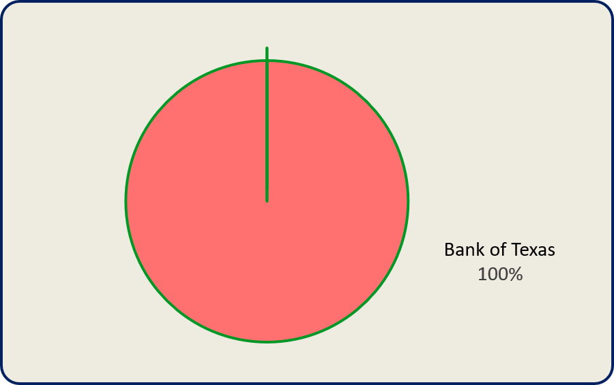
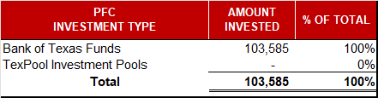
MONTHLY INVESTMENT REPORT (unaudited) PFC PORTFOLIO BY INVESTMENT TYPE As of September 30, 2025

Slide 15
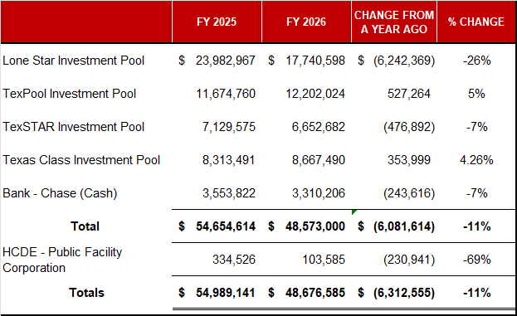
MONTHLY INVESTMENT REPORT (unaudited) HCDE INVESTMENT PORTFOLIO COMPARISON As of September 30, 2025

Slide 16
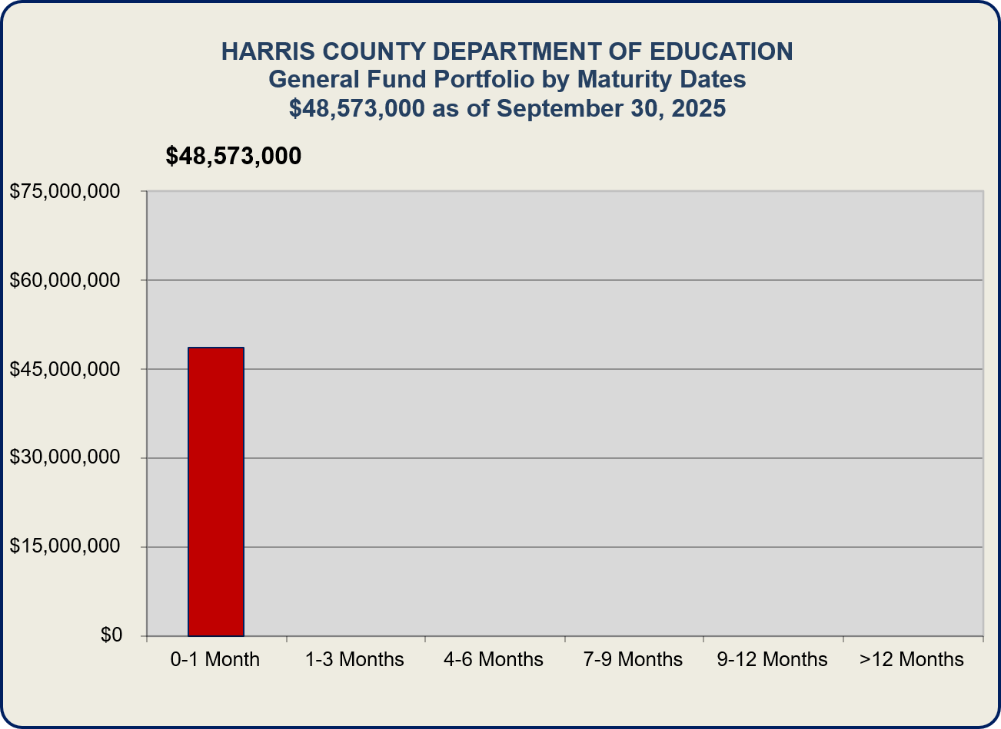
MONTHLY INVESTMENT REPORT (unaudited) INVESTMENT PORTFOLIO MATURITY As of September 30, 2025

Slide 17
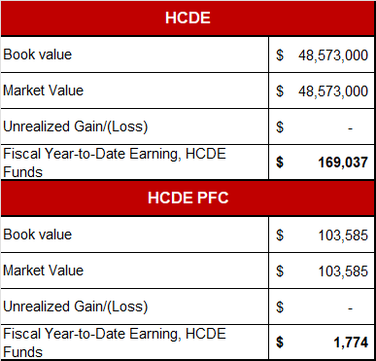
MONTHLY INVESTMENT REPORT (unaudited) HCDE & PFC PORTFOLIO MARKET AND BOOK VALUE As of September 30, 2025

Slide 18
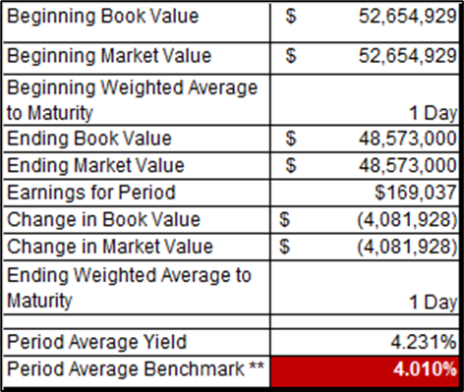
MONTHLY INVESTMENT REPORT (unaudited) BEGINNING AND ENDING VALUES / WAM / YIELD As of September 30, 2025
** Benchmark – 13 Week Treasury Bill at Maturity
Note: The Department also maintained an average of $3,033,429 during September 2025 to yield 4.322% in earnings credit resulting in Savings of $3,710.54

Slide 19
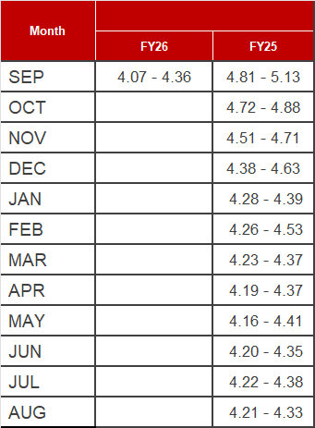
MONTHLY INVESTMENT REPORT (unaudited) INVESTMENT INTEREST RATES AND EARNED YIELD As of September 30, 2025

Slide 20
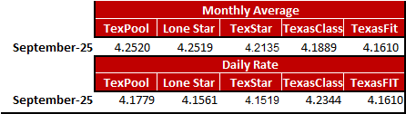
MONTHLY INVESTMENT REPORT (unaudited) INVESTMENT INTEREST RATES AND EARNED YIELD As of September 30, 2025

Slide 21





Q&A
I certify that the following information is true and accurate to the best of my knowledge.
/s/ Jesus Amezcua, Ph.D., CPA, RTSBA, CPFIM,
Assistant Superintendent for Business Services
/s/ Marcia Leiva, Chief Accounting Officer

