Slide 1

Truth-In-Taxation Calculation
Tax Year 2025
Fiscal Year 2025-2026
Board Presentation
September 10, 2025

Slide 2

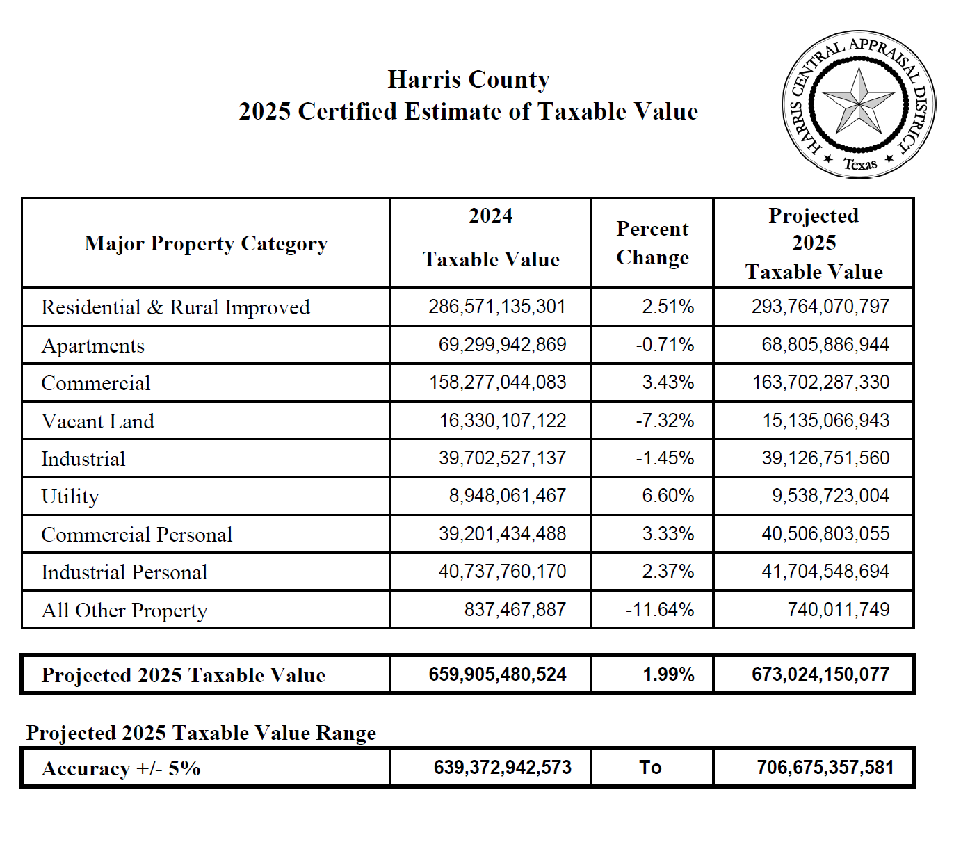
$688 Billion – Estimated
Other uses from General Fund
Harris County Department of Education
2

Slide 3
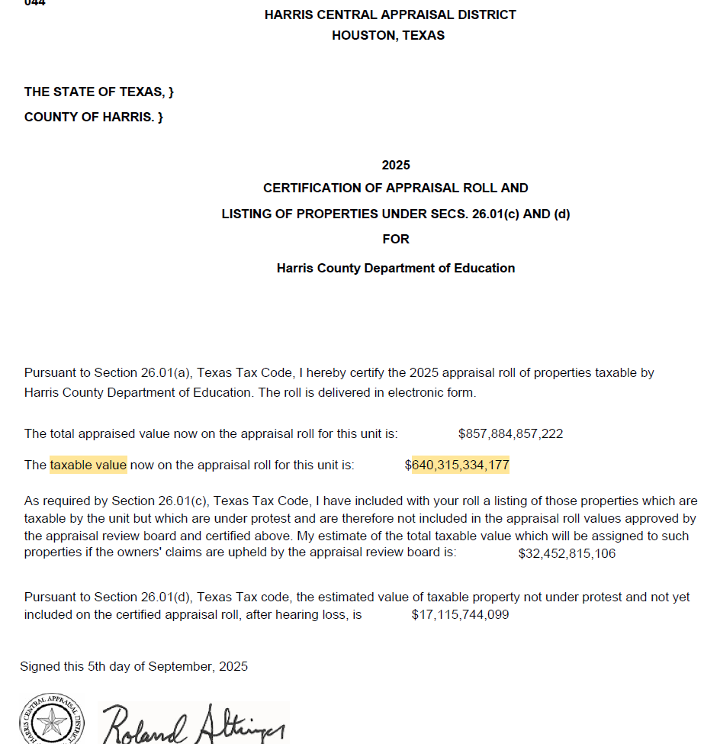
3

Slide 4
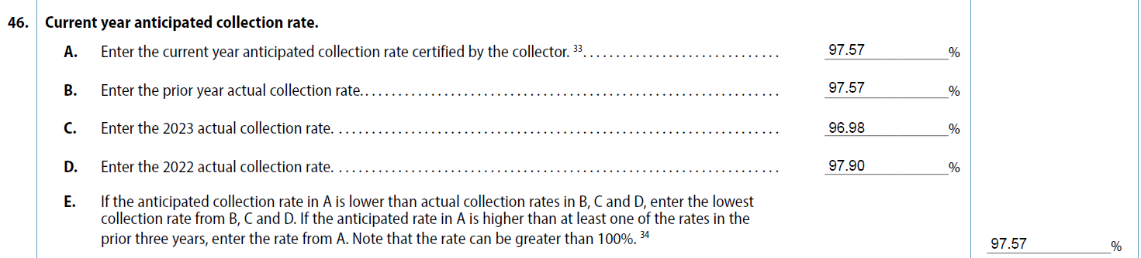
Analysis of New Values
Assumes a 97% collection rate
4

Slide 5
Growth of Property Values
$688 B
+31 B
$657 B
+10 B
$647 B
+83 B
$556 B
+40 B
$516 B
+6 B
$510 B
+27 B
FY 2021
FY 2022
FY 2023
FY 2024
FY 2025
FY 2026
Harris County Department of Education
5

Slide 6

Property Tax Rate $.01 Maximum
Levies same tax revenue as last year with this year’s property values
= No New Revenue Rate (NNRR)
Increasing ⬆ property values naturally reduces ⬇ the NNRR.
$.005422
NNRR +8% = Voter Approval Rate
REQUIRES ELECTION
Below
Effective Tax Rate
$.005200
$.005195
Below
Effective Tax Rate
$.005190
Below
Effective Tax Rate
Below
Effective Tax Rate
$.005000
Below
Effective Tax Rate
$.004993
Below
No New Revenue Tax Rate
$.004990
Fiscal years
2011-2022, 2025:
BELOW the Effective Tax Rate or NNRR
Below
No New Revenue Tax Rate
$.004900
$.004800
$.004798
$.004799
Below
No New Revenue Tax Rate
16
17
18
19
20
21
22
23
24
25
26
FY
Harris County Department of Education
6

Slide 7
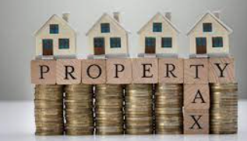


“A Decade + of Tax Decreases”
On an average taxpayer of $250,000 tax value, the tax bill has decreased by 31% since 2013
12 years of tax reductions
31%
or $4.55
less
Note: The value of $250K does not include exemptions that the taxpayer may be eligible.

Slide 8

Truth-In-Taxation
2025 - Tax Rate
Definitions
Nominal Rate – Current TY 2024 Tax rate to generate revenues to support last year’s approved budget.
[ .004799 ]
No-New Revenue Tax Rate – A calculated rate that provides the taxing unit with the same amount of revenue it received in the year before--on property taxed in TY25 [.004725]
TY 24 [.004800 ] TY23 [.004402 ] TY22 [.004541] TY21 [ .004807 ] TY20 [ .004745 ]
Voter-Approval Tax Rate – A calculated maximum rate allowed by law without voter approval. The rollback rate provides the taxing unit with about the same amount of tax revenue it spent the previous year for day-to-day operations, plus an extra eight percent increase for those operations plus sufficient funds to pay debts in the coming year. TY 25 [ .005127 ]
TY 24 [ .005259 ] TY 23 [ .004816 ] TY22 [.004915] TY21 [ .005202] TY20 [.005135]
Maintenance & Operations (M&O) Rate – Tax rate to generate revenues to support general operating expenditures. [ .004798 ]
Debt Service Rate (Sometimes referred to as Interest & Sinking or I&S) – Tax rate to generate revenues obligated for repayment of indebtedness. HCDE currently does not have an I&S rate. All debt is backed by M&O taxes and revenues and not I&S. N/A [.000000 ]
Total Tax Rate – The M&O and I&S tax rates combined. (Proposed)
[ .004798 ]
8

Slide 9
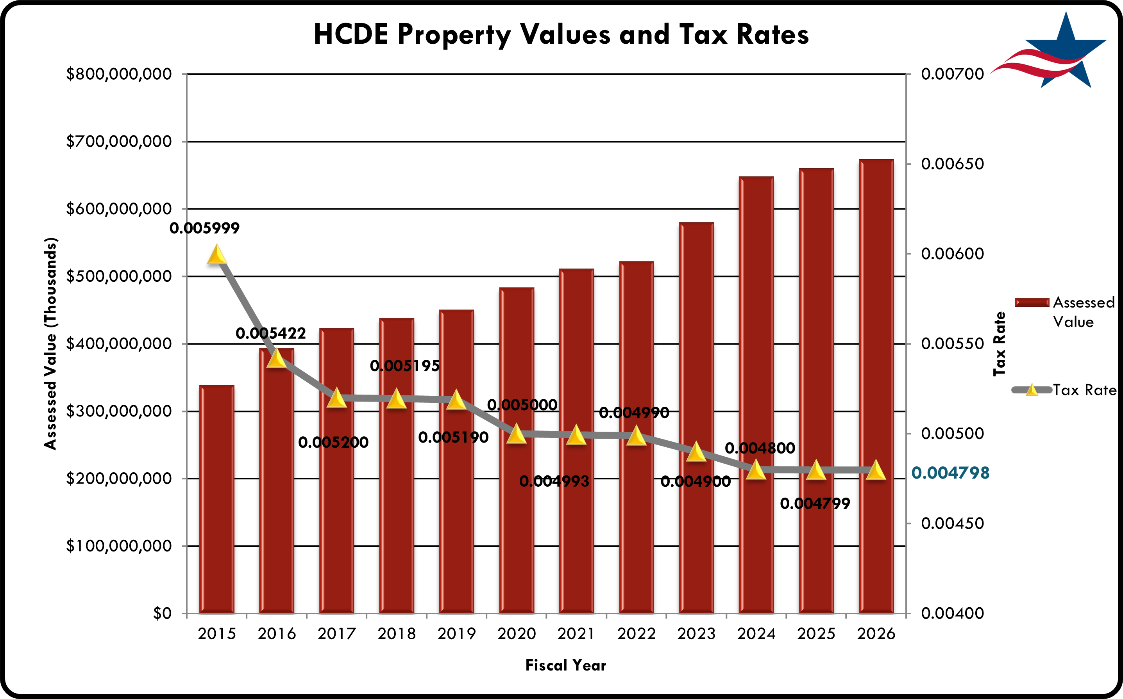
9

Slide 10

Proposed Tax Rate
10

Slide 11
Tax Rate Adoption Calendar

Slide 12
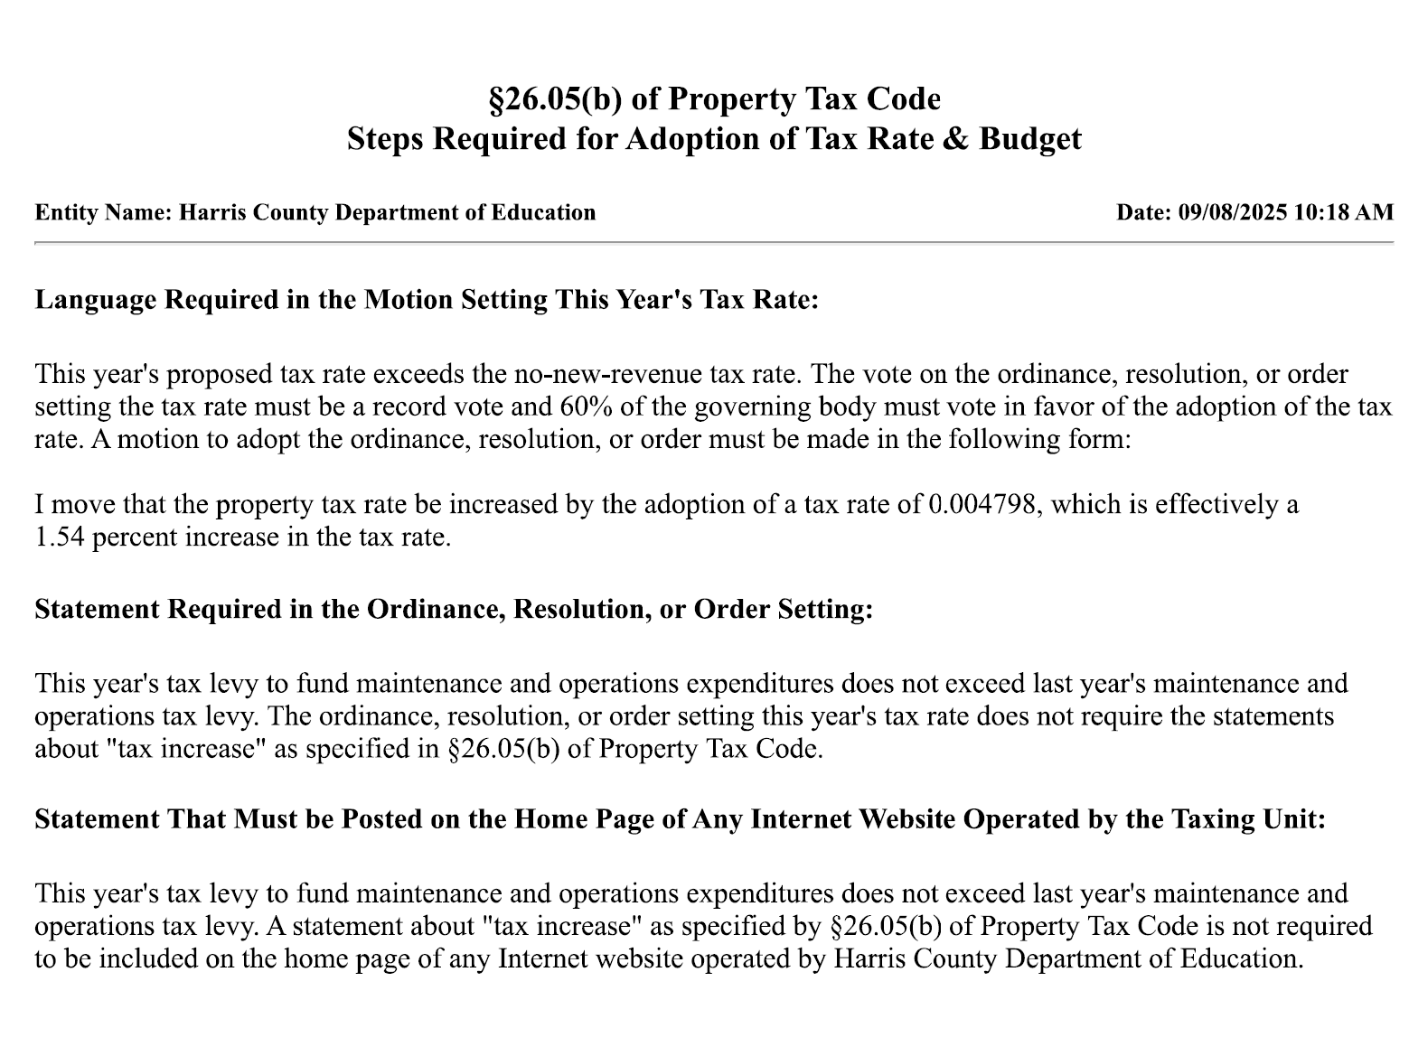


Slide 13

NEXT STEP
Harris County Department of Education PROPOSING A TAX RATE that exceeds the no-new-revenue tax rate. The vote on the ordinance, resolution, or order setting the tax rate must be a record vote and 60% of the governing body must vote in favor of the adoption of the tax rate. The form should be: I move that the property tax rate be increased by the adoption of a tax rate of 0.004798, which is effectively a 1.54 percent increase in the tax rate. This requires a public hearing. It can up to 7 days after or on the date of hearing.
This year's tax levy to fund maintenance and operations expenditures does not exceed last year's maintenance and operations tax levy. The ordinance, resolution, or order setting this year's tax rate does not require the statements about "tax increase" as specified in §26.05(b) of Property Tax Code.
Current Tax Year 2024 Tax Rate – Nominal .004799
Tax Year 2025 Calculated Rates
No-New Revenue Tax Rate .004725
Voter Approval Tax Rate .005127
Recommended M&O Tax Rate .004798
I move to approve a plan to adopt tax rate of 0.004798 per $100 valuation which is effectively less than the current tax rate.
13

